Slide 1
POLICY DEVELOPMENT:
“Primary Care Physicians in Delaware 2018” Report

Slide 2
Delaware’s Primary Care Physicians 2018
Delaware Health Care Commission
3/7/2019
Tibor Tóth

Slide 3
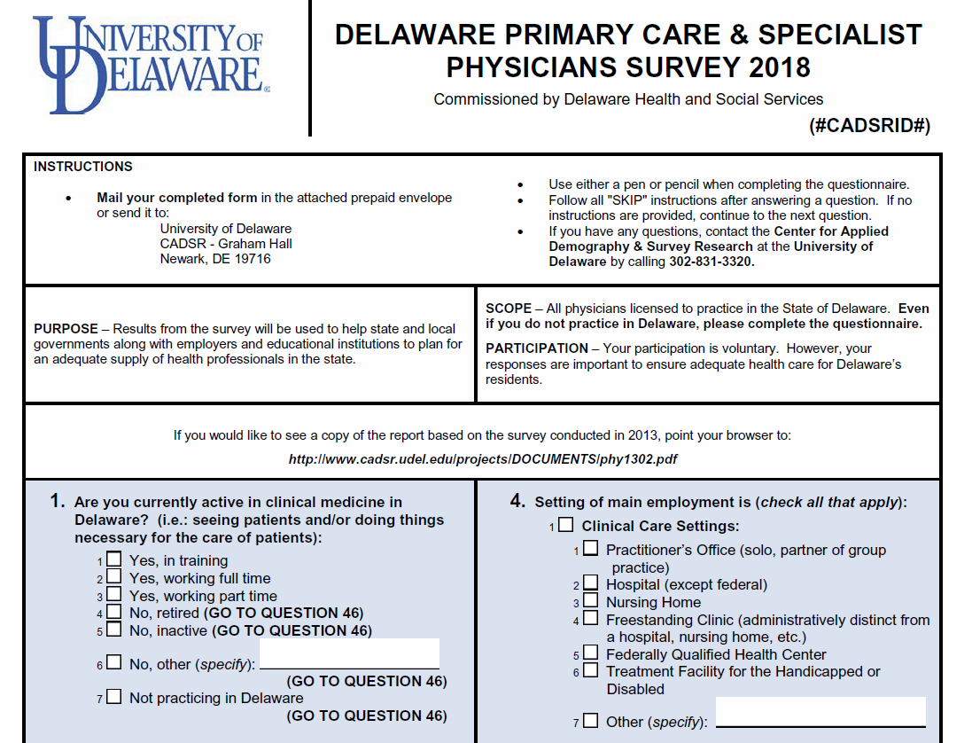

Slide 4
Number and Full-Time Equivalent Count of Primary Care Physicians by County, Delaware, 2018

Slide 5
Full-Time Equivalent Primary Care Physicians by County and Year, Delaware, 1998-2018

Slide 6
Age of Primary Care Physicians by County, Delaware, 2018

Slide 7
Primary Care Physicians Active Five Years from Now by County, Delaware, 2018

Slide 8
State of High School Graduation of Primary Care Physicians by County, Delaware, 2018

Slide 9
State of Medical School Graduation of Primary Care Physicians by County, Delaware, 2018

Slide 10
State of Medical Residency of Primary Care Physicians by County, Delaware, 2018

Slide 11
Specialty of Primary Care Physicians by County, Delaware, 2018

Slide 12
Provision of Selected Specialty Services by Primary Care Physicians by County, Delaware, 2018

Slide 13
Accepting New Primary Care Patients by Primary Care Physicians by County, Delaware, 2018

Slide 14
Percentage of Time Serving Selected Patient Groups by Primary Care Physicians by County, Delaware, 2018

Slide 15
Average Wait Time in Days for Types of Patients reported by Primary Care Physicians by County and Year, Delaware, 1998-2018

Slide 16
Use of Non-Physician Resources by Primary Care Physicians by Year, Delaware, 1998-2018

Slide 17
Participation in Network Based Organizations by Primary Care Physicians by County, Delaware, 2018

Slide 18
Participation in Value Based Reimbursement Payment Methods by Primary Care Physicians, by County, Delaware, 2018

Slide 19
Awareness of the Delaware Health Information Network by Primary Care Physicians by County, Delaware, 2018

Slide 20
Use of the Delaware Health Information Network by Primary Care Physicians by County, Delaware, 2018

Slide 21
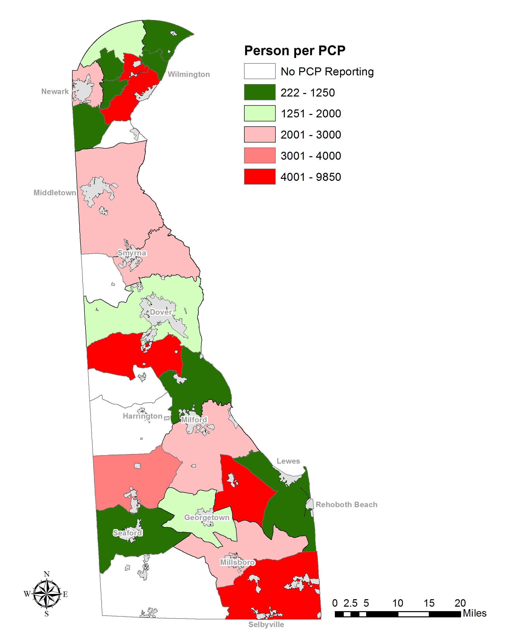
Number of Persons per Primary Care Physician by Census County Division, Delaware, 2018

Slide 22
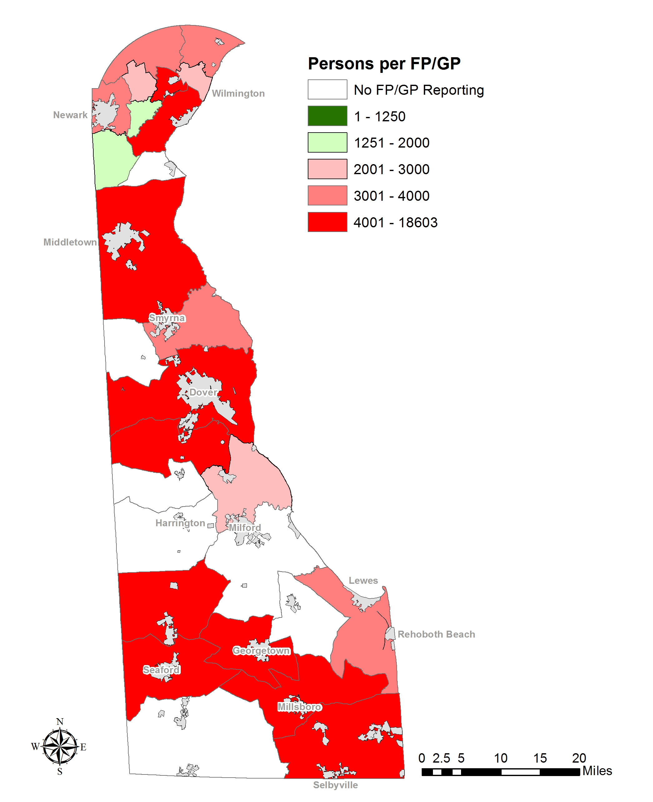
Number of Persons per Family Practice Physician by Census County Division, Delaware, 2018

Slide 23
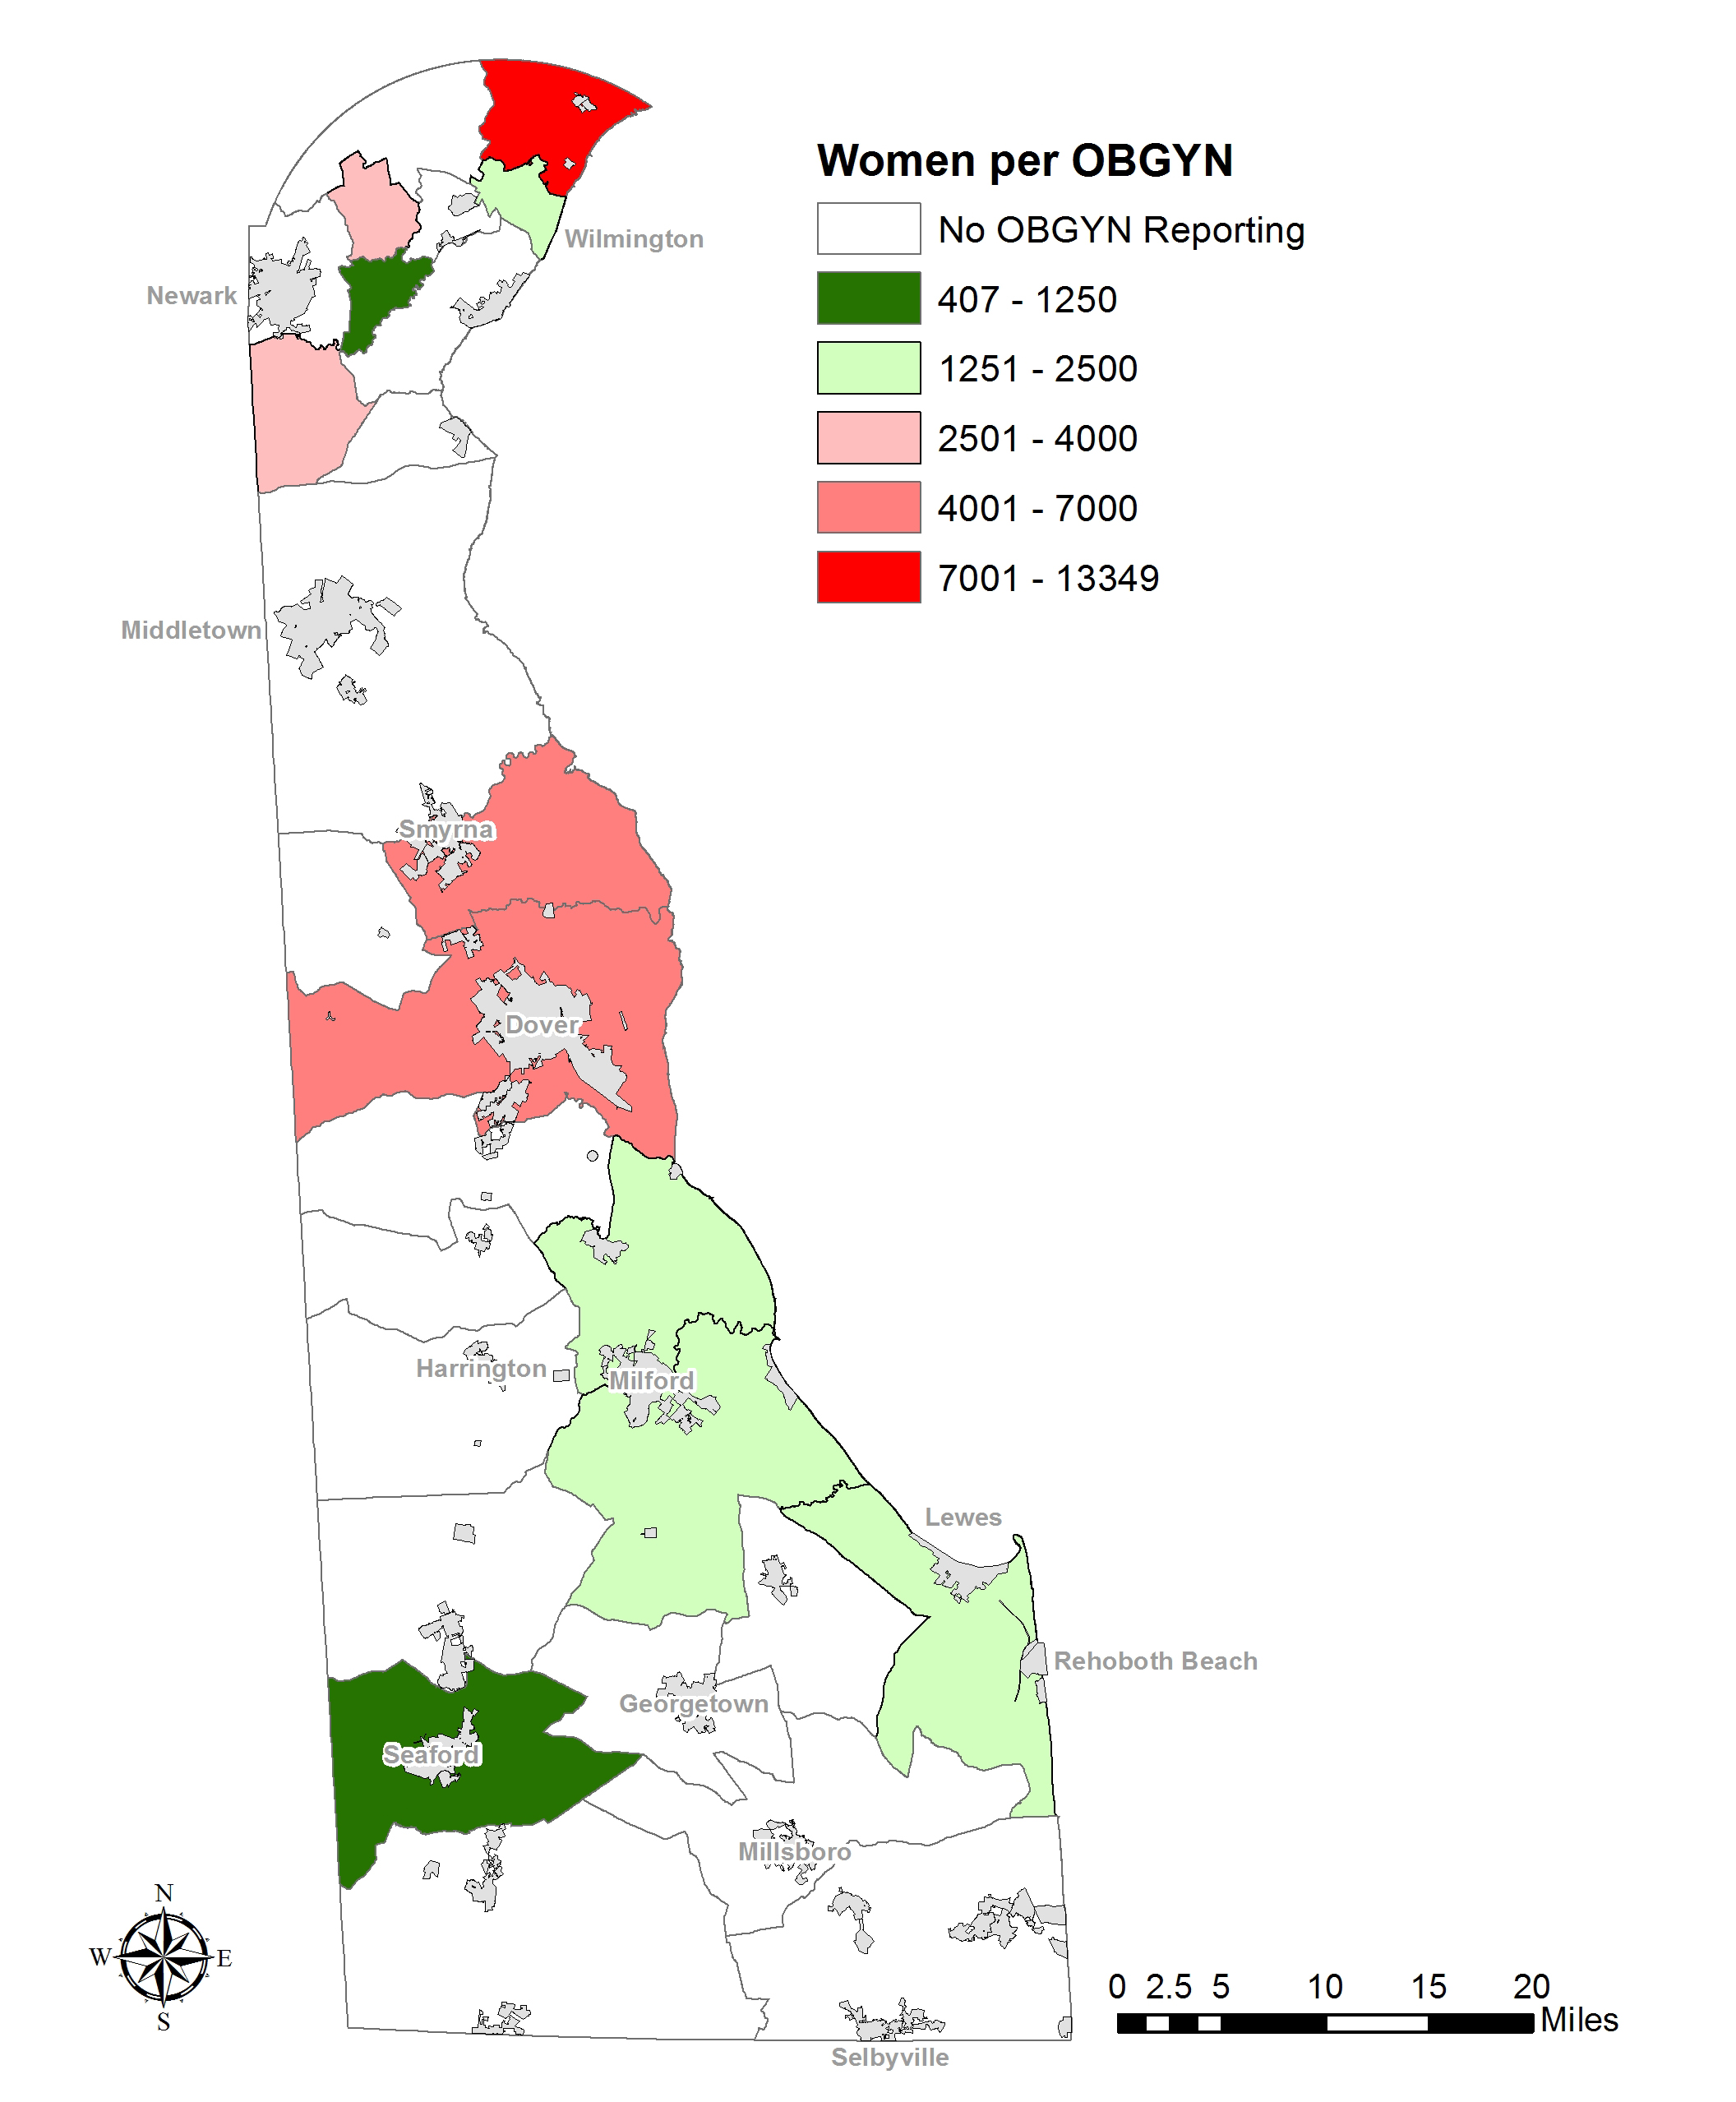
Number of Women (ages 15-64) per OBGYN by Census County Division, Delaware, 2018

Slide 24
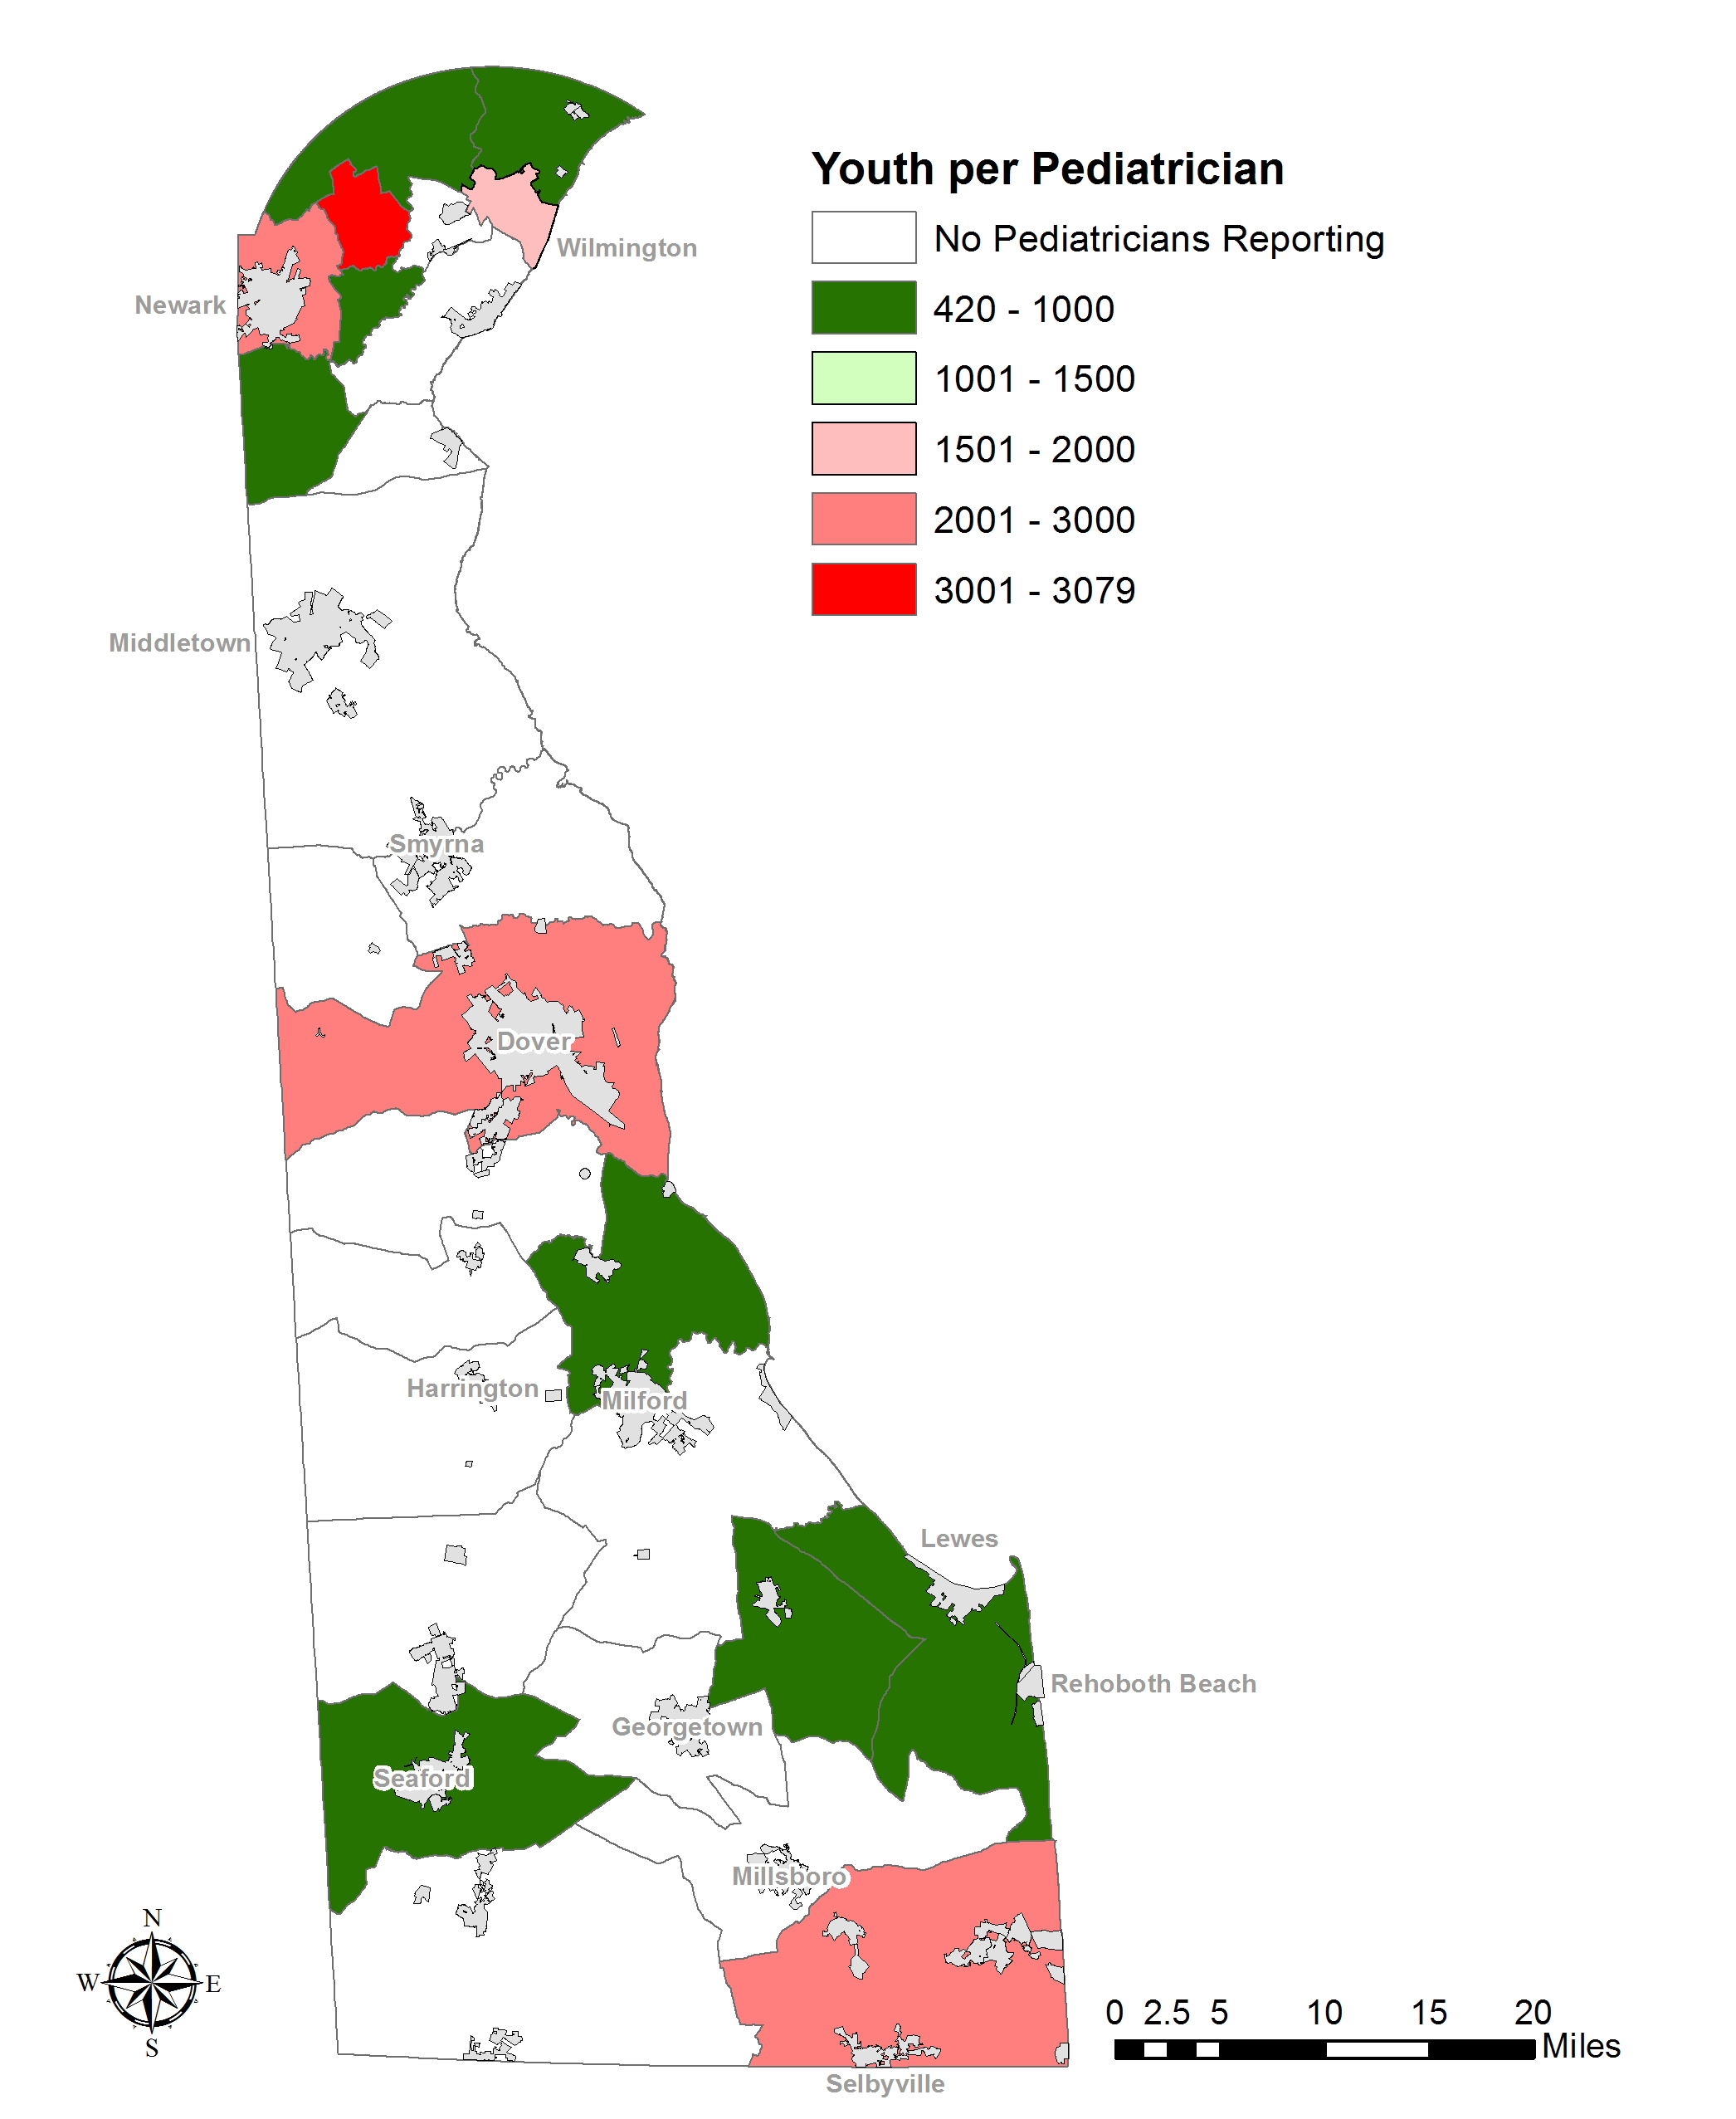
Number of Youth (ages 0-19) per Pediatrician by Census County Division, Delaware, 2018

Slide 25
  Tibor Tóth
  Assistant Professor, Biden School of Public Policy & Administration
  Associate Director, Center for Applied Demography & Survey Research
  tibi@udel.edu | 302-831-3320
  www.bidenschool.udel.edu

