Slide 1

Delaware’s Health Insurance Marketplace: Update on Activity
Delaware Health Care Commission
August 4, 2016
Laura Howard
Delaware Health Care Commission
Notes:
Good morning.
I am filling in for Secretary Landgraf on today’s Marketplace update, which will be brief.
I know if she were here, she would remind us all that open enrollment will begin in less than three months on November 1st. Hard to believe it’s that close.

Slide 2
National Updates
2
Notes:
First up, I’ll go through the National Updates.

Slide 3
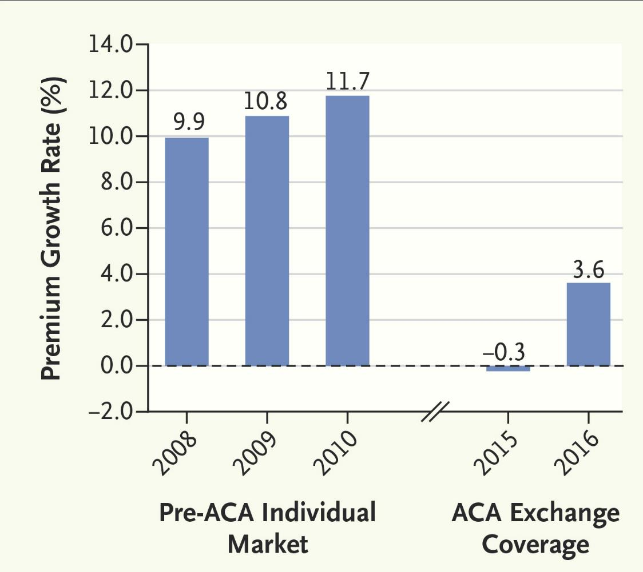
Individual Plan Premium Rate Growth
New England Journal of Medicine looked at trends in individual plans premiums nationwide since 2008.
From 2008 to 2010, premiums grew between 9.9% and 11.7% per year.
In the first 2 years of the marketplace, premiums were below those levels.
Expectation is for a higher growth in 2017 because of the expiration of the risk corridor and reinsurance provisions in 2016.
315
Notes:
The New England Journal of Medicine published a study in July looking at trends in individual plan premiums since 2008.
The chart shows that premiums grew between 9.9% and 11.7% from 2008 to 2010. Remember, the Affordable Care Act was signed into law in March 2010, but the Health Insurance Marketplace didn’t begin covering people until 2014.
During the first two years of the Marketplace, premiums were below those 2008-2010 levels.
But as have seen in Delaware and across much of the country, the expectation for 2017 is higher growth in premiums because of the expiration of the risk corridor and the reinsurance provisions.

Slide 4

The State of Millennials
A spring 2016 study by nonprofit Transamerica Center for Health Studies of 1,171 millennials nationwide found:
  The percentage of cohort who is uninsured declined to 11%, an all-time low for this population. Of those currently uninsured, 37% have never had insurance.
  7 of 10 said cost is a very important factor when looking for health care.
  66% said a premium at or above $200 a month is unaffordable
  47% said they had to cut corners on health care by skipping, delaying or stopping care.
Katelyn Powers of Glasgow signed up for coverage in 2016 -- with the help of a Westside navigator -- for less than $110 a month.
415
Notes:
Let’s turn to a specific population affected by those rates – millennials. This spring, Transamerica Center for Health Studies look at the state of the nation’s millennials – ages 18 to 35 -- when it comes to health insurance. A few highlights from the study of 1,171 millennials nationwide:
The percentage of this group who is uninsured declined to 11% in 2016 -- an all-time low for this population. Of those who currently uninsured, 37% have never had insurance. That’s the opportunity population for the marketplace.
7 of 10 said cost is a very important factor when they look for health care. They particularly want ER visits and prescription medications to become more affordable.
As far as coverage affordability, 66% said a premium at or above $200 a month is unaffordable
47% said they had cut corners on their health care in order to maintain affordability by skipping, delaying or stopping care.

Slide 5
Plan Management Updates
5
Notes:
Now, let’s shift to plan management.

Slide 6
Requested Rates Increases for 2017 QHP Issuers Announced
June 2: Department of Insurance announces 2017 rate requests from Marketplace Issuers – Aetna Health, Inc., Aetna Life and Highmark Blue Cross Blue Shield of Delaware.
Overall Average Increase Requested
Issuer rate requests are subject to review and approval by the Insurance Commissioner and are not the final rates.
 | Aetna Health, Inc. | Aetna Life | Highmark BCBSD
Individual | 25.0% | 23.9% | 32.5%
Small Group | 23.2% | 18.6% | 2.7%
615
Notes:
First, I want to use this slide to remind you of the 2017 rate requests made by issuers on the marketplace. These are requested rates. As you remember, the requests are subject to review and approval by the Insurance Commissioner.

Slide 7
Public Comment
The Public Comment Period ran from June 15-July 15, 2016.
The DOI received 18 comments, 1 statement and 1 petition.
All comments may be found on the DOI website at: http://de.gov/doicomments2017
Presentations made by Aetna and Highmark Blue Cross Blue Shield Delaware at the public information sessions may also be found on the DOI website.
715
Notes:
The Department of Insurance had a public comment period on the rates from June 15 to July 15. It received 18 comments, 1 statement and 1 petition.
The link on this slide shows where the comments can found on the DOI’s website.
In addition to written comments, Aetna and Highmark also participated in public information sessions in all three counties.

Slide 8
Health Insurance Premium Rate Review for Plan Year 2017
The DOI approves/disapproves all health insurance rates following a comprehensive review of all Issuer filings, including requests for rate increase.
Reminder:
  The rate is the base amount filed by the carrier. Premiums paid by an individual include the base rate plus whatever adjustments are permitted under the law -- Age, Family Size and Tobacco Use
Information on proposed health insurance rates for Plan Year 2017 is located on the DOI’s website: delawareinsurance.gov
  These are the initial requests from Issuers and not the approved rates.
88
Notes:
And just to reiterate, the DOI must approve all health insurance rates after a comprehensive review.
The rate is the base amount filed by the issuer. Premiums are adjusted based on the number of enrollees in a household, the age of participants and whether any of the enrollees smoke.
The initial rate requests can be found on the DOI’s website at delawareinsurance dot gov.

Slide 9
QHP Review for Plan Year 2017
DOI is reviewing Issuers’ QHP plans for compliance with federal and state laws and standards, and will submit the plans to CMS for final review in late August.
CMS will release a list of certified QHPs for Plan Year 2017 in early October.
Open enrollment runs from Nov. 1 to Jan. 31, 2017.
Proposed Timeline | QHP Review Activities
May - September 2016 | DOI reviews plans for compliance with federal and state laws and standards Areas for review include rates, actuarial value, benefit design, cost-sharing, network adequacy, among others
September 2016 | Federal government conducts final QHP reviews and certifies state-recommended plans DOI releases Premium Rate information
October 2016 | Federal government releases list of certified QHPs for Plan Year 2017
99
Notes:
Now, let’s move to the dates for the Qualified Health Plan review for 2017:
Between now and September, the DOI will continue its review and then submit its review of state laws and standards to the Center for Medicare and Medicaid Services by September.
In September, the federal government conducts it own review and certifies the state-recommended plans.
Also in September, the DOI will release premium rate information.
And finally, in October, the federal government will release a list of certified QHPs for Plan Year 2017.

Slide 10
Key Dates
Date | Milestone
September 2016 | DOI releases premium rate information
November 1, 2016 | Beginning of Open Enrollment for PY 2016
January 31, 2017 | End of Open Enrollment for PY 2017
Only those with qualifying life events, such as birth/adoption of a child, loss of minimum essential coverage, aging out of parents’ insurance at age 26, etc., may enroll in the Marketplace outside of open enrollment. Visit www.HealthCare.gov for more information.
Enrollment assisters and agents and brokers are available to assist with enrollments outside of an open enrollment period.
Consumers can visit www.ChooseHealthDE.com to locate assistance near them.
Medicaid enrollment is open all year.
Small businesses can enroll in SHOP at anytime.
Notes:
And, finally, key dates for the marketplace.
DOI will release premium rate information in September.
Open enrollment will begin November 1st and run through Jan. 31st.
To get more information, go to DOI’s website or to www.ChooseHealthDE.com and click on “Getting Insurance.”

