Slide 1
THE START Initiative
A catalyst for SUD TREATMENT Transformation
Elizabeth Romero, director
Delaware division of substance abuse and mental health
Notes:
THANK YOU
DSAMH team including
Hello Everyone, I want to take a few minutes to highlight a few important updates as it relates to DSAMH’s ongoing efforts to partner with providers, payers, and public health stakeholders throughout the state.
As you’ve heard today, our Substance Use Treatment and Recovery Transformation Centers and System or START centers are both catalyst for- and participants in a more connected, accountable, and compassionate SUD treatment service continuum

Slide 2
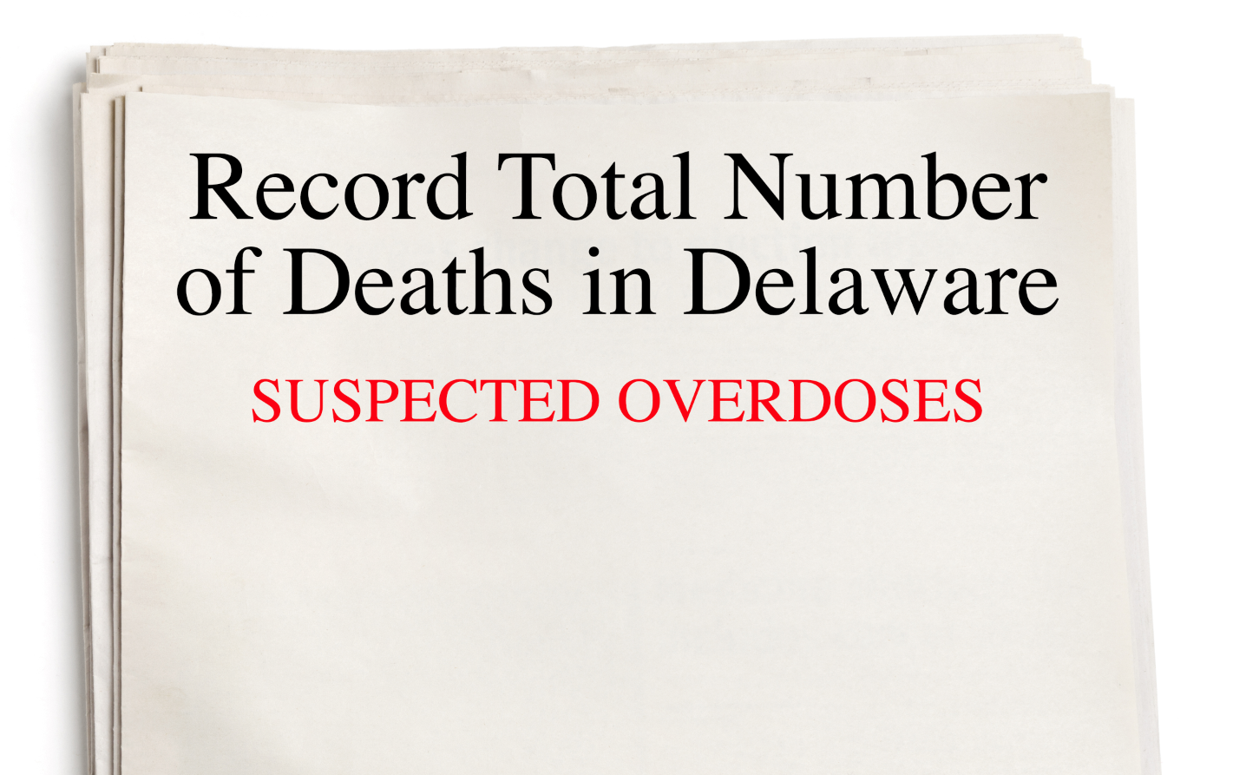
Delaware’s Statistics
345
213
308 overdose deaths in 2016
overdose deaths in 2017 (double the deaths recorded 5 years earlier)
suspected overdose deaths in 2018 (as of Sept. 23)
Notes:
As you all know, the statistics on this slide compel the need for targeted investment in treatment capacity and wraparound services.
National NIDA Statistics:
Every day, more than 115 people in the United States die after overdosing on opioids.¹ The misuse of and addiction to opioids—including prescription pain relievers, heroin, and synthetic opioids such as fentanyl—is a serious national crisis that affects public health as well as social and economic welfare. The Centers for Disease Control and Prevention estimates that the total "economic burden" of prescription opioid misuse alone in the United States is $78.5 billion a year, including the costs of healthcare, lost productivity, addiction treatment, and criminal justice involvement.²
Roughly 21 to 29 percent of patients prescribed opioids for chronic pain misuse them.
Between 8 and 12 percent develop an opioid use disorder.
An estimated 4 to 6 percent who misuse prescription opioids transition to heroin.
About 80 percent of people who use heroin first misused prescription opioids.
Opioid overdoses increased 30 percent from July 2016 through September 2017 in 52 areas in 45 states.
The Midwestern region saw opioid overdoses increase 70 percent from July 2016 through September 2017.
Opioid overdoses in large cities increase by 54 percent in 16 states.

Slide 3
Delaware’s Statistics
Using more recent data, NSDUH estimates that for every overdose there are close to 240 people that need treatment for abuse, misuse and/or OUD
345
240
82,800
overdose deaths in 2017
National Survey on Drug User Health, 2018 (NSDUH)
Notes:
One statistic that is less know is that the National Survey of Drug User health (NSDUH) estimates that for every overdose there are close to 240 people that need treatment for abuse, misuse and/or OUD
In Delaware, this means that 82,800 people may be in need of treatment.
Our job is to create access points for quality evidence-based treatment intervention across the traditional health system and beyond
5 days ago, the CDC estimate was a higher estimate of 300 overdose which is 103,500.

Slide 4


CURRENT TREATMENT and engagement:
Building on our existing performance
Initiation of Alcohol & Other Drug Dependence Treatment: Age 18 & Older
DELAWARE
UNITED STATES
38%
36%
Source: CMS Adult Core Set for Medicaid, 2016
Notes:
Looking at data from CMS’ Adult Core Set for the Medicaid population we see that Delaware exceeds the national average for treatment initiation across all SUD. This measure reports the percentage of adults ages 18 and older with a newly diagnosed episode of alcohol and other drug (AOD) dependence who initiated timely treatment within 14 days of diagnosis.

Slide 5
CURRENT TREATMENT and engagement:
Building on our existing performance
Engagement of Alcohol & Other Drug Dependence Treatment: Age 18 & Older (Engagement Rate)
DELAWARE
UNITED STATES
16%
14%
Source: CMS Adult Core Set for Medicaid, 2016
Notes:
When we take a look at engagement, we see rates going down yet our performance still exceeds the national average. This measure reports the percentage of adults ages 18 and older with a newly diagnosed episode of alcohol and other drug (AOD) dependence who initiated timely treatment within 14 days of diagnosis and continued treatment with two or more treatment services within 30 days of the initial visit. Higher rates are better.
This statistic represents a significant opportunity for growth to increase rate of engagement and adherence to treatment.

Slide 6

Our Vision to Inspire Change
Our vision to meet this challenge:
Connect all points from referral to treatment-- Using certified recovery peers to help patients navigate their way through treatment and social-services worlds.
Provide care that is high-quality, comprehensive, coordinated, evidence-based,
Address the social determinants that affect a patient’s overall health and treatment outcomes.
Treat each patient as a whole person.
Notes:
Our vision to meet this challenges is based on engaging people immediately with a peer and navigating to high quality treatment options.
Build upon efforts underway
Connect all points from referral to treatment-- Using certified recovery peers to help patients navigate their way through
treatment and social-services worlds.
Provide care that is high-quality, comprehensive, coordinated, evidence-based,
Address the social determinants that affect a patient’s overall health and treatment outcomes.
Treat each patient as a whole person.

Slide 7
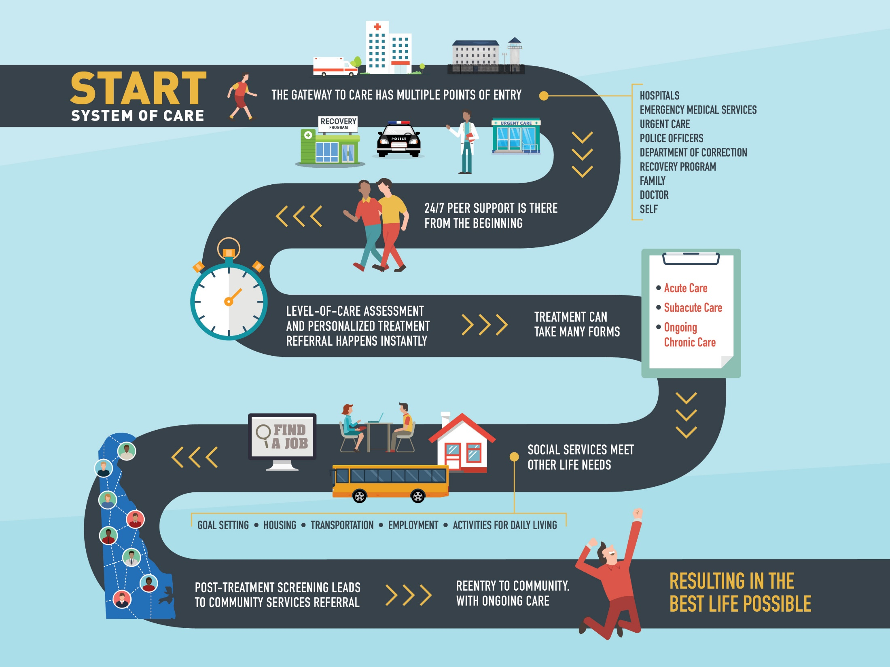
Notes:
You have all heard the ongoing conversations about the need for change in Delaware. We spend more on health care and get less. To get better results, we have to improve health care quality and reduce the cost. The benchmark is intended to drive change to put Delaware on the Road to Value.

Slide 8





Overview of the Delaware Network
2
STATE NETWORK ADMINISTRATOR
SYSTEM ADMINISTRATOR AND
CUSTOMER SUPPORT
1
3
REFERRERS
4
RECEIVERS
Medical facilities
Inpatient & Outpatient
Justice system
County authority
Outpatient
Inpatient detoxification
Mobile crisis units
Acute Inpatient Care
Residential Treatment Program
Partial Hospitalization
Recovery Support Services
Inpatient Detoxification
Recovery Housing
Intensive Outpatient Treatment
Outpatient Counseling
MAT
5
REFERRING AND WRAPAROUND SUPPORT

Slide 9
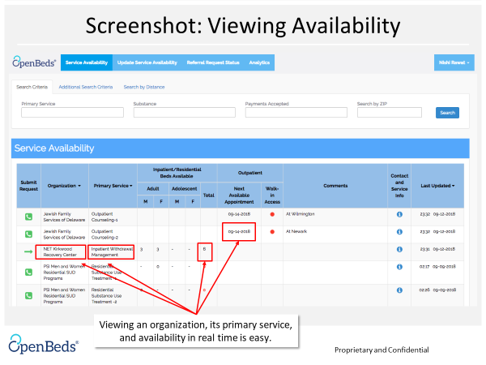

Slide 10
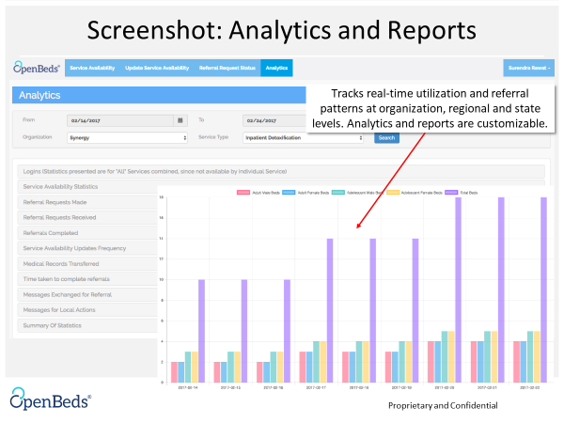

Slide 11
Five days: Referral Overview
Total Number of Requests = 95
Accepted and Closed = 72
Declined and Closed = 06
Remained Opened = 17
Peer Recovery = 0

Slide 12
Week 1: Daily Average Availability
Treatment Facilities | Total (71) | CS (3) | RST (6) | PI (6) | IWM (7)
Adult Male | 23.8 | 1.5 | 0.5 | 6.8 | 15.1
Adult Female | 35.7 | 1.5 | 15.7 | 7.4 | 11.1
Adolescent Male | 2.5 | 0 | 0 | 2.6 | 0
Adolescent Female | 1.6 | 0 | 0 | 1.6 | 0
All | 63.7 | 2.95 | 16.2 | 18.3 | 26.2

Slide 13
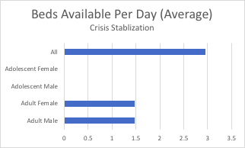
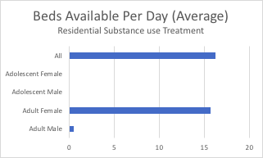
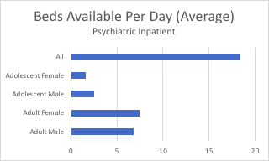
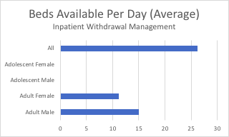
Week 1: Capacity Data

Slide 14
Notes:
You have all heard the ongoing conversations about the need for change in Delaware. We spend more on health care and get less. To get better results, we have to improve health care quality and reduce the cost. The benchmark is intended to drive change to put Delaware on the Road to Value.

Slide 15
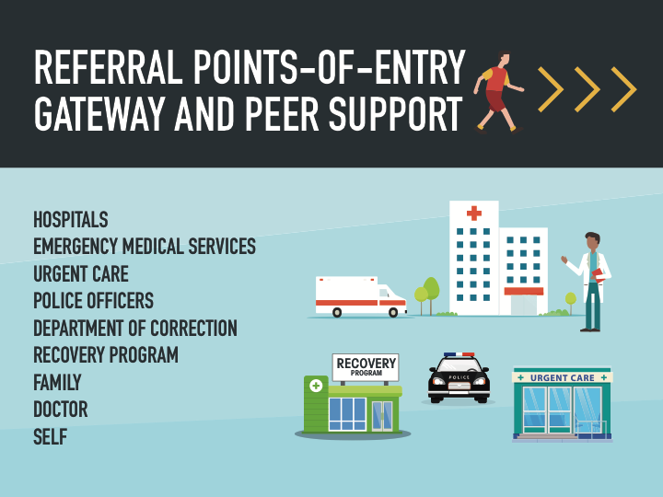

Slide 16
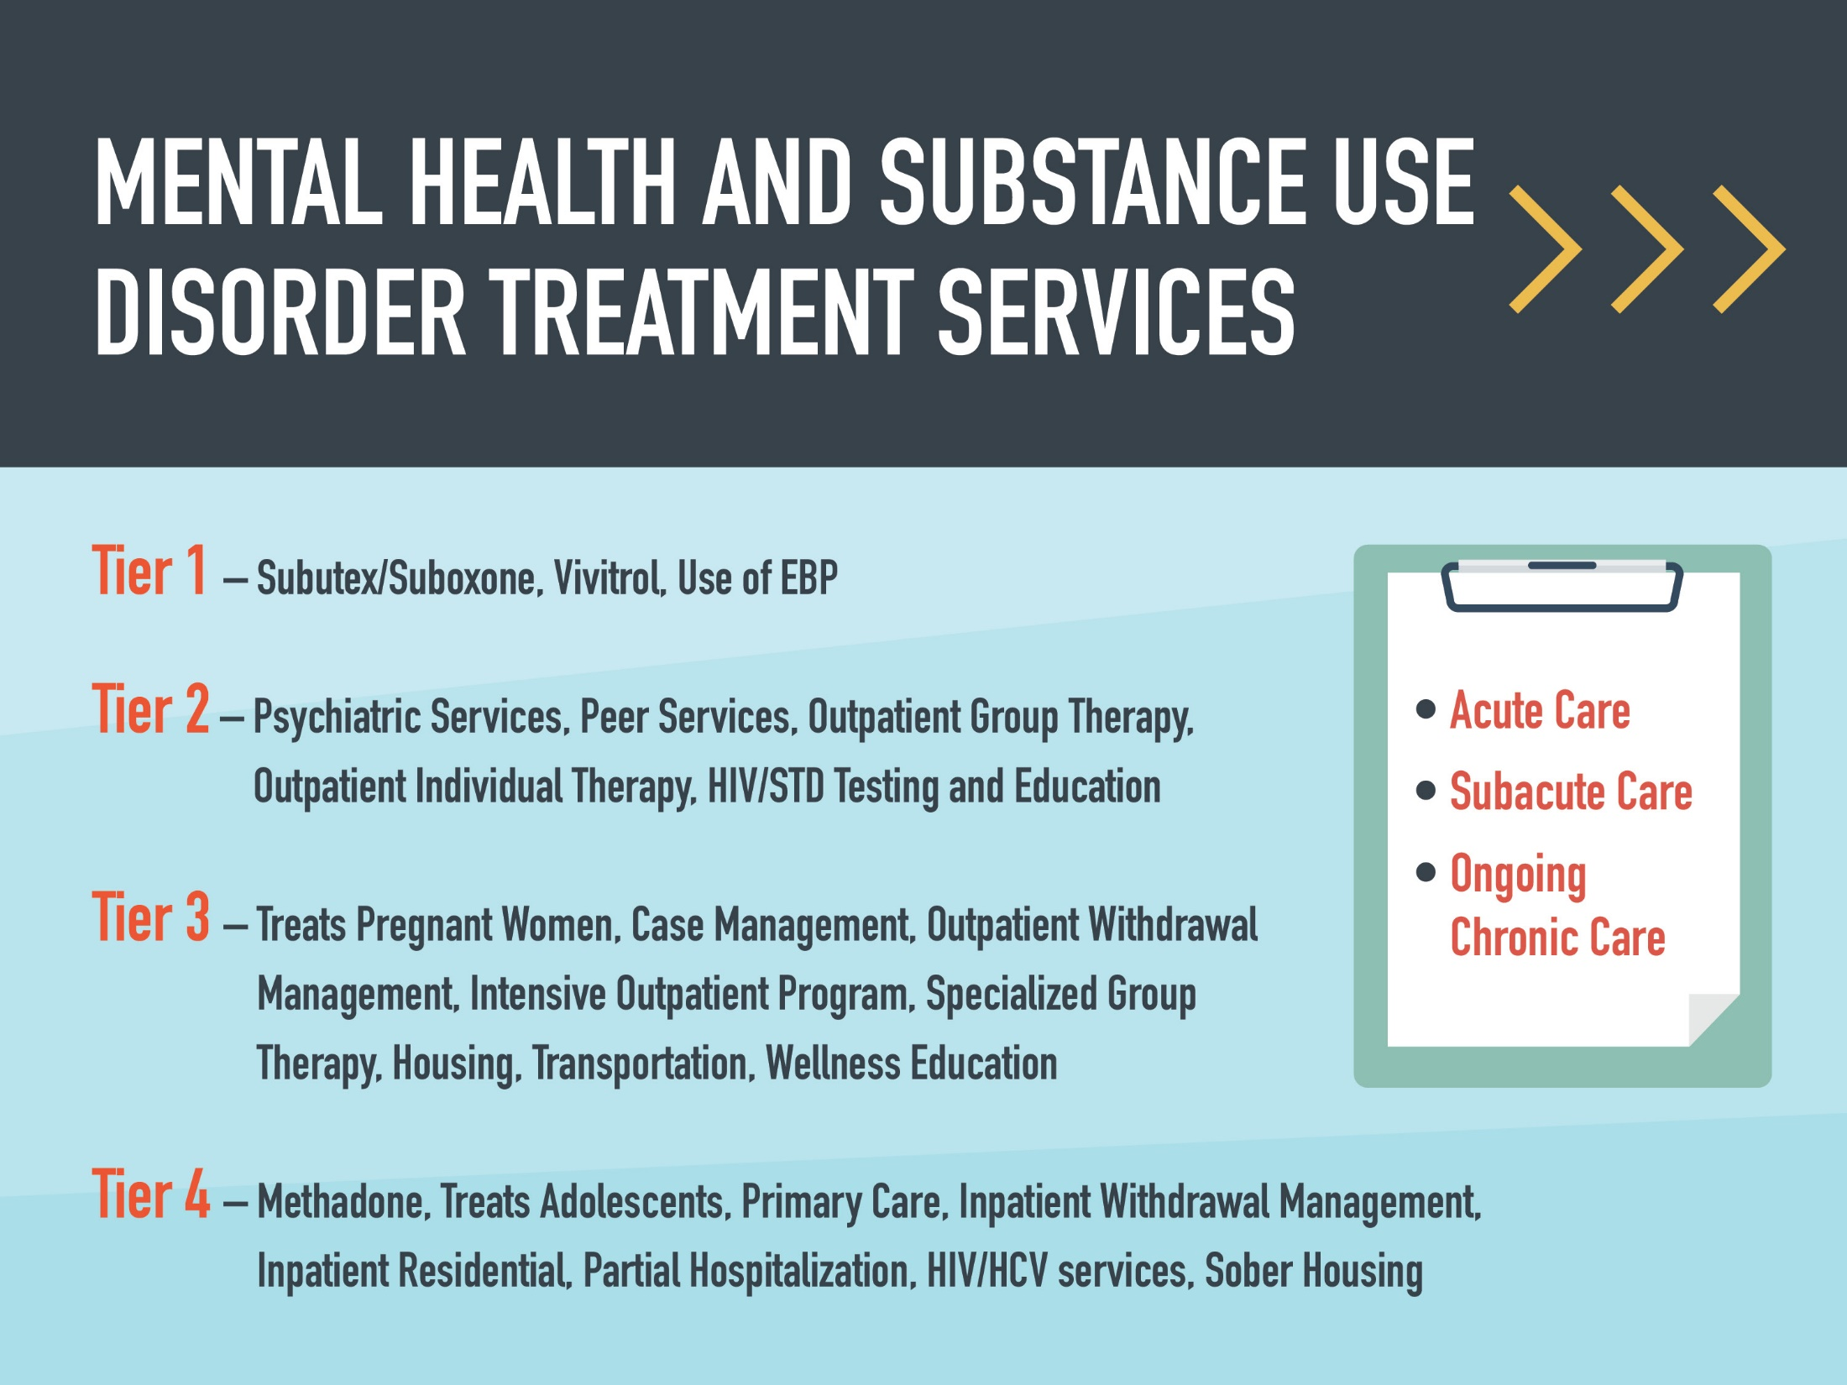

Slide 17


Slide 18
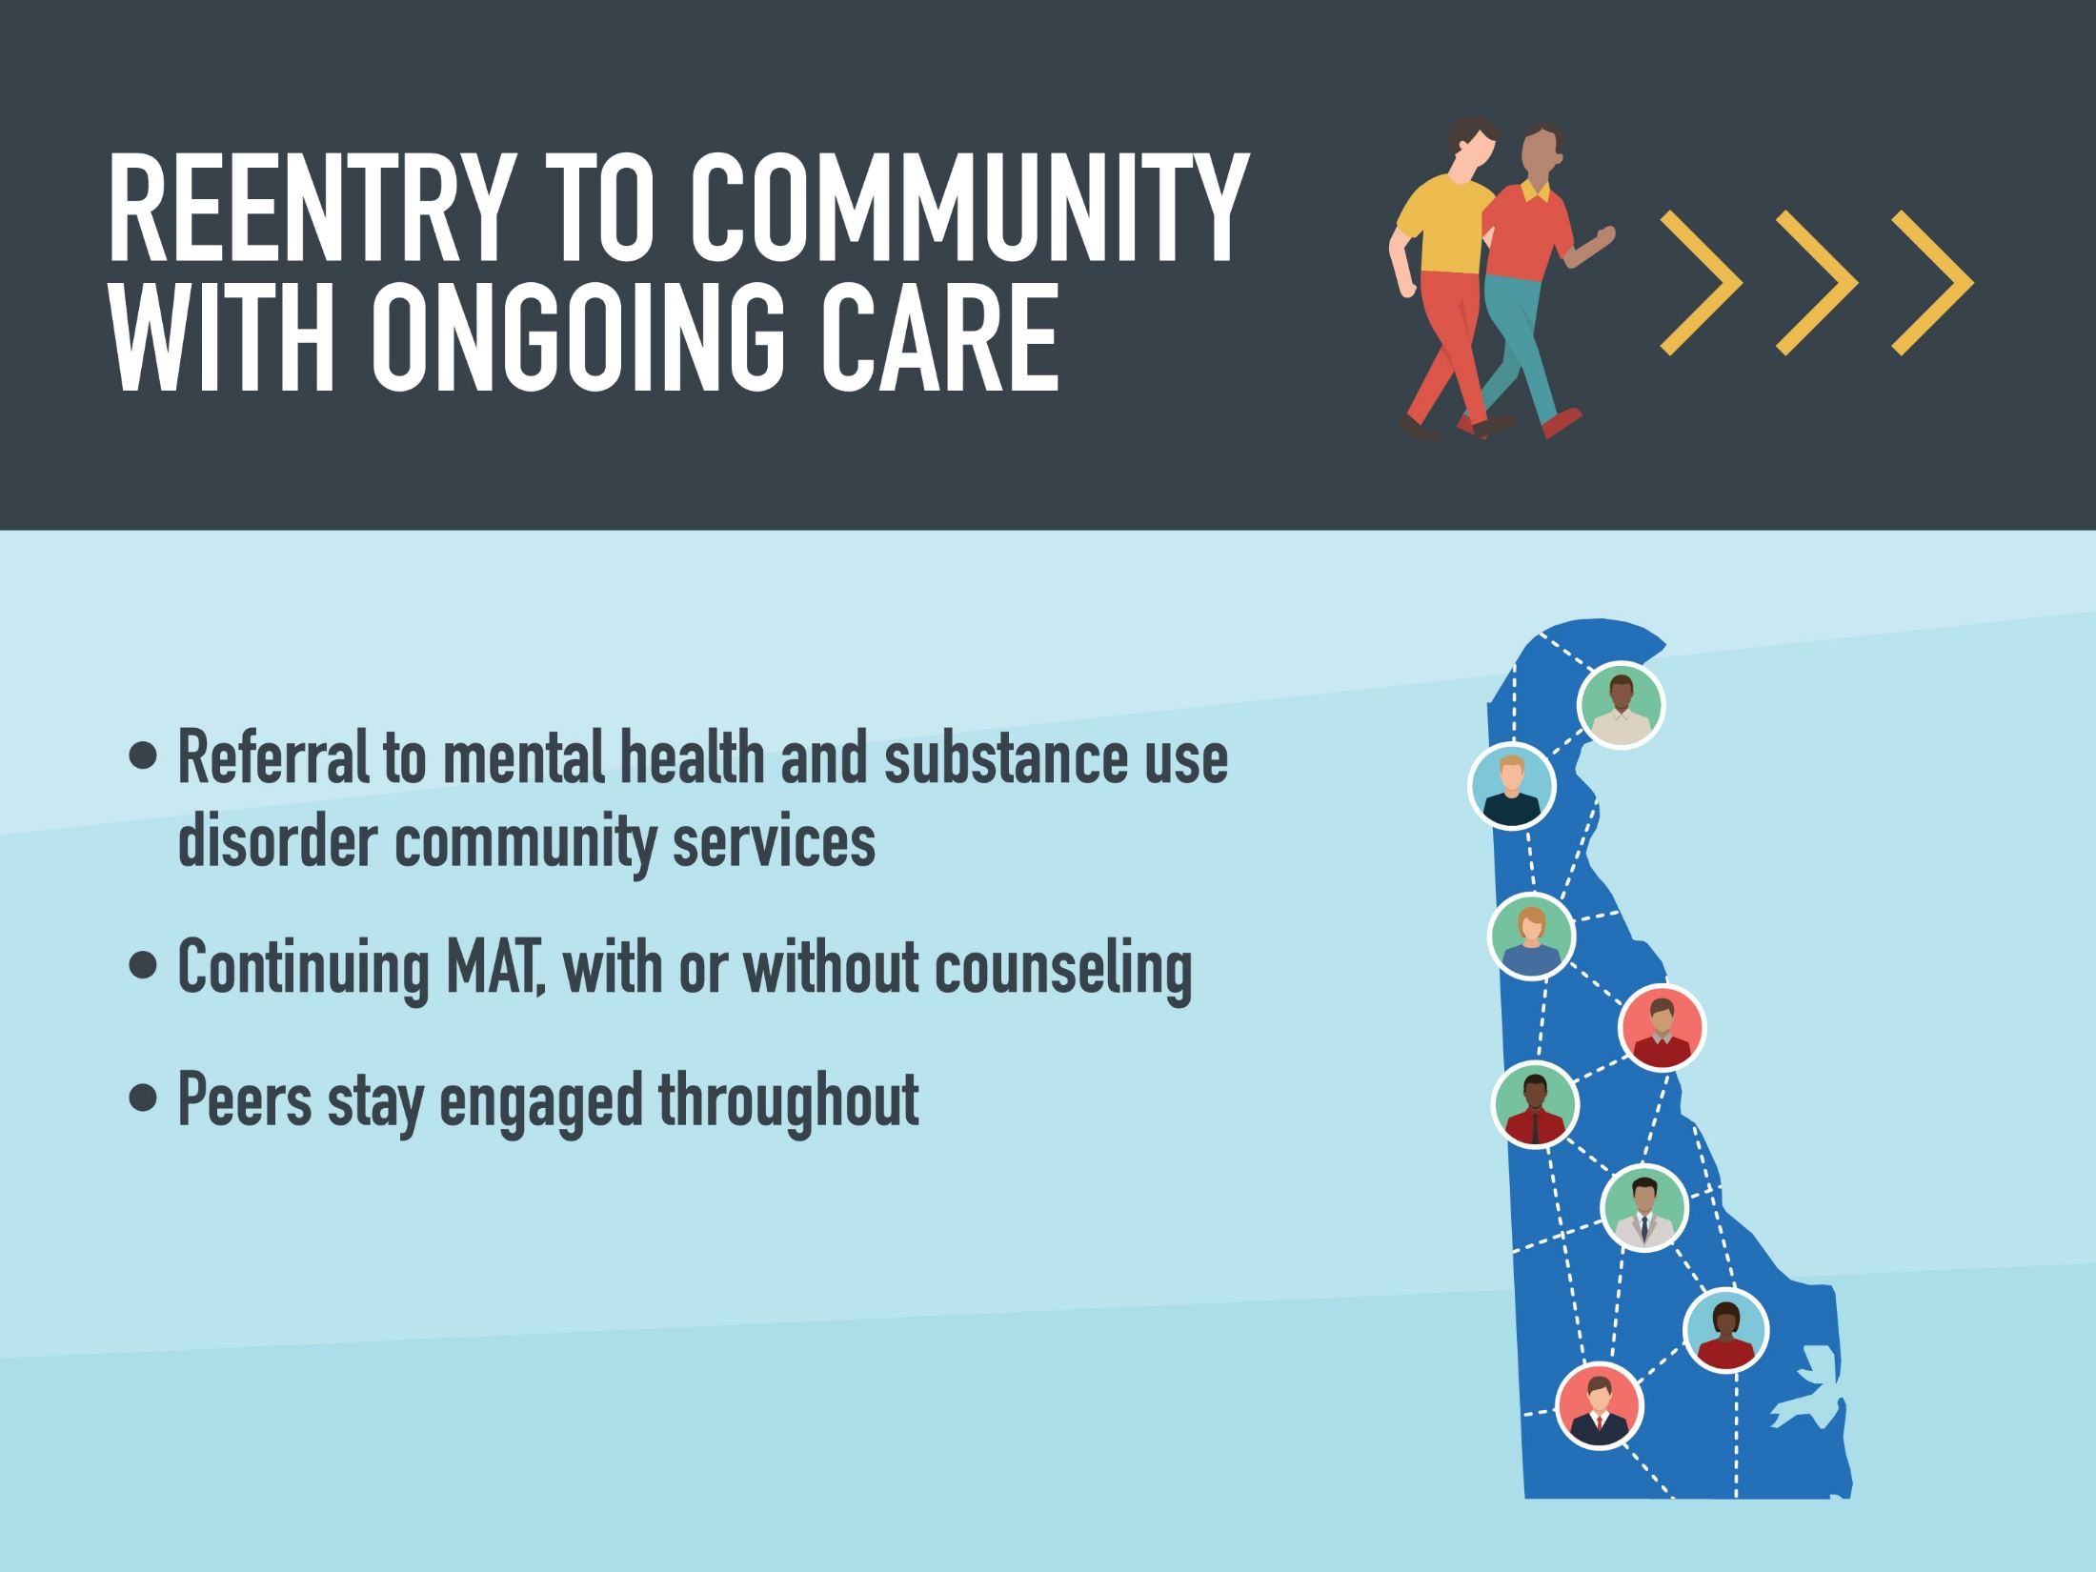

Slide 20
MEASUREMENT-BASED CARE TO ASSESS PATIENT OUTCOMES START System performance measures
Measure | Collection Source | Outcome Improved
% or patients with OUD on MAT | Medicaid claims | Mortality Retention in treatment
% of patients with follow up in 14 days | Medicaid Claims (open beds in future) | Improved initiation of treatment
Length of time on MAT | Medicaid claims | Increased remission Decreased relapse
All Cause Readmission | Medicaid Claims | Indicator of stability
ED or Hospital visit for OD | Medicaid Claims | Decreased mortality
Notes:
Performance measure helps to ensure that we’re all moving toward the same outcomes. The START initiative’s performance measures are divided in to two categories:
Those which can be ascertained from Medicaid claims data
Those which are acquired directly from providers
Claims data based measures include:
% or patients with OUD on MAT
% of patients with follow up in 14 days
Length of time on MAT
All Cause Readmission
ED or Hospital visit for OD

Slide 21
MEASUREMENT-BASED CARE TO ASSESS PATIENT OUTCOMES
START System performance measures
Measure | Collection Source | Outcome Improved
Ability to provide MAT | Survey, SAMHSA data | Mortality decreased Retention in treatment
Ability to prescribe naloxone | Survey | Decreased OD death
Provider has EHR | Survey | Improved reporting and billing
Wait time after referral for treatment | Survey and EHR | Improved initiation of treatment
Ability to test for HIV, Hep C and STIs | Survey | Improved population health
Notes:
Survey based measures include:
Ability to provide MAT
Ability to prescribe naloxone
Provider has HER
Wait time after referral for treatment
Ability to test for HIV, Hep C and STIs

Slide 22
Notes:
You have all heard the ongoing conversations about the need for change in Delaware. We spend more on health care and get less. To get better results, we have to improve health care quality and reduce the cost. The benchmark is intended to drive change to put Delaware on the Road to Value.

