Slide 1
DHIN – Innovative Solutions That Make Health Data Useful
Jan Lee, MD
Chief Executive Officer
04.04.2019

Slide 2
5-Year Strategic Plan
Workstream | FY17 | FY18 | FY19 | FY20 | FY21
DHIN Organizational Capabilities
Customer Engagement/ Marketing
Service Offerings
Enterprise and Solution Architecture
Service Operations and Management
Hire, train, and/or contract for new skill sets
Targeted marketing – right message for right audience
Implement specific new high value services
Modernize the technology stack
Implement ITIL framework of best practices for IT Service Management

Slide 3
Major Current DHIN Initiatives
Operationalizing the ITIL framework of IT Service Management best practices
Technology refresh and modernization
Implementation of the Health Care Claims Database

Slide 4
New Skill Sets
HIRED
TRAINED/CERTIFIED
Chief Technology Officer / Enterprise Architect / Security Officer – Jeff Reger
Director of External Affairs – Stacey Schiller
Marketing Coordinator– Dave McGurgan
General Counsel – Scott Perkins
PMP certified – all DHIN project managers
TOGAF certified – Enterprise Architect
ITIL Foundations certified – all DHIN staff (except newest hires)
ITIL Intermediate – all DHIN managers/executives
ITIL Expert – DHIN managers in FY20
Cloud Technology – MedicaSoft
Claims Database Consultant – Freedman Healthcare
CONTRACTED

Slide 5
Modernizing the DHIN Technology Stack
Key Principles:
Modularity – Avoid single vendor lock-in
Flexibility – Don’t architect rigid solutions that are hard to modify or update
Cost Management – use scalable, cutting edge, “pay as you use” hosted cloud technologies where feasible

Slide 6
DHIN’s Current Platform
PHR
Analytics
Reporting
CHR
3rd Party Applications
Internal Development
Services
Transactional
Services
Bulk
Parse, Match, Map, Normalize, Notify, etc.
FHIR API
Elasticsearch
Validate, Version, Match, Extract-Transform-Load, etc.
Data Lake (S3)
Transactional Database
(Couchbase)
Data Lake (S3)
Data Warehouse (Redshift)

Slide 7
Implementing the HCCD
Data Collection: ~ 56% of Delaware Residents
To begin submitting on commercial lines of business in July
Data Quality, Identity Matching
Awaiting resubmissions from United, Cigna, DMMA
Identity matching with a DHIN EID is between 88% to 98% for most lines of business
Aetna | All 2013-2018 data validated, versioned
AetnaMed | All 2013-2018 data validated, versioned
Highmark | All 2013-2018 data has been resubmitted, validated, versioned
Express Scripts | All 2013-2018 data validated, versioned
CVS Caremark | All 2013-2018 data validated, versioned
Humana | All 2013-2018 data has been resubmitted – validation/versioning in progress
United | All 2013-2018 eligibility and pharmacy data validated, versioned All 2013-2018 medical claims and provider data will be resubmitted
Cigna | All 2013-2018 eligibility and provider data has been validated All 2013-2018 pharmacy claims data will be resubmitted
DMMA | All 2013-2018 data has been received. Currently working to resubmit eligibility data that allows us to identify different lines of business
Medicare | 2013-2016 data received, being staged now

Slide 8
Implementing the HCCD
Data Access
Interagency Agreement executed with SEBC; data extract prepared
HCCD Admin Committee – meeting monthly
Committee has considered and denied the first application for data
Other applicants have signaled intent to apply once fee structure is established
Continue working on fee structure
Several reports have been created to demonstrate the data and types of questions that can be brought to the data
Funding and Sustainability
SIM funds now exhausted
State appropriation of $2M will carry us through June 2020 if no other sources of revenue
Working with DMMA, DHSS, Freedman on IAPD submission for federal matching funds
Could be 90% federal match for substantial portions and 75% match for remainder

Slide 9
HCCD DEMO

Slide 10
A Health Information Ecosystem…
… in which all participants both contribute and receive value

Slide 11
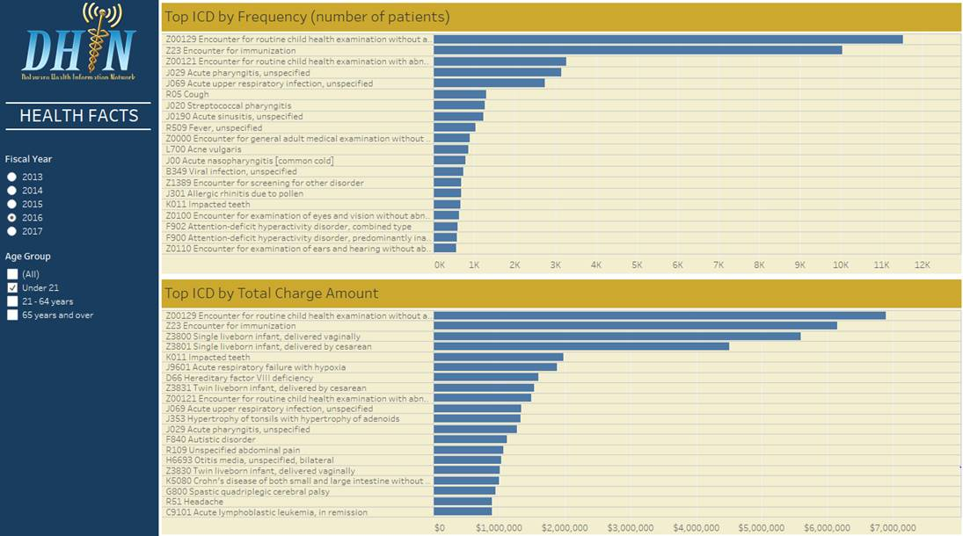
Sample Reports

Slide 12
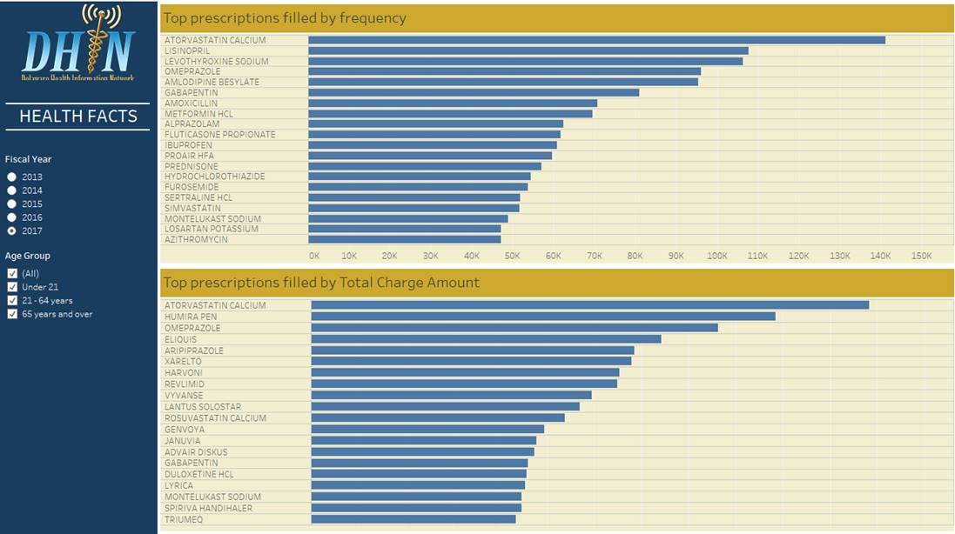
Sample Reports

