Slide 1
Graduate Medical Education
at Bayhealth
Presented to the Delaware Health Care Commission
April 4, 2019
WWW.BAYHEALTH.ORG

Slide 2
Outline of Discussion:
Background
Benefits of GME, including Workforce Development
Program design and key staff
Specialties selected and annual # of residents for each
Progress to date and upcoming steps

Slide 3
Bayhealth
3
Mission: To strengthen the health of our community, one life at a time.
About the Organization:
  Employees 3,723
  Hospitals 2
  Ambulatory Care Centers/Site 56
  Inpatient Admissions 18,418
  Emergency Department Visits 101,692
  Births 2,303
  Unreimbursed Care $62.3 Million
  Employed Physicians/Mid-Level Provider 195
  Active Admitting Physicians 615

Slide 4
Bayhealth Payor Mix
Discharges by Payor
4

Slide 5



Bayhealth Affiliations
eBrightHealth
Health Visions Delmarva
Penn Medicine
WWW.BAYHEALTH.ORG

Slide 6
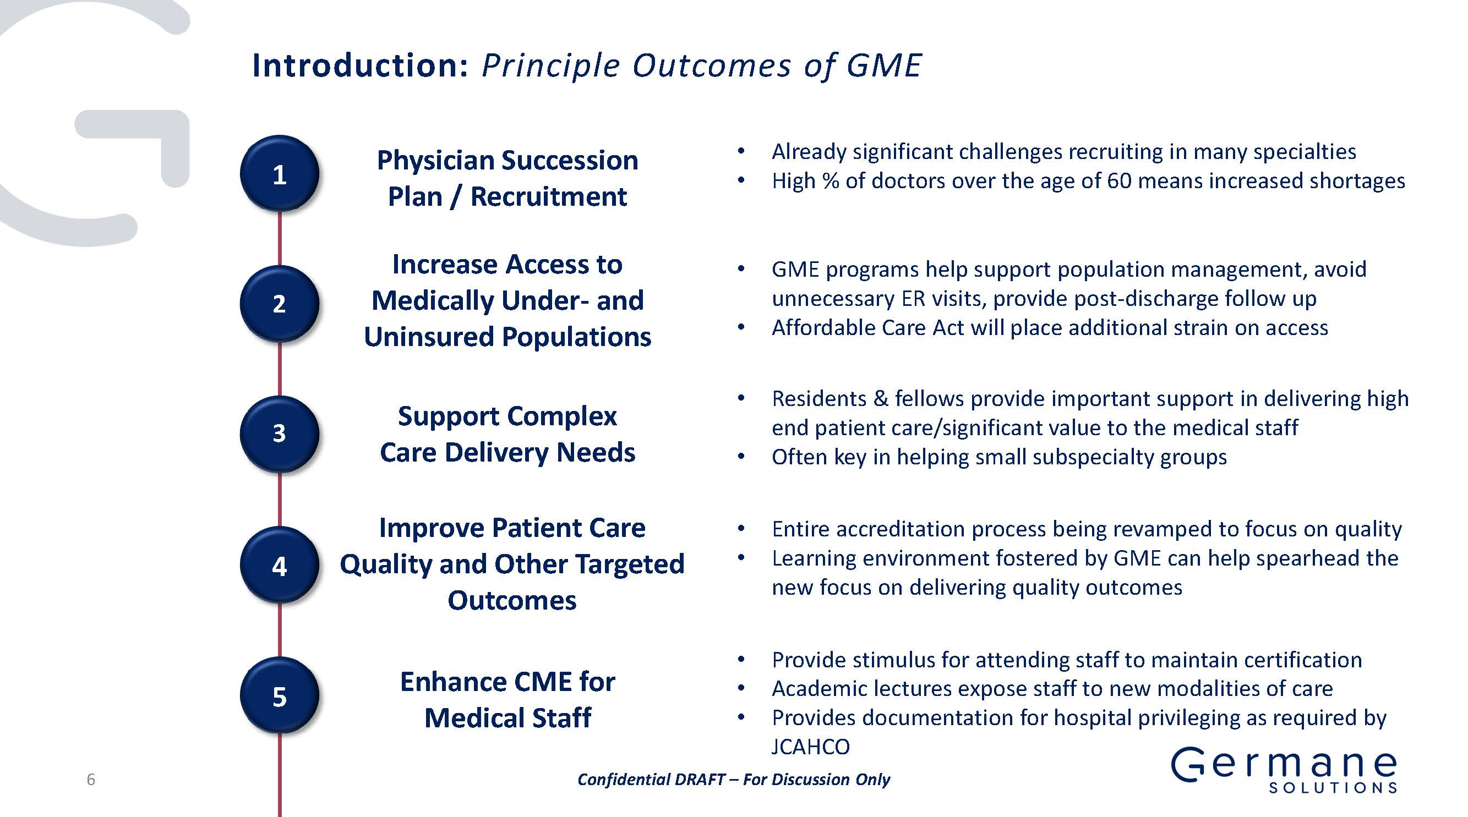

Slide 7
National need for GME positions
Due primarily to longer life spans/aging, and growth of the US population, a physician shortage of 42,000 – 121,000 physicians is anticipated by 2030
Medical schools are expanding and outpacing the capacity of residency programs:
  Since 2007, 22 new Medical Schools have been created
  From 2002-2017 Medical school enrollment has increased by 30%, from 16,400 matriculants in 2002 to 21,300 in 2017
A shortage of 46,000 to 90,000 GME positions is projected by 2025
AAMC recommends an increase of 3,000 GME positions annually over the next five years
Reference: AAMC Residency Physician Shortage Act of 2017

Slide 8
Key Findings from 2018 DHHS Primary Care Report*
FTE Supply of Primary Care Physicians, by County and Year
Kent Sussex New Castle
2006 93 115 463
2008 89 143 504
2011 92 163 452
2013 99 138 470
2018 89 112 461
*https://dhss.delaware.gov/dhss/files/primarycarestudy.pdf

Slide 9
Key findings from Bayhealth’s 2018 Triennial assessment of Community need
Three to five year new Physician/provider supply needs in Bayhealth Primary Service area likely to be:
70+ primary care providers, and
50 specialists/subspecialists.
This includes replacements for retirement

Slide 10
GRADUATE MEDICAL EDUCATION
Planned ACGME Residency programs beginning in July, 2021 at Bayhealth:
  Internal Medicine
  Family Medicine
Beginning in 2022 and 2023:
  Emergency Medicine
  Surgery
  Transitional year

Slide 11
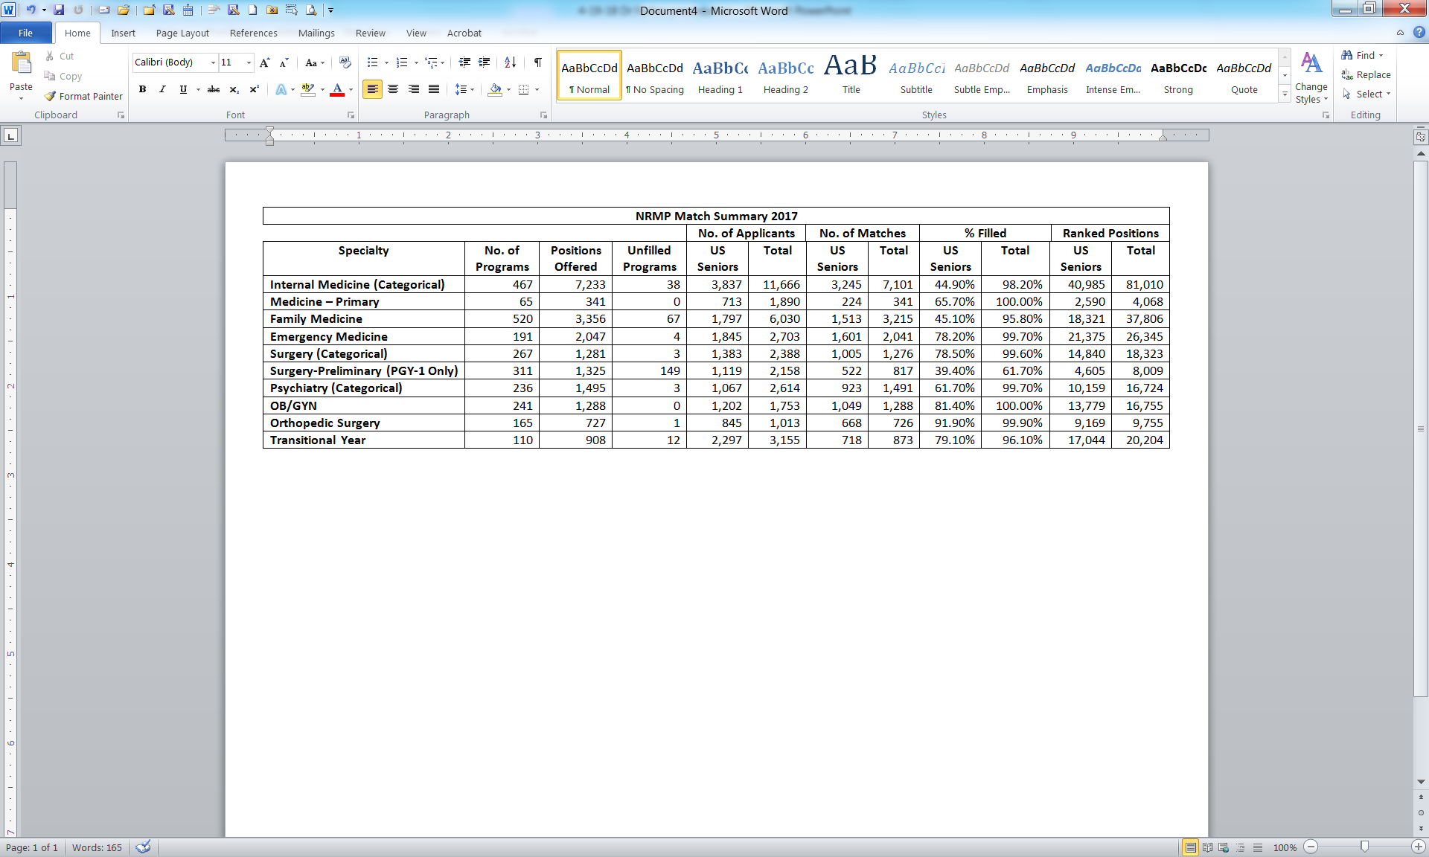

Slide 12
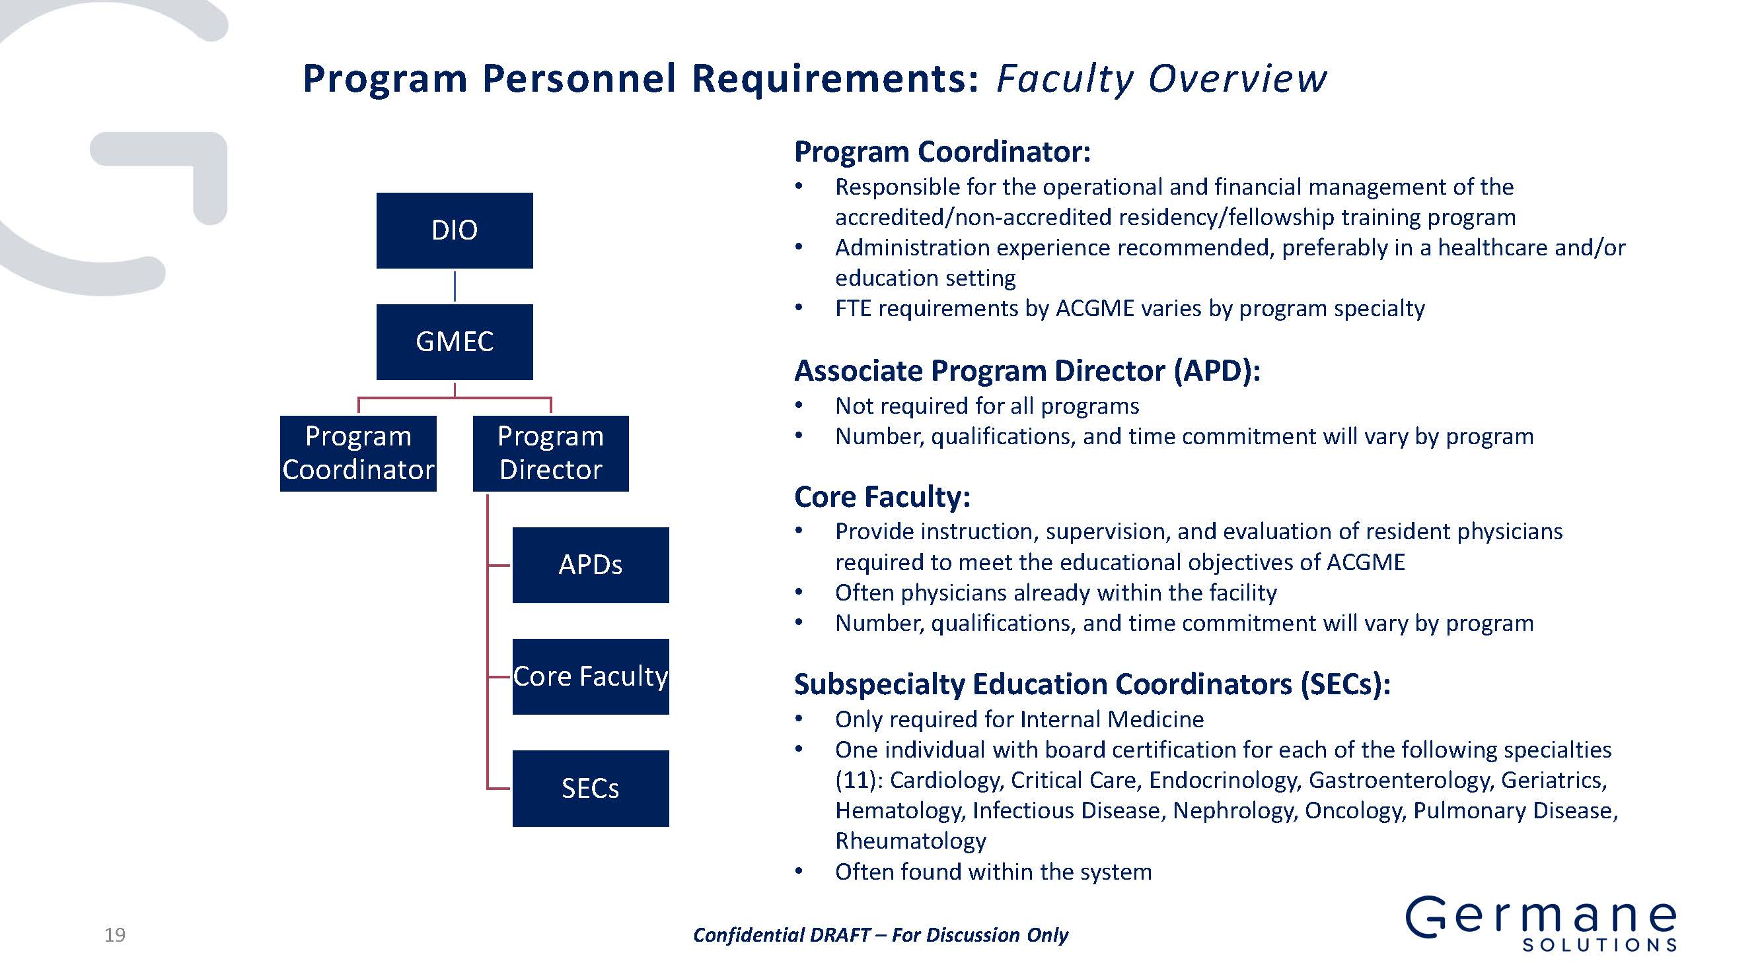

Slide 13
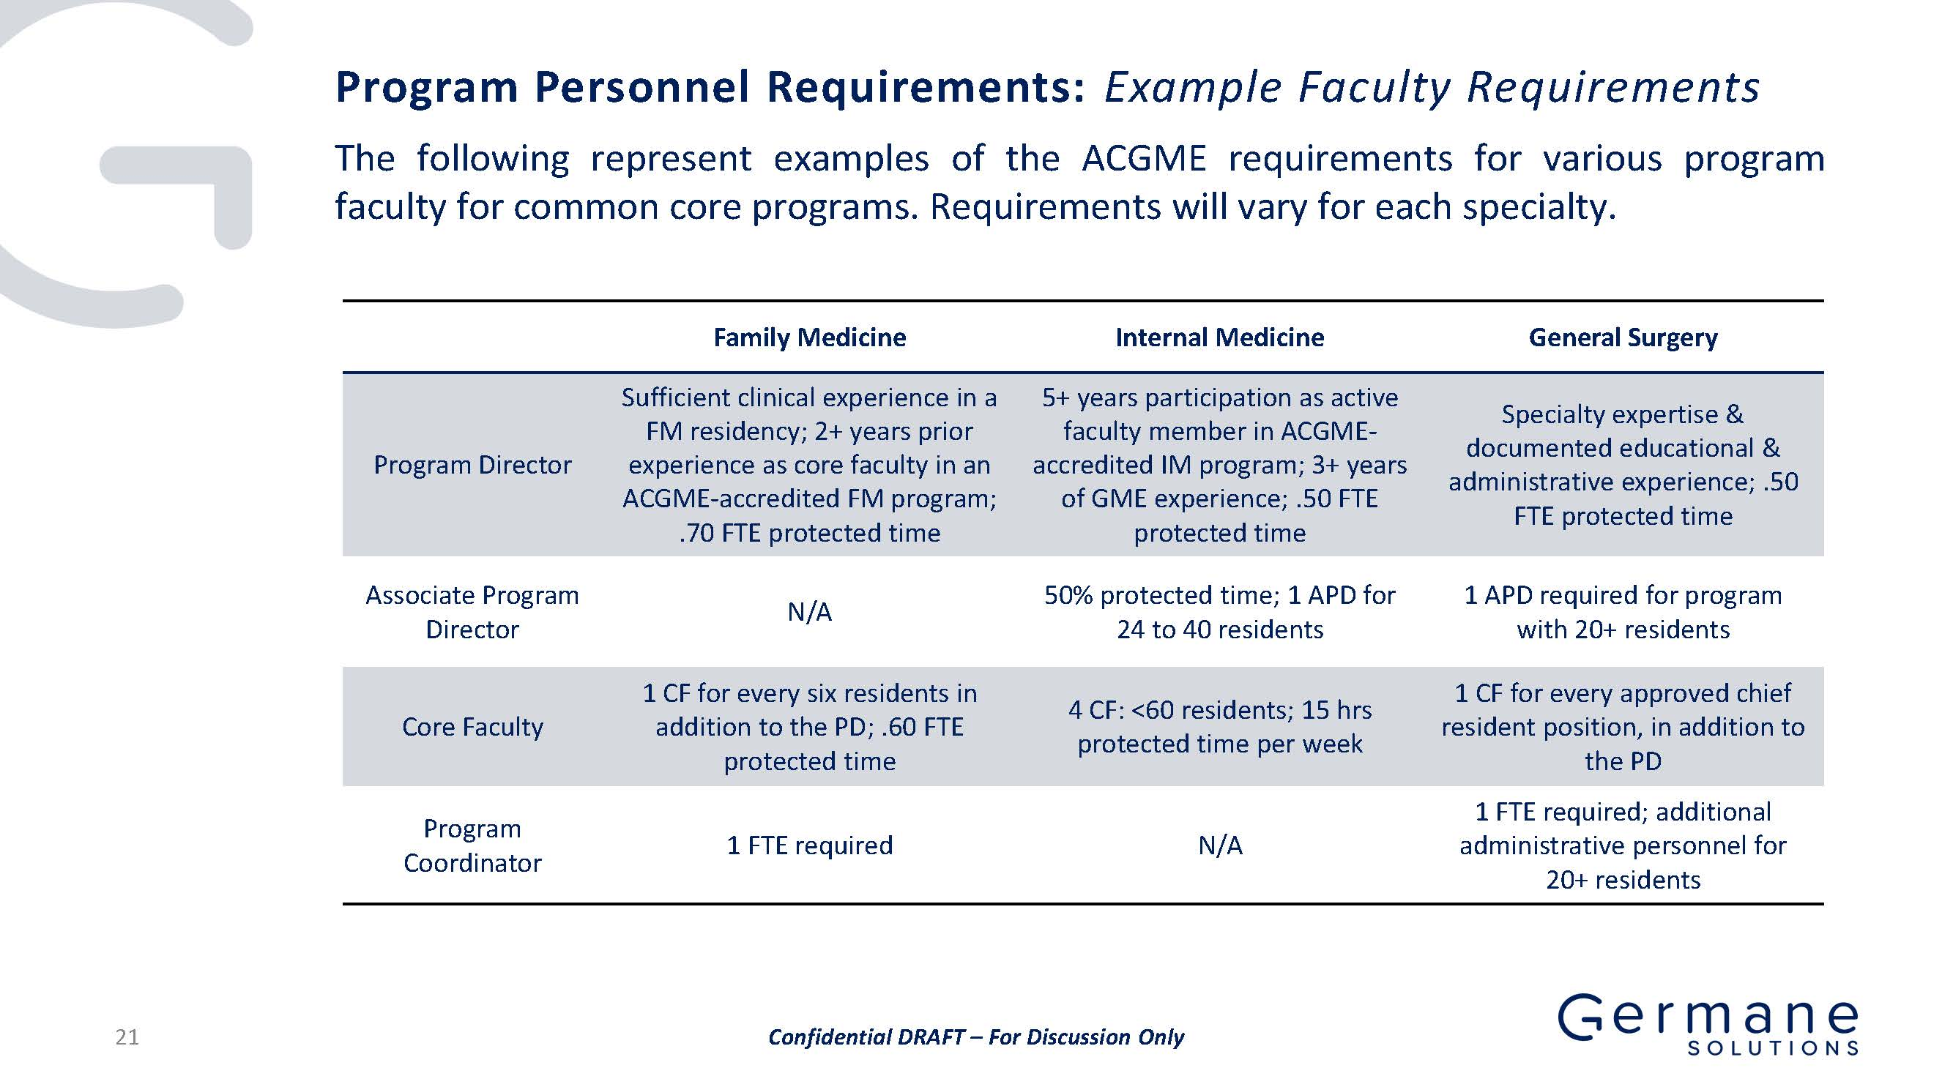

Slide 14
Planned Program Size and Timing
The Bayhealth Kent campus would have a total of 64 residents in all 5 specialties.
Bayhealth Kent Resident Timeline
Academic Year | 21 -22 | 22-23 | 23-24 | 24-25 | 25-26 | 26-27
Internal Medicine | 5 | 10 | 15 | 15 | 15 | 15
Family Medicine | 4 | 8 | 12 | 12 | 12 | 12
General Surgery | - | 3 | 6 | 9 | 12 | 12
Emergency Medicine | - | 4 | 8 | 12 | 12 | 12
Transitional Year | - | - | 13 | 13 | 13 | 13
Total | 9 | 25 | 54 | 61 | 64 | 64

Slide 15
Planned Program Size and Timing
The Bayhealth Sussex campus would have a total of residents 36 in four specialties. Transitional Year residents may be distributed to this campus as well.
Bayhealth Sussex Resident Timeline
Academic Year | 21 -22 | 22-23 | 23-24 | 24-25 | 25-26 | 26-27
Internal Medicine | 5 | 10 | 15 | 15 | 15 | 15
Family Medicine | 4 | 8 | 12 | 12 | 12 | 12
General Surgery | - | - | - | - | 3 | 3
Emergency Medicine | - | 2 | 4 | 6 | 6 | 6
Transitional Year | - | - | - | - | - | -
Total | 9 | 20 | 31 | 33 | 36 | 36

Slide 16
Core Planning Steps for GME Program
1
2
3
4
5
Initial Feasibility Assessment
Core Program Planning
Accreditation Preparation
Post-Program Accreditation
Program Management
Sponsorship Options
Establish GMEC & File IRD
GME Infrastructure
Full Curriculum Development
GME Office
Functionality
Cost Report Review
Program Determination & Size
Inventory of Clinical Training Capabilities
Clinical Training Models and Rotations
Evaluation System Set-Up
Program Marketing
Pro Forma Review & Update
Clinical Training Strategy
Faculty Sourcing
Pro Forma Development
Program Leadership Training
Faculty Development/ Training
PROMPT Productivity Review
Initial Economic Assessment
Partnerships & Affiliations
New Program Applications
Mock Site Visit & Review
Residency Recruitment & Onboarding
Review GME Opportunities
Viable Program
GME Operating Profile
Program Approval
Initial Operations
Comprehensive GME Program

Slide 17
Highlights of GME development in 2018-19
Following formal Board approval, the Designated Institutional Official (DIO) and GME Chair, Assar Rather, MD, were appointed and GME Committee formally began work in summer, 2018.
Institutional application was submitted September 28, 2018 and approved by ACGME in January, 2019.
“Core Clinical Campus” arrangement developed with PCOM to provide all clinical training for a group of 3rd year medical students, beginning July 1, 2019. The first 11 student class “matched” in December, 2018.
An Undergraduate Medical Education (UME) Committee was formed and UME Physician Director appointed to support the above work.

Slide 18
Highlights of GME development in 2018-19
The Family Medicine Program Director, Dr. Brintha Vasagar, signed in February, 2019, and begins June 1, 2019. Internal Medicine Director interviews are ongoing.
A HRSA grant application for new rural Family Medicine residencies was submitted March, 2019.

Slide 19
Key upcoming steps in 2019 – 2021
Evaluate FQHC or other teaching partnerships for primary care/specialty training.
Submit Family Medicine and Internal Medicine full applications to ACGME in late 2019.
Full curriculum and program evaluation tool development.
Finalize faculty for each program and provide formal faculty development training.
Complete facility modifications to accommodate programs.
Initiate Family Medicine and Internal Medicine programs in July, 2021.

Slide 20
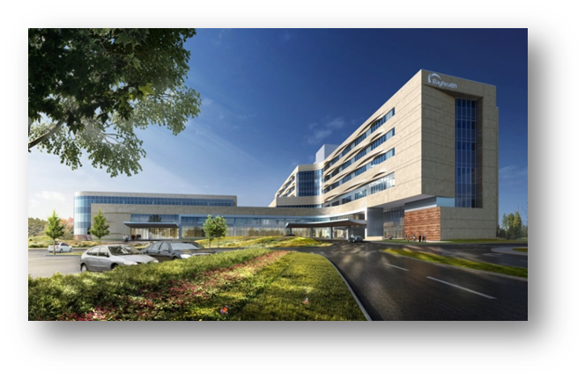
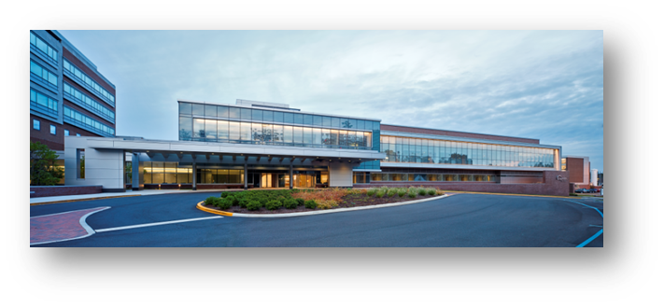
Questions?

Slide 21


