Slide 1
Fiscal Year 2017 Budget Hearing
Office of Management and Budget
Legislative Hall
House Chambers
Thursday, November 19, 2015
Rita Landgraf
Cabinet Secretary
Notes:
Good Afternoon Director Visalli, Kimberly Reinagel-Nietubicz of the Controller General’s Office, OMB personnel and members of the public, who represent our stakeholders, partners and the media. On behalf of the Department of Health and Social Services (DHSS), I am here today to present our Fiscal Year (FY) 17 Operating and Capital Budget requests.
We will continue to evaluate and transform our delivery systems to provide services in the most cost effective manner, with a primary focus on gaining positive outcomes for the population, and whenever possible to meet the needs and desires of the population served. As you know all too well, the more efficient and the more we demonstrate continuous improvement, from an administrative perspective, the greater impact our system will have on those who find themselves in need of our support.
In the chamber, my leadership team, inclusive of my Deputy Secretary Henry Smith is present and I ask them to stand to be publicly acknowledged. They represent this department, our personnel and most importantly our constituents. All of them standing, and those they represent, rely on the partnerships within the government, across the Cabinet, and in concert with the Legislative and Judicial Branches, and in alignment with our community partners and constituents. As you know, DHSS is one of the largest departments in state government and as such continues to face many challenges. Because of the talents and dedication of our personnel, we continue to respond to these challenges. This includes: the successful execution of the Affordable Care Act (ACA) insurance marketplace; being a key stakeholder in the ongoing transformation of the health care delivery system; achieving milestones in transforming our public mental health system; responding to both flu epidemic and addiction epidemic; and providing services to an increasing number of Delawareans in a caring, time-sensitive, and professional manner with diminishing human resources. Several slides follow that highlight a sampling of these efforts.

Slide 2

Improve the quality of life for Delaware’s residents by promoting health and well-being, fostering self sufficiency and protecting vulnerable populations
OFFICE OF THE SECRETARY
Management Services
State Service Centers
Public Health
Social Services
Medicaid and Medical Assistance
Long Term Care Residents Protection
Substance Abuse and Mental Health
Child Support Enforcement
Developmental Disabilities
Aging and Adults with Physical Disabilities
Visually Impaired
Notes:
As you are aware, the Department of Health and Social Services fulfills its mission To improve the quality of life for Delaware’s citizens by promoting good health and well being, fostering self-sufficiency, and protecting vulnerable populations through the work of our 11 divisions and the Office of the Secretary.
When people look at how DHSS’ policies and programs have improved the lives of Delawareans during the Markell Administration they will find a common theme – we meet communities where they are. And when we meet individuals and organizations, we typically have the same goal: to support them or their clients in living engaged lives in the community among their peers. That DHSS legacy also will include:
Less reliance on institution/facility-based services and more community-based services for seniors, people with disabilities, and individuals with behavioral health challenges, assuring that people get access to the right level of care.
A mental health care system that has achieved critical reforms, while better supporting people with serious and persistent mental illness as they live in their own homes in the community.
Momentum for ongoing change in the way health care is delivered and paid for in our state, tying payments to an increase in positive outcomes.
An urgent and growing response to the addiction epidemic, which continues to take too many lives and impact too many families.
Enhanced opportunities for people with disabilities to live, work, and participate as active members of the community.
Support for more individuals and families to move out of poverty by empowering them to improve their own financial security.
A strong safety net for tens of thousands of individuals and families who continue to face economic challenges.

Slide 3
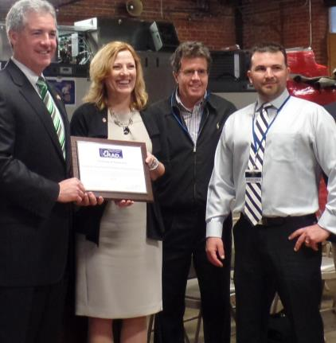
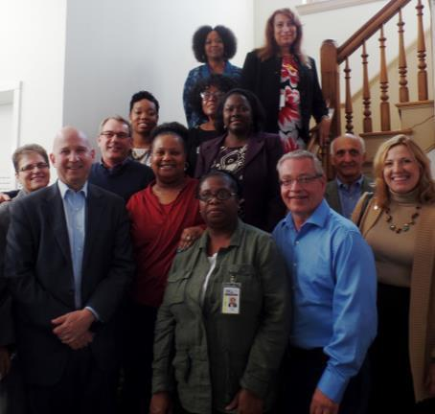
In Service to the People
Notes:
The Department remains committed to meeting the challenges and creating opportunities to advance our worthy mission. We continue to work within our means, while attempting to preserve the core services, and executing innovative, best practice measures that promote and increase healthier outcomes, healthier experiences with the system while remaining fiscally responsible.
All of this work compels me to reflect upon, and to be cognizant of, its impact on our employees, the people who must do the labor-intensive work that rests in their hands. And they have performed admirably, even while at the same time seeing a reduction in staff by more than 670 positions, a 13 percent decrease; and an average daily vacancy of more than 500 positions. Our staff believes as I do that providing needed government services and being good stewards of taxpayer money are not mutually exclusive goals.
Prior to addressing the FY 17 Budget Request, I wish to highlight the Department’s focus, investments and accomplishments. This is merely a sampling, not to be viewed as an inclusive list, and lays the important foundation for the continued work of the administration in the area of health and social service transformation.

Slide 4

Focus on Community
For every person DHSS serves in a facility, we estimate we can serve three in the community – where people can share their gifts and talents like these Volunteer Delaware 50+ volunteers.
Notes:
Community-Based Services
In 2009, Delaware’s long-term care expenditures were tilted too far toward facility-based care with limited options in community-based care. Today, those expenditures are balancing to promote choice of being supported within the community whenever possible.
WHAT CHANGED
In FY 2009, spending at DHSS’ three long-term care nursing facilities totaled $64 million. By FY 2015, spending was down almost 8.6% to $58.5 million. That ongoing shift is also more cost-effective, in that as a general rule:
For every person DHSS serves in a facility, we estimate that we can serve three in the community.
Beginning in February 2011, DHSS’ Care Transitions Team has diverted 88% of individuals (411 individuals as of September 2015) to the community who had been referred to DHSS’ three long-term care facilities. Since FY 2009, the total census at Emily Bissell Hospital, Governor Bacon Health Center and the Delaware Hospital for the Chronically Ill has been reduced by 40% from 354 residents to today’s census of 209, better leveraging the state’s resources and facilities, and satisfying the desires of Delawareans to remain engaged members of the community.
In September 2015, I made the decision to permanently close Emily Bissell. My decision was predicated on the following factors:
the desires of residents to remain where they had been temporarily relocated after a water boiler failure in February 2015;
a declining census - Emily Bissell served 48 residents, or only 56 percent of the facility’s capacity, at the time of the temporary closure;
feedback we received from the facility’s residents, families and our own staff; and
a review of the need for facility-based, nursing home services in New Castle County.
A decision on repurposing the buildings will be made in concert with stakeholders.

Slide 5
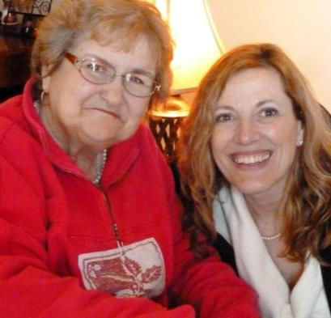
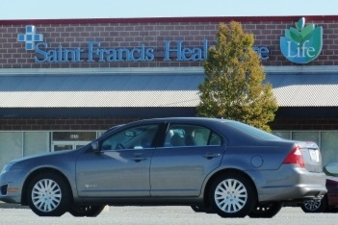
Focus on Community
187 Delawareans receive services at the LIFE Center on the Riverfront.
249, including Dolores, have transitioned from facility-based care to community settings through Money Follows the Person.
Notes:
Not only are our citizens aging but our buildings are as well, with an average age of 58 years old . You will hear more about this when I talk about our Capital Budget request.
As I review our focus on community, you will see that the Medicaid-eligible Delawareans receiving home and community-based services increased from 1,688 in January 2009 to 3,248 in July 2015, a 92% increase. Another 187 Delawareans are receiving services at the LIFE Center on the Riverfront through Program for All-Inclusive Care for the Elderly (PACE), which began in 2013. And 249 individuals have transitioned from facility-based care to community settings through the Money Follows the Person program, which began in 2008.

Slide 6
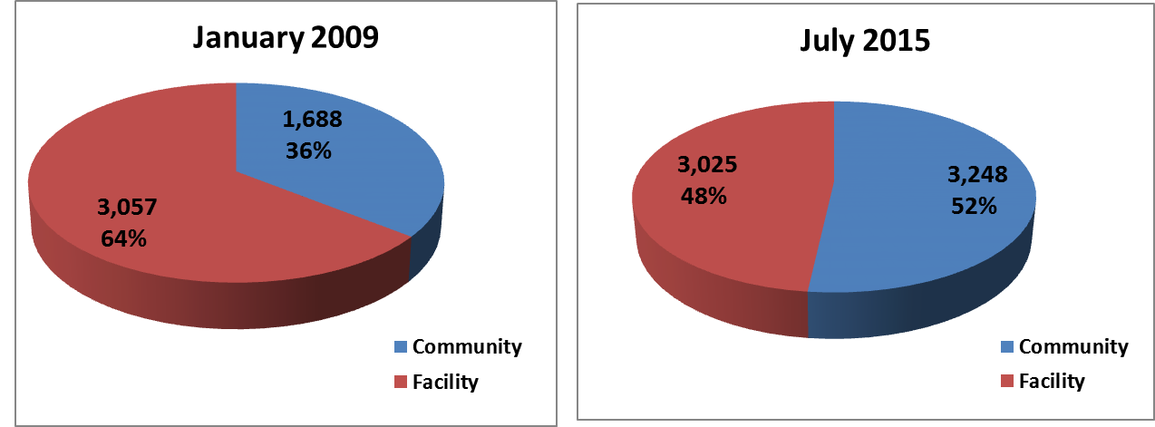
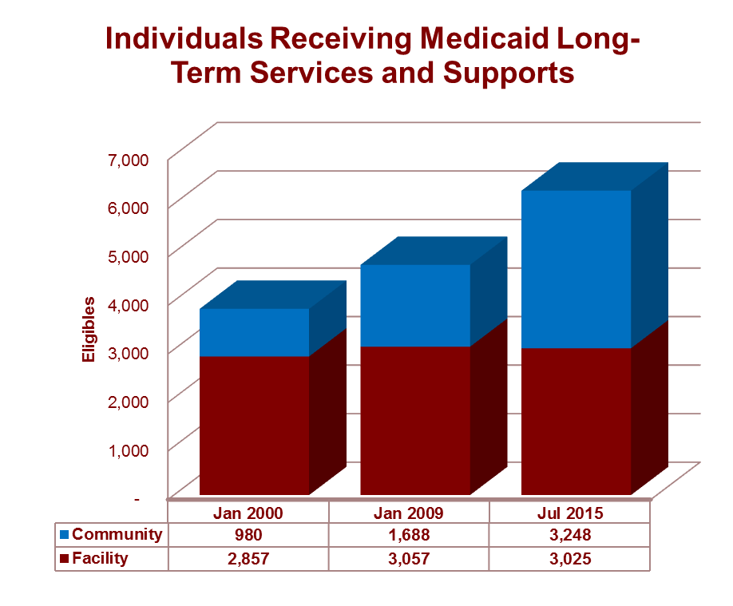
Focus on Community
Increase in Medicaid-Eligible Delawareans Receiving Home and Community-Based Care
Notes:
First, let me share with you how DHSS is leveraging the fiscal resources to embrace and develop this community based opportunity.
WHAT WAS DONE
Launched Delaware Aging & Disability Resource Center (www.DelawareADRC.com) in September 2011.
Moved Medicaid long-term care population from fee-for-service to managed care in April 2012, increasing the menu of services for individuals over the previous fee-for-service model.
Used housing vouchers through the Delaware State Housing Authority’s State Rental Assistance Program (SRAP) to support the transition of 507 individuals from DHSS’ five facilities to the community.
So What Does This Mean?
BY THE NUMBERS
1,042: Total census of DHSS’ five facilities in 2000.
662: Total census of DHSS’ five facilities in 2009, down 36% from 2000.
379: Total census of DHSS’ four facilities in 2015, down 43% from 2009, and down 64% from 2000.
We could not make these options a reality without the assistance of our stakeholders, inclusive of individuals and their families; advocates; professionals in long-term care and the acute care hospitals; and housing and community organizations.

Slide 7
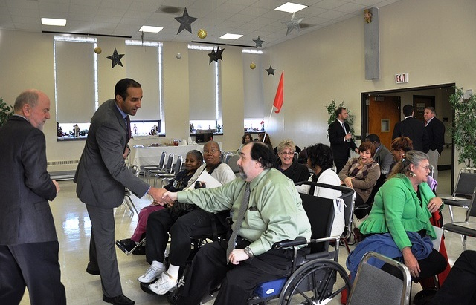
What it Means to the Individuals
Notes:
WHAT IT MEANS TO DELAWAREANS
John Talone of Claymont is among the hundreds of Delawareans who have been discharged or diverted from DHSS’ three long term nursing facilities to live in the community with wrap-around supports and services. John likes his own Italian cooking, and after spending four-and-half years in the Delaware Hospital for the Chronically Ill in Smyrna, he now can cook and eat those meals on his schedule at his Claymont apartment.
Recently Arline Hampton shared with me her story. Several years ago, Arline was employed by the City of Wilmington for over 18 years, but was living with the disease of addiction for over 30 years, Her addiction resulted in loss of employment, which facilitated her going into a rehab facility for treatment of her addiction. As we all are very aware, relapse is probable with this disease and her relapse also brought on 3 major strokes. She went from being hospitalized, to being placed in a nursing home for 4 years. She learned about Money Follows the Person and began her journey of returning back to the community to live on her own with supports. With the assistance of her Medicaid MCO, Independent Resources and her family, she is able to live on her own in her own apartment. Arline states: “My victorious triumphs came from my faith, having a great support team, and my personal determination to change my destructive lifestyle for a better one. It was work, but I’m worth the investment.”

Slide 8
Mental Health Transformation
Notes:
From day one of the Markell Administration, DHSS has worked to improve conditions at the Delaware Psychiatric Center (DPC) and reform how mental health services are provided in the community. A pivotal benchmark in that commitment came in July 2011, when the State of Delaware entered into a Settlement Agreement with the U.S. Department of Justice, which resolved a three-year investigation of DPC beginning in 2007. Most importantly, that agreement became the blueprint for how Delaware would provide mental health services in the community to the more than 9,000 people today estimated to be living with a serious and persistent mental illness.
While there is more work to do in building community mental health services, the expectation is that by the end of the fifth year of the Settlement Agreement in July 2016, we anticipate that the U.S. Department of Justice will agree that the State of Delaware has met its goals set forth in the terms of the agreement. The State recognizes that the transformation continues to be a fluid process and that the foundation has been constructed to continue to build upon.
WHAT CHANGED
In 2008, only 3,700 people were being served in the community, and too many people with serious and persistent mental illness were institutionalized, homeless, forgotten, or their families were doing the best they could to patch together support for them. By 2015, more than 6,100 Delawareans – an increase of almost 65% – are being served in the community with a wide array of services.

Slide 9
Mental Health Transformation
Notes:
As mental health system reforms were instituted and the shift to community-based services took hold, DPC shifted to becoming the acute-care psychiatric hospital it was meant to be, licensed for 200 beds. Individuals who have been discharged after years or, in some cases, decades at DPC are receiving intensive treatment in the community with access to housing, employment, clinical services, medications and other services.
WHAT WAS DONE
Created Assertive Community Treatment (ACT) teams – consisting of 11 members plus a psychiatrist – who provide 24/7 services in the community instead of in an office setting. The 16 ACT teams must respond to clients who are in crisis regardless of the time of day, thereby increasing the chance of de-escalation and reducing unnecessary hospitalizations.
Reduced by 80% the number of institutional bed days from 2010-2011 to 2013-2014 for a group of 2,503 Delawareans with serious and persistent mental illness.
Opened Recovery Response Center (RRC) in Sussex County to support people experiencing a behavioral health crisis. From its opening in September 2012 through March 2015, DHSS’ Mobile Crisis and RRC in Ellendale have worked together to divert 76% of clients from hospitalization. A similar crisis walk-in center will open in New Castle County early 2016.
Funded 749 housing units, under the Settlement Agreement, for individuals with serious and persistent mental illness so they can lead stable lives in the community.

Slide 10
Mental Health Transformation
Notes:
WHAT WAS DONE (cont’d)
Developed crisis apartments in New Castle, Kent and Sussex Counties that provide 24/7 supervision in a stable environment for up to seven days so the client can work through a crisis with the support of the ACT team.
Expanded Mobile Crisis Services statewide to 24/7, with a team member required to respond anywhere in the state in less than an hour.
Updated Delaware’s civil mental health laws for the first time in 50 years.
Won approval in January 2015 to implement PROMISE (Promoting Optimal Mental Health for Individuals through Supports and Empowerment). An estimated 3,000 Delawareans with behavioral health needs and functional limitations will be eligible for this Medicaid Managed Care Organization benefit package, better leveraging Medicaid dollars and increasing employment opportunities.
Created the position of peer support specialist, someone with a shared life experience, to support individuals in recovery as they navigate the health care system and live in the community.

Slide 11
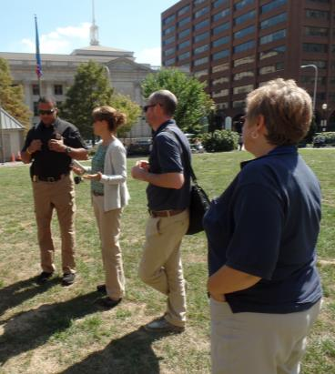
Mental Health Transformation
BY THE NUMBERS
25,000 Mobile Crisis calls statewide in FY15. With skills in de-escalation and knowledge of services, Mobile Crisis Team members are making a difference in our communities.
80 peers work throughout the behavioral health system, 90 people have completed Peer Support 101, and 80 have completed certification training. About 25 peers have been certified with the state board.
DHSS’ 24/7 Mobile Crisis Services in New Castle County: 1-800-652-2929. In Kent and Sussex counties: 1-800-345-6785.
Notes:
WHAT IT MEANS TO DELAWAREANS
William and Steve, both of whom have a serious mental illness, share an apartment and are served by a Sussex County ACT team. William has a history of involvement with the criminal
justice system. Steve, who also has been in the criminal justice system, has a co-occurring addiction to alcohol and has been homeless. Like other roommates, William and Steve share the shopping and cooking. ACT team members visit two to three times a week to support them. Today, in recovery, they are living ordinary lives in the community.
BY THE NUMBERS
25,000 Mobile Crisis calls statewide in FY15. With skills in de-escalation and knowledge of services, Mobile Crisis Team members are making a difference in our communities.
80 peers work throughout the behavioral health system. 90 people have completed Peer Support 101, and 80 have completed certification training. About 25 peers have been certified with the state board.
DHSS’ 24/7 Mobile Crisis Services in New Castle County: 1-800-652-2929. In Kent and Sussex Counties: 1-800-345-6785.
THEY SAID IT
“… from the Governor’s Office on down, there is a commitment to serve people with [serious and persistent mental illness], as well as other disabilities, in ways that promote their full participation in community life.” - Court Monitor, Robert Bernstein.

Slide 12
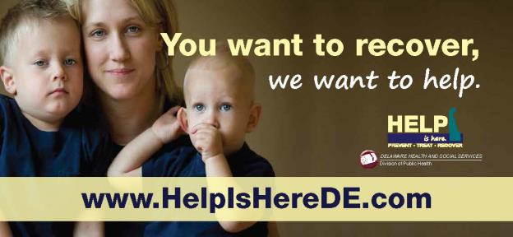
Urgent Response – Addiction
Department of State established Prescription Drug Monitoring Program.
Gov. Markell established the Prescription Drug Action Committee.
Division of Medicaid placed new requirements on opioid medications.
Gov. Markell signed the 911/Good Samaritan Law.
Notes:
Urgent Response to Addiction Epidemic
The number of Delawareans impacted by addiction has been rising for two decades, mirroring the rapidly rising increase in prescriptions for opioid pain medications. Thousands of people are facing addiction, impacting their families, the treatment and criminal justice systems, and costing hundreds of people their lives from overdoses.
WHAT CHANGED
In 2010, Delaware ranked fifth in the per-capita rate of opioid pain reliever sales, and the state had the ninth-highest drug overdose death rate in the nation. By 2010, the number of overdose deaths in Delaware had surpassed car accidents as the leading cause of death by injury.
By 2012, the thousands of individuals and families impacted by the addiction epidemic were struggling to get the treatment services their loved ones needed. For Delaware, it was an all-hands-on-deck moment. As with any public health crisis, we are working on three fronts – to prevent substance abuse and to educate about the disease of addiction ; to expand treatment and recovery services; and to control the crisis from a criminal justice standpoint by working to understand how it originated.
WHAT WAS DONE
In 2012, the Department of State established the Prescription Drug Monitoring Program with the requirement of 24-hour pharmacy reporting.
In February 2012, Gov. Markell established the Prescription Drug Action Committee of stakeholders from across the spectrum, charging the committee with developing a plan to combat the abuse and misuse associated with prescription painkillers.
In March 2012, the Division of Medicaid required prescribing providers to get preauthorization for long-action opioid medications for Medicaid patients and placed annual limits for short-acting opioid medications. The new requirement affected an estimated 3,500 Medicaid clients.
In July 2013, Gov. Markell signed the 911/Good Samaritan Law, which encourages people to call 911 to report an overdose without risking arrest for low-level drug crimes.

Slide 13
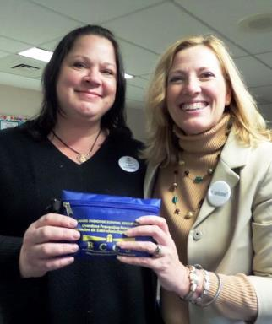
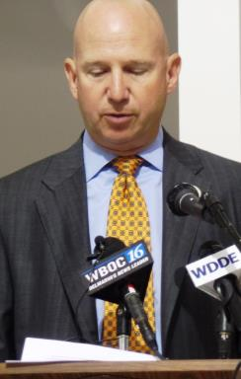
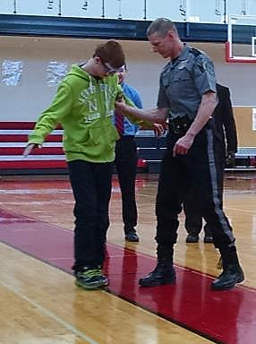
Urgent Response – Addiction
Naloxone: Increased use of overdose-reversing medication in community and among police agencies is saving lives.
Added resources: New withdrawal management center in Harrington first of many steps.
Prevention: Launched underage and binge drinking prevention campaign aimed at young people and influencers.
Notes:
In June 2014, as DHSS began to address both capacity and levels of care redesign issues. The General Assembly added $1 million in new resources to DHSS’ budget for increased treatment services through the Division of Substance Abuse and Mental Health and increased prevention services through the Division of Public Health.
In June and August of 2014, Gov. Markell signed two bills – one expanding the use of the overdose-reversing drug naloxone in the community and one allowing it to be used by law enforcement agencies. In September 2015, we had our first report of someone reversing a friend’s overdose. Officers in four police departments – New Castle County, Elsmere, Middletown and Ocean View – are carrying the medication, and all four departments have used it to save people’s lives.
In October 2014, DHSS launched www.HelpIsHereDE.com - a one-stop website for information about prevention, treatment and recovery services.
In his State of the State in January 2015, Gov. Markell pledged to make a substantial investment in services for those struggling with addiction. In February, his recommended budget included $4.45 million in new resources for withdrawal management, residential and outpatient treatment, and recovery living services.
With the new resources included in the FY16 current budget, DHSS will increase and reform our treatment system to ebb and flow with an individual’s needs, embracing the American Society of Addiction Medicine model. When individuals in active use are ready for treatment, DHSS must have the capacity to support them at that time.
In April 2015, as part of our prevention initiatives, DHSS launched an underage and binge drinking prevention campaign aimed at teens, their parents and other influencers, and college-age binge drinkers.

Slide 14
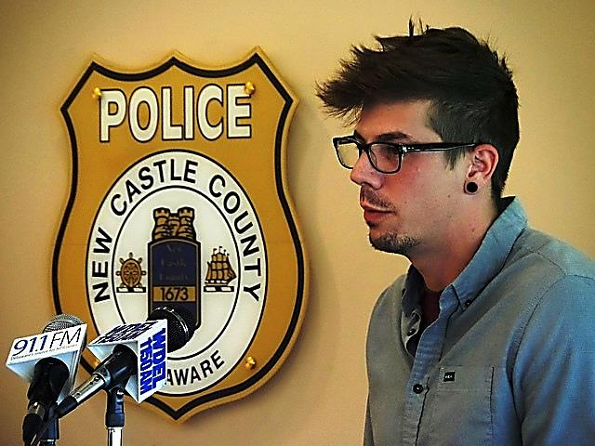
Urgent Response – Addiction
185 people died from suspected overdoses in 2014; 125 people died in Del. traffic accidents in 2014.
10,000 Delaware adults sought public treatment in 2014, about one-third for heroin.
17 people saved by police administering naloxone as of Nov. 15, 2015.
"I never wanted anything more than how bad I wanted to be clean and sober in that moment,” said Tim Miller, who underwent detox in prison and now has three years in recovery.
Notes:
WHAT IT MEANS TO DELAWAREANS
Tim Miller took a path too many young adults are taking today. In middle school, he tried alcohol. Then he took his grandfather’s prescription painkillers from the medicine cabinet, saying they made him feel less socially awkward. Years after high school, having become addicted to heroin, he was sent to Howard Young Correctional Institution on a burglary charge.
BY THE NUMBERS
185: The number of people who died from suspected overdose of any substance in 2014 – that’s one son, daughter, mother, father, sister or brother every other day. The youngest person to die from an overdose was 15; the oldest was 87. The average person to die was a 42-year old white male from suburban New Castle County.
10,000: The number of Delaware adults who sought public treatment in 2014, with about one-third of those adults indicating heroin as their primary drug at the time of admission.
646: Number of people in the community who have been trained to use naloxone and are carrying the drug to save a loved one or a friend if necessary.
115,000: Number of page views for HelpIsHereDE.com in its first year, connecting people to prevention, treatment and recovery services.
8: Number of police stations with 24/7 Drug Take-Back collection containers to encourage the disposal of unwanted, unnecessary or expired medications.
15: Starting in 2015-2016 school year, number of hours of drug and alcohol education required before graduation for every public high school student.
THEY SAID IT
"I never wanted anything more than how bad I wanted to be clean and sober in that moment,” said Tim Miller, who underwent detox in prison and now has three years in recovery.

Slide 15
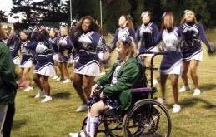

Enhanced Opportunities for People with Disabilities
With the Americans with Disabilities Act celebrating its 25th anniversary in 2015, the civil rights for the one in five Americans with a disability are even more entrenched.
While inclusion grows with each successive generation, there is still much more work to do in terms of health equity, housing options, transportation, education, financial self-sufficiency and especially employment.
Notes:
WHAT CHANGED
Under Governor Markell’s leadership and in partnership with the business community, Delaware reported an 8.6 percent increase in active employment from 2011 to 2013 among the 187,000 people with disabilities. The Governor also has made the hiring of people with disabilities a priority for state government, using hiring practices and programs to increase employment levels.
As Chair of the National Governors Association from 2012 to 2013, Governor Markell made advancing employment opportunities for people with disabilities his yearlong initiative. With his business background, he knows that companies’ bottom lines should be about embracing a person’s ability, not their disability. The Governor laid out how to advance employment opportunities in his blueprint to his fellow governors, “A Better Bottom Line: Employing People with Disabilities.”
I served as a key adviser to the Governor during his NGA initiative, and was appointed in January 2015 to the U.S. Department of Labor’s U.S. Advisory Committee on Increasing Competitive Integrated Employment for Individuals with Disabilities.
Opportunity begins with a job, a place to live, good health, supports and services, and financial well-being -- and joining the McKean High School Cheerleading squad or a Zumba class at the YMCA, as noted in these pictures.

Slide 16
Enhanced Opportunities for People with Disabilities
With the Americans with Disabilities Act celebrating its 25th anniversary in 2015, the civil rights for the one in five Americans with a disability are even more entrenched.
While inclusion grows with each successive generation, there is still much more work to do in terms of health equity, housing options, transportation, education, financial self-sufficiency and especially employment.
Notes:
WHAT WAS DONE
In July 2012, the Governor signed the Employment First Act, requiring state agencies to consider, as their first option, competitive employment for individuals with disabilities.
To increase hiring of qualified individuals with disabilities, the State uses such tools as Selective Placement, Temp to Perm, casual seasonal hires, and internships and career exploration.
In 2013, a work group was tasked with advancing hiring opportunities for people with disabilities in state government.
As part of that work, the group commissioned the University of Delaware to conduct an online survey of state employees to better understand disability awareness. More than 5,000 state employees responded, identifying two key areas for improvement: HR training related to disability awareness and refinement of state hiring practices in order to recruit qualified applicants with disabilities.
In October 2014, the Office of Management and Budget launched “Focus on Ability,” disability awareness training for all employees, with a separate module for hiring managers.
DHSS has hired several Specialisterne contractors to do document scanning. One graduate of Specialisterne is now a state employee in the materials center for the Division for the Visually Impaired.
By the end of 2015, CAI has committed that 3 percent of its workforce will be individuals on the autism spectrum.
In late 2015, DHSS created a video to promote employment for individuals with disabilities that highlights the jobs or expectations of five Delawareans. The video will be shown and discussed with individuals, families and prospective employers.

Slide 17
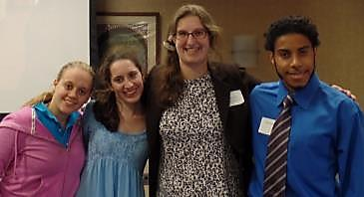
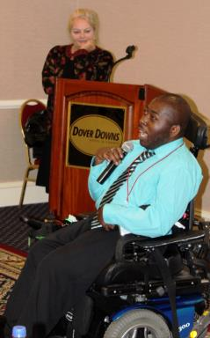
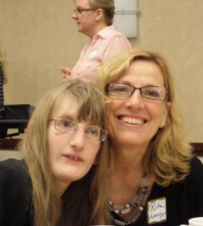
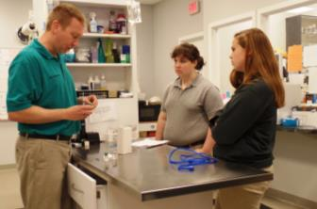
Opportunity
First Statewide Disability Mentoring Day
Dover
Newark
Woodbridge
Notes:
In 2015, Delaware’s Disability Mentoring Day was expanded from New Castle County to all three counties. More than 60 students participated in job-shadowing at nearby workplaces.
To support young people with disabilities and their families, DHSS earned approval from the Centers for Medicare and Medicaid Services in January 2015 for the Pathways to Employment program, becoming the first state to successfully adopt a Home and Community-Based Services State Plan Amendment that cuts across disability groups with a focus on employment. The program will leverage Medicaid dollars to support young people ages 14-25 with transportation, personal care and assistive technology needs as they launch their careers.
The financial empowerment program, $tand By Me, created in 2011 in partnership with the United Way of Delaware, supports people with disabilities in managing their finances with one-on-one coaching.
Medicaid for Workers with Disabilities allows people with disabilities to buy into Medicaid in order to keep the supports they need while they are employed.
In June 2015, Delaware became the 19th state to create an Achieving a Better Life Experience (ABLE Act) program, following a December 2014 federal law creating the program. The state Department of Finance must devise rules for the tax-free savings accounts for disability-related expenses.
Because a Delaware public health assessment found a number of health disparities among people with disabilities -- including obesity rates, higher rates of smoking, and higher rates of chronic conditions such as diabetes, heart disease and depression, DHSS is requiring its divisions and programs to include a person’s disability status when demographic information is collected. That information will allow DHSS to remove barriers to care and increase access.
I value the opportunity to increase access to employment which leads to greater self sufficiency for individuals with disabilities, advancing individuals out of poverty, which promotes healthier outcomes.

Slide 18
Video
Notes:
WHAT IT MEANS TO DELAWAREANS
Jessica Hengst, who has Down syndrome, folds towels and cleans the pool area at Mainstay Suites in Dover and has a second job at Old Navy in the Dover Mall. One day, her mom said she would like to live on her own.
A gun incident in Philadelphia led to Dwayne Adams losing his left eye and having only partial vision in his right eye. Job specialists asked him if he wanted to sell newspapers at a stand. He told them he wanted to become a massage therapist. He built on that interest in physical health, and today owns the Breaking Barriers fitness center in Wilmington.
Since joining Cabela’s at the Christiana Mall in May 2014, Steve Howell, who uses a wheelchair, has been promoted twice and now works in the Fishing Department. “My goal is to make our customers as passionate about the sport as I am,” says Steve, who has loved to fish since his dad started taking him as a kid.
Establishing the expectation of a lifetime of work is crucial for young people with disabilities. For Rick and Amy Kosmalski of Bear, the expectations for Kayla, their 9-year-old daughter with Down syndrome, are no different than they are for Logan, their 4-year-old son without a disability. The Kosmalskis believe Kayla and Logan each can be whatever they want to be.
BY THE NUMBERS
36.4%: Percentage of Delawareans age 18 to 64 with disabilities who are employed.
8.6%: Percentage increase in active employment from 2011 to 2013 among people with disabilities.
5,000: Number of state employees who responded to a 2013 UD survey about disability awareness in the workplace.
30,631: Number of people age 18 to 64 who received SSDI or SSI benefits in 2012.
12%: Percentage of individuals with disabilities among all people served by the financial empowerment program $tand By Me since 2011.
1,008: Estimated number of people with disabilities expected to create ABLE savings accounts in Delaware by
FY 2017.
THEY SAID IT
“Disability Mentoring Day is a great opportunity for kids to learn about different jobs, to be involved with the community.” ~ Jay Siegel, a 2014 Disability Mentoring Day Graduate.

Slide 19
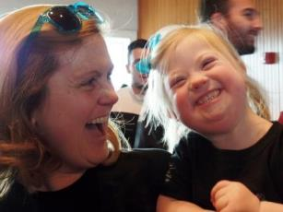
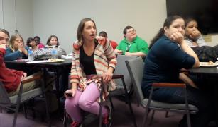
Support throughout the Lifespan
Birth to Three
Early Childhood
Elementary & Middle School
High School & Transition
Adulthood
Retirement
Notes:
DHSS provides supports to Delawareans in a multitude of ways, some of which may be time limited, but many Delawareans may rely on our support throughout the lifetime. Supporting persons with an intellectual disability and or autism spectrum disorder and their families is work that spans a lifetime. It changes as the person ages and the family dynamics change. It is not static but evolves as abilities grow and needs change. One way of looking at the dynamics of change for families and persons with developmental disabilities is to think about developmental or life stages. One paradigm would be the following example.

Slide 20
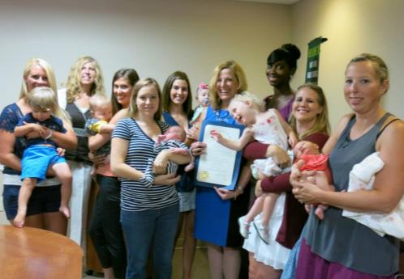
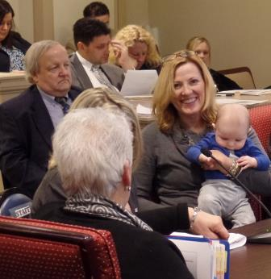
Birth to Three – Early Childhood
Notes:
The infant may require intense and comprehensive therapies. The parents are commonly thrust into a new and foreign world of medical interventions and intensive therapies. The primary state agency providing supports is Public Health and our Birth to Three program located within the Division of Management Services.
These years continue to be critical ones for therapies and preschool activities. Parents and family members are deeply engaged in ensuring the child is supported to learn about how to navigate and use his/her world. The schools play an increasing role during this period.

Slide 21
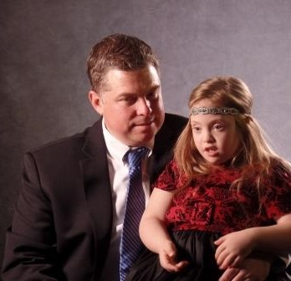

Elementary, Middle, High School,
Transition
Notes:
The child and the parents face new challenges in the world of special education. These are critical years for education and learning social skills. Although local school systems are the primary provider of supports, DDDS is often asked to provide respite services.
The student learns from academic programs but they also begin the transition to adulthood by exploring adult roles, including employment, and refining social skills. School continues to play a major role in supporting the student to learn his/her new skills and adult roles.
DDDS also begins to provide supports to the student and the family including assistance with transition through Early Start to Employment and Pathways to Employment and other day and employment supports. These services are largely funded by Medicaid under the State Plan. A contracted DDDS Family Support Specialist helps the family to navigate the service delivery system.
All the work that the student and his/her family engaged in with the local school system has enabled him/her to begin to explore having real jobs, and navigating his/her community.

Slide 22
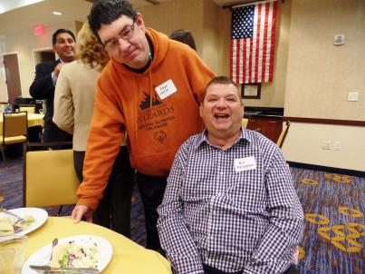
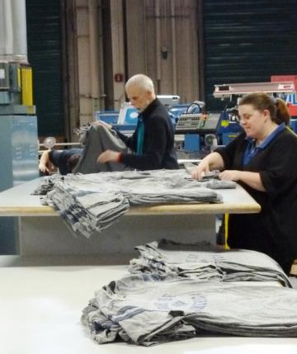
Adult and Retirement
The retirement years, like for everyone else, the individual who has had a long and varied career, now gets the opportunity not to have to go to work.
Notes:
DDDS services provided by private agencies begin to play a major supportive role helping graduates to find and maintain employment and lead the lives they want to live as independently as possible via a person-centered plan. Most of these services are funded under the DDDS HCBS Medicaid Waiver. DDDS Case Managers play a major role in ensuring that the individual can achieve their life goals.
The retirement years, like for everyone else, the individual who has had a long and varied career, now gets the opportunity not to have to go to work if that is what they desire.
DDDS and its provider network support the individual to live a safe and healthy life, taking full advantage of the opportunities available in the local community and beyond pursuing activities of his/her own choosing.

Slide 23
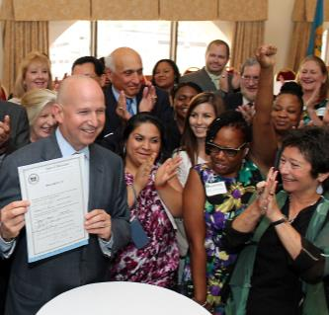
Financial Empowerment and a Strong Safety Net
30,000 Delawareans served by $tand By Me through June 2015 have:
Reduced their debt by $2.8 million.
Increased their savings by $1.2 million.
Raised their credit score by an average of 52 points.
Established 1,522 budgets.
Filled out 3,700 college financial aid applications.
Established 14,000 personal financial goals.
Notes:
Soon after becoming Cabinet Secretary, I asked my leadership what the department was doing to foster self-sufficiency. Their answer was: We provide benefits.
Our mission as a department is to foster self-sufficiency, and while benefits can supplement in a crisis as they did for so many families during the recession, they will never provide financial sustainability or security.
Delaware’s household financial demographics speak to the need for this focus. According to the U.S. Census, of the 335,707 households in Delaware in 2013, 42% had incomes below $50,000, and 29% had incomes below $35,000. Many of these households have traditionally struggled with monthly expenses that exceed income. They have no savings or safety net, supplement their income with credit, have low credit scores and high debt, are exploited by the “fringe” financial sector, and lack access to maintain financial services.
With the support of Governor Markell, we launched $tand By Me, Delaware’s financial empowerment partnership with the United Way of Delaware, in 2011. $tand By Me, which is headquartered in DHSS, has as its core service free personal financial coaching. The coach never dictates, but rather asks each customer to identify their own challenges and goals, and come with a customer-driven action plan.
WHAT HAS CHANGED
Through June 2015, $tand By Me had served 30,000 Delawareans through coaching, workshops, college financial aid applications, and free tax preparation.
Collectively, $tand By Me customers have reduced their debt by $2.8 million, increased their savings by $1.2 million, raised their credit score by an average of 52 points, established 1,522 budgets, filled out 3,700 college financial aid applications, and established 14,000 personal financial goals.
In addition to its employer- and school-based programs, $tand By Me has special programs for Delawareans 50 and older, Hispanics, veterans, people with disabilities, young people aging out of foster care and child care employees.

Slide 24
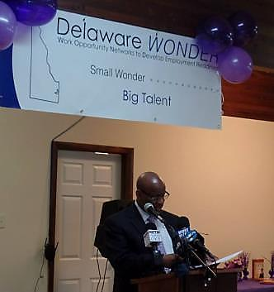
Financial Empowerment and a Strong Safety Net
In March 2015, DHSS was awarded $18.8 million federal grant for Delaware WONDER (Work Opportunity Networks to Develop Employment Readiness) to support SNAP recipients with limited job skills or work experience. The program begins in early 2016.
Office of Financial Empowerment codified in 2015.
Eastside Rising will provide one of the employment tracks for Delaware WONDER in construction.
Notes:
WHAT WAS DONE
To build security for the future of $tand By Me beyond the Markell Administration, legislation was introduced and passed in 2015 to codify the Office of Financial Empowerment within DHSS.
In March 2015, DHSS was awarded a competitive federal grant of $18.8 million for Delaware WONDER (Work Opportunity Networks to Develop Employment Readiness), an innovative program that works with local partners to provide job training and intensive case management to Delawareans who receive food benefits and have limited job skills or work experience. About 20% of the 150,000 Delawareans who receive food benefits will be eligible for job training in four areas: construction trade, culinary arts, manufacturing, and broad job-placement. The program will begin in early 2016.
WHAT IT MEANS TO DELAWAREANS
Three years ago, Waldemar Colon, who works at Dover Downs Hotel & Casino, and his wife wanted to buy a house, but their credit scores were not high enough to get a mortgage. Waldemar, a $tand By Me client, worked with his financial coach and, together, they developed a strategy for him to raise his credit score. With financial empowerment provided through $tand By Me, the Colons bought their house.
THEY SAID IT
“This is why we do what we do. It gives people the foundation and stability to try and pursue a better life.” ~ Governor Markell at the July 2015 bill signing to codify the Office of Financial Empowerment within DHSS.

Slide 25



Delaware’s Health Care Innovation Work
  Health care is confusing for Patients, and premiums are rising
  Employers are facing increasing costs, an unhealthy workforce, and complex decisions
  The State of Delaware
  Providers lack time and resources to proactively coordinate care
  faces health care costs that consume approximately 25% of the state budget
Notes:
Health Care Reform and Innovation
Beginning in March 2010 when the Affordable Care Act was signed into law, Delaware has been on the superhighway of health care reform. As the lead state agency, DHSS has worked to implement its state-federal partnership Health Insurance Marketplace, with coverage that began Jan. 1, 2014, along with the expansion of Medicaid, to ensure greater access to insurance. In addition, DHSS has been a significant partner in designing a plan and applying for a federal Center for Medicare and Medicaid Innovation (CMMI) grant and implementing the plan to change the way health care is delivered and paid for in Delaware.
WHAT CHANGED
In 2008, Delaware’s uninsured rate was estimated at 11.2%, or 101,000 individuals. That rate ranked Delaware 33rd among the states. By 2014, that percentage was down to 9.6% among all adults, with an estimated 85,000 Delawareans without coverage. Delaware now has the 10th-lowest uninsured rate in the country.
However, Delaware’s health care costs are 25% above the national average, with $8 billion spent annually on health care and 25% of the State budget devoted to health care costs. Those expenditures have not resulted in a high rate of positive outcomes. Delaware’s rate for such diseases as diabetes, obesity and cancer are above the U.S. average, and the health of many Delawareans remains at or below average on many measures.
WHAT WAS DONE
Delaware adopted a state-federal partnership for its Health Insurance Marketplace, meaning Delaware would retain responsibility for plan management and consumer assistance, while the federal government would be responsible for information technology through HealthCare.gov.
Through the first two years, 25,036 Delawareans enrolled for private health insurance plans, with enrollment increasing 74 percent from Year 1 to Year 2 – one of the highest increases in the country.

Slide 26
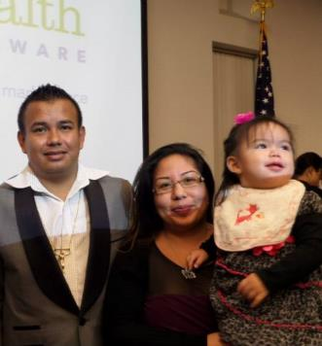
Delaware’s Health Care Innovation Work
34,000: Delawareans who have gained access to care through the Marketplace and Medicaid expansion since 2014.
84%: Delawareans eligible for tax subsidies on the Health Insurance Marketplace.
$35 million: Amount of federal grant Delaware received to change the way health care is delivered and paid for.
Notes:
In July 2013, Gov. Markell expanded eligibility for Medicaid up to 138 percent of the Federal Poverty Level beginning Jan. 1, 2014. Through October 2015, 9,101 Delaware adults were eligible for coverage through the expansion.
And to address health care costs - Beginning in 2013, more than 100 stakeholders, including those representing hospitals, providers, insurers, educational institutions, patients, and government, came together to develop Delaware’s health innovation plan.
Based on that plan, Delaware was awarded a four-year, $35 million grant from the Centers for Medicare and Medicaid Innovation (CMMI) to transform the state’s health care delivery system by using a total investment of $130 million over four years.
In 2015, the Delaware Center for Health Innovation (DCHI), a not-for-profit organization, was created to carry out the innovation work. The DCHI Board created six committees: Clinical, Workforce and Education, Payment, Health Information Technology, Healthy Neighborhoods, and Patient/Consumer Advisory. Two multi-payer, value-based payment models will be offered statewide: Pay-4-Value and Total Cost of Care.
Delaware’s goals by 2018 are to become one of the five healthiest states in the U.S.; to achieve top performance for quality and patient experience; and to bring health care spending growth more closely in line with the growth of the economy.

Slide 27
Delaware’s Health Care Innovation Work
34,000: Delawareans who have gained access to care through the Marketplace and Medicaid expansion since 2014.
84%: Delawareans eligible for tax subsidies on the Health Insurance Marketplace.
$35 million: Amount of federal grant Delaware received to change the way health care is delivered and paid for.
Notes:
WHAT IT MEANS TO DELAWAREANS
Felipe Hernandez, a 26-year-old machine operator from Wilmington, did not have insurance coverage like his wife and daughter did. Relatives told him about the Health Insurance Marketplace and he enrolled for coverage beginning in 2014 and re-enrolled for 2015. Hernandez, who pays a monthly premium of about $73, said he is now more hopeful about the future for him and his family.
BY THE NUMBERS
34,000: Number of Delawareans who have gained access to care through the Marketplace and Medicaid expansion since 2014.
84%: Percentage of Delawareans eligible for tax subsidies on the Health Insurance Marketplace.
$35 million: Amount of federal grant Delaware received to change the way health care is delivered and paid for.
THEY SAID IT
“I’ve gone to the doctor for exams, blood work, and medications to prevent future illness. My health has improved a lot. I’m not going to go broke because I get sick.” ~ Felipe Hernandez, who bought private coverage on the Health Insurance Marketplace.

Slide 28
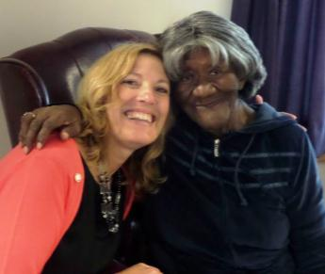
Moving Forward
Build Upon Our Successes:
  Affordable Care Act mandates
  US DOJ Settlement
  LTC Transition
DHSS Mission
Best Practices
Notes:
Moving forward, we will continue to focus our efforts on building upon these successes and ensuring that our services and our budget advance the DHSS mission.
Our fundamental sense of purpose must always be to:
facilitate and empower individuals and
communities to gain healthy outcomes, both in
physical wellness and emotional well being; to gain
economic self sufficiency, which will eliminate or
limit long term reliance on government, and to
protect and support those citizens most vulnerable
due to advanced age, disabilities, and produce
positive outcomes for the individuals we serve
Therefore, our primary focus, through our intervention shall be inclusive and responsive to best practices and continue to evaluate and re-engineer for enhanced performance.

Slide 29
Moving Forward
Urgent Issues
  Addictions Services
We know that untreated, or poorly treated, substance use disorders cause suffering, illness, loss of human potential, damaged families, weakened communities, and extraordinary costs to the state and the nation at a higher rate than other serious illnesses.
  U.S. COSTS
  Cancer (15% tobacco) $128B
  Diabetes $245B
  Heart Disease & Stroke
(30% tobacco and drugs) $444B
  Substance Abuse $559B
Notes:
At the same time that reforms continue in our mental health system, we will continue to reform our substance usage treatment system to build a system in which care is coordinated across the spectrum and when individuals relapse, services are intensified, not ended. The work we are doing in DHSS is being coordinated with the Department of Correction, the Children’s Department, the Department of Education, the courts, law enforcement, school nurses, providers, insurers (both Medicaid and commercial), families, advocates, consumers, physicians and the Prescription Drug Action Committee (PDAC). With suspected overdose deaths climbing to 16 deaths per month and demand for treatment services far outstripping what our Division of Substance Abuse and Mental Health can offer, we will work to add and reform our services as the DHSS and State budgets allow.
In both FY 2015/2016, additional funds allowed us to open a new detox center in Harrington, to create additional 23-hour assessment and observation services, to double the number of slots for coordinated care management, and to increase capacity in out patient, young adult treatment centers and sober-living. In FY 2017, I plan to seek budget increases that would further increase the State’s capacity to advance treatment and recovery services throughout our state. These new services, combined with what we have began in FY 2015, will continue to facilitate a solid foundation for our approach to address substance misuse going forward.
In addition to increased treatment, we will continue to increase awareness. It is a significant challenge to both expand services to meet the demand for services relative to the treatment of this disease, especially during this epidemic, while simultaneously reforming the system so that people can access the level of care they need at the time it is needed. We are committed and determined to address this issue and continue to work with our legislative branch and community stakeholders to combat this devastating disease.

Slide 30
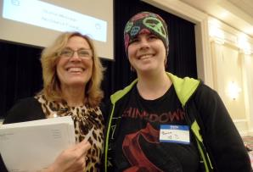
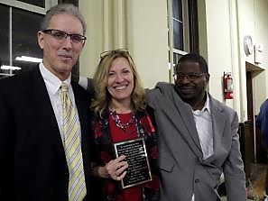
Continued Focus
Community-Based Services:
  DSAMH
  DDDS
  DSAAPD
Coalition of Caring
CDC/DHSS Work on Violence
Notes:
We continue to provide Community-Based Services as evidenced in the decreased reliance on facility based care and increases in the community based infrastructure. As you also heard we are leveraging our Medicaid dollars further to provide flexible supports and services that will enhance the employability of individuals with disabilities, provide care coordination, that increases the seamlessness of services and financial coaching to name a few. As you will see later in my presentation, we are requesting funds to continue our efforts in promoting community based services, supports and options throughout the Department.
Successfully meet the requirements of our 5 year strategic plan for individuals with serious and persistent mental illness as identified within the USDOJ Settlement Agreement.
Increase the availability of housing vouchers – that bridge the financial gap relative to the affordability of housing for individuals in poverty and fixed incomes.
Expand family support services to family caregivers of children and adult children with developmental disabilities.
Expand Community-Based Services overall.
We are also continuing our work with the Coalition of Caring, a newly formed coalition, to focus on the need to support homeless Delawareans, with an initial pilot in the City of Wilmington. The focus will be an integrated approach to service delivery access inclusive of access to existing services that meet individualized needs and enhanced services both of a crisis nature and those that would promote longer term healthier outcomes.
In addition we will look to build upon the recent work of the Centers for Disease Control and Prevention (CDC) regarding gun violence. Using almost fifteen years of arrest records as well as administrative medical, child welfare, criminal, employment and educational records , the CDC found that individuals most at risk for violence can be identified based on a history of adverse life events including sexual and physical abuse, family history of addiction, lack of education or employment, child welfare interventions and poverty.
If we apply a public health approach to the data, we may be able to identify individuals at the highest risk for gun violence and intervene early in their lives with comprehensive, integrated services and supports. Because this predictive analysis concept is so new, it will require a multi-faceted approach across government entities and other institutions; a comprehensive legal analysis of data-sharing issues; and a coordinated strategy going forward.

Slide 31
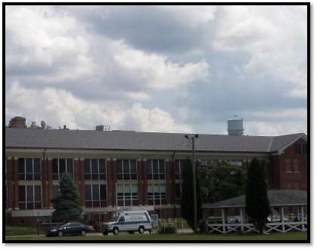
Continued Focus
Staff and Client Security
Continued Efficiencies
Physical Plant
Notes:
Staff and client security issues - these past years we have an enhanced awareness relative to the safety and security of both our personnel and those who visit with us. This year we experienced incidents which required heightened awareness and law enforcement engagement. I am extremely grateful to DHSS personnel who continue to work to de-escalate unruly behaviors and who also immediately advance safety protocols for increased safety during crisis. Our budget request does identify some immediate needs in order to make our environment a safer one.
After over 3 years of planning, earlier this month we successfully launched our computer upgrades including the Eligibility Modernization suite of systems that:
Modernizes our IT systems to continue to improve service delivery;
Provides technology to help accurately and timely deliver benefits
Uses 90/10 enhanced Medicaid funding to reduce the cost to the State while improving the IT Functions;
Provides continuity for existing benefit programs and policy rules;
Provides enhanced security controls to protect client information; and
Improves navigation capabilities and workflow in the system for workers and providers.
This is a large complex project with over 200 moving parts across 30 organizations but we believe we are well positioned after over 3 years of preparation and testing. This is 3rd in a series of 4 upgrades, the last of which is scheduled for the summer of 2016.
Staffing efficiencies - we continue to look to redeploy our vacant positions, especially from institutions. In closing Emily Bissell we were able to redeploy the employees to other areas within our organization inclusive of Governor Bacon, DHCI and DPC which has resulted in limiting vacancies within those facilities, decreasing overtime and continuing to provide a high quality of care. Both Governor Bacon and recently DHCI have achieved the highest overall 5-star quality rating from the Centers of Medicare and Medicaid.
Physical Plant improvements are on-going and include: MCI (Minor Capital Improvements); M&R (Maintenance and Restoration); roofs; HVAC; and electrical systems, as well as continued adaptive reuse efforts to use existing space efficiently and effectively.

Slide 32
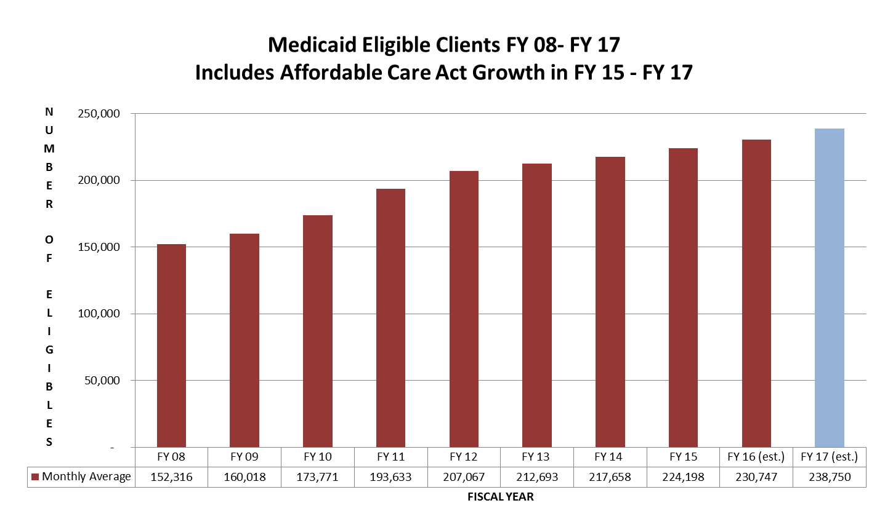
Medicaid Growth
Notes:
When the Markell administration took office, there were about 160,000 Delawareans receiving Medicaid benefits and 85,000 receiving food benefits. The economic impact of the Great Recession impacted thousands of individuals and families who were accustomed to helping others, not being the ones in need of support. Today, while the growth of enrollment has slowed, the projected numbers for FY 16 remain high: approximately 231,000 enrolled in Medicaid; 143,000 receiving food benefits.
DHSS is keeping its commitment to people in need to provide a strong safety net. But we have also been concentrating on extending supports to prevent individuals from slipping into poverty whenever possible, as well as, assisting individuals with advancing out of poverty. As, we shifted from the Fee for Service to Managed Care for Long Term Support Services, we are advancing more individualized services which enables individuals to remain in least restrictive environments, not having to advance to a higher level of care due to limited community options.
We also changed formulary and pharmacy payment methodology, expanded program integrity services, implemented a nursing home provider tax which leveraged additional federal dollars, and through the implementation of the State Health Innovation Model which is inclusive of Medicaid Managed Care Organizations, we expect payment for value models will produce healthier outcomes for our citizens, by earlier interventions of care and managing health more directly with our consumers, while reducing the cost.

Slide 33
Notes:
The presentation thus far as been geared towards establishing the framework for the emerging issues and focus of the Department.
I now would like to review our current FY 16 budget and the allocations of these resources across our programs. As you can see by this pie chart, Medicaid is 61% of the overall DHSS budget, Personnel represents 18%, and all other programs within the Department represent 21%. Now, let us share with you our FY 17 budget request.
As noted on this chart Medicaid represents more then 60% of DHSS’s budget distribution, it is important to recognize that as a state/federal benefit – this chart represents the state general fund budgeted amount which is matched by federal funds. It is also important to recognize that the state has been leveraging these federal dollars to support those with disabilities inclusive of those with behavioral health conditions to advance supports within community based settings. By leveraging state dollars with federal dollars we are able to support more individuals in need who meet the eligibility criteria for Medicaid.

Slide 34
Budget Process
(in thousands)
FY 16 GF Budget $1,118,804.1
Requested New Dollars $ 37,828.5
  FY 17 Door Openers
  Resources needed for increased
  volume, annualizations
FY 17 Total GF Request $1,156,632.6
[3.3% Increase over FY 16]
Notes:
Our current General Fund (GF) budget is over $1.1 billion.
The requested operating budget for FY 17 includes $37.8 million in new dollars, which represents a 3.3% increase over FY 16. The FY 17 Total General Fund request is $1.156 billion dollars. The following slides will provide greater insight into our request.

Slide 35
FY 17 GF Budget Request - $1,156,632.6
Door Openers
DMMA – Medicaid $13,436.4
Notes:
Our FY 17 Budget request reflects the State’s economic realities. Our FY 17 request is $37.8 million, of which $13.4 million is for Medicaid. Growth in the State Medicaid budget is influenced by several factors. – volume, utilization and rate increases. As noted earlier, there are approximately 231,000 people on Medicaid.
Volume: Although the rate of growth is stabilizing, the average monthly number of Medicaid eligibles continues to increase due to a slower economic recovery and the loss of employer sponsored coverage for adults and families.
Cost of Services: Cost of services is impacted by reimbursement rates (including MCO capitation rates which are how most Delaware Medicaid services are covered), the health of the enrolled population and Delaware demographics, changes in medical practice, as well as other factors. The Department continues to apply some provider rate freezes to fee-for-service claims that were implemented in April of 2009. [Nursing Facility rates were increased through revenue generated by an industry-wide provider fee, and primary care physician rates were increased to 100% of Medicare using federal funds.] As indicated previously, we continue to explore alternative strategies to contain costs through improved care coordination, value-based purchasing, and enhanced program integrity initiatives. This is why the transformation work that I mentioned previously is so very critical.
The growth in the state share is offset by increased federal matching on some adult eligibility groups due to Delaware’s eligibility as an early expansion state under provisions of the ACA. The state is receiving a decrease in the regular FMAP calculation applied to non-expansion eligibility groups. Also increases in Medicare cost-sharing resulting from the lack of COLA increase in January 2016 added cost to Medicaid.

Slide 36
FY 17 GF Budget Request - $1,156,632.6
Door Openers
DMS – Birth to Three Program $ 392.0
DMMA – DMES Maintenance & Operations $ 4,336.3
DSAMH – USDOJ Housing Vouchers $ 250.0
DSAMH – FYF for Substance User Disorder $ 815.0
DSS – General Assistance $ 539.2
Notes:
Our FY 17 Budget request includes approximately $19.1 million for Door Openers in these categories:
$392.0 for the Birth to Three Program for continued growth;
$4,336.3 for Delaware Medicaid Enterprise System to support contractual Maintenance and Operations;
$250.0 for Housing Vouchers to comply with the US DOJ Settlement;
$815.0 for Full Year Funding (FYF) for FY 16 Substance Use Disorder funding that was initiated in FY 16 for Residential Treatment, Young Adult Opiate Residential Treatment, and Sober Living programs; and
$539.2 for General Assistance inflation and volume.

Slide 37
FY 17 GF Budget Request - $1,156,632.6
Door Openers (Cont’d)
DSS – FYF DEMS Maintenance & Ops $1,976.2
DDDS – FY 16 Placements (FYF) $2,087.3
DDDS – New Community Placements/
Special School Grads $2,872.4
DHSS – Lease Escalators $ 160.7
DHSS – FY 16 Salary Policy Contingency $5,717.0
Notes:
For FY 17 Door Openers, the Department is also requesting:
$1,976.2 for Full Year Funding (FYF) for the Delaware Eligibility Modernization System to support contractual Maintenance and Operations;
$2,087.3 for FYF for FY 16 DDDS Placements;
$2,872.4 in DDDS’ budget to support 75 new Community Residential Placements and 162 new Special School Graduates entering the adult service system;
$160.7 for DHSS Lease Escalators; and
$5,717.0 for FY 16 DHSS Salary Policy Contingency.

Slide 38
FY 17 GF Budget Request - $1,156,632.6
Inflation/Volume
  DHSS Network and License
  Charges (DMS) $783.7
Notes:
Inflation/Volume
Our FY 17 Budget request also includes approximately $783.7 for inflation and volume adjustments, which is requested for DHSS IT Network and Licensing Charges to support department-wide computer applications.

Slide 39
FY 17 GF Budget Request - $1,156,632.6
Enhancements
  DMS – PC Replacement $1,072.9
  HCC – State Loan Repayment $ 211.7
  DMMA – Program Enhancements $2,265.9
  DPH – Public Health Program Expansion $ 826.5
  DSAMH – Substance Use Disorder Programs $2,075.0
Notes:
Enhancements
Our FY 17 Budget request also includes approximately $8.6 million for enhancements:
$1,072.9 is requested for the Division of Management Services to establish a computer replacement program.
$211.7 is requested for the Delaware Health Care Commission to leverage additional federal funds for the State Loan Repayment Program.
$2,265.9 is requested for the Division of Medicaid and Medical Assistance to increase the personal needs allowance, change the bed hold day policy for ICF/IDD facilities, and establish an adult dental benefit (6 mos.).
$826.5 is requested for the Division of Public Health to expand the Needle Exchange Program, establish the Delaware Community Cooperative/Healthy Lifestyles program, and enhance the use of information technology through electronic medical records.
$2,075.0 is requested for the Division of Substance Abuse and Mental Health’s Substance Use Disorder programs. The following programs are part of the redesign for the substance abuse treatment programs:
$975.0 to establish a Substance Use Disorder Assertive Community Treatment (ACT) Team; and
$1,100.0 to establish a Substance Use Disorder Day Program.

Slide 40
FY 17 GF Budget Request - $1,156,632.6
  Enhancements
  DSS – Client Services/Program Enhancements $1,015.8
  DVI – Educational Resources & Assistive Tech $ 63.9
  DCSE – Fatherhood and Paternity Initiatives $ 78.3
  DDDS – Family Support Services & Case Managers $ 830.1
  DSSC – Shelter Programs & Volunteer 50+ $ 205.8
Notes:
$1,015.8 is requested for the Division of Social Services to increase the General Assistance benefit; conduct a case review of General Assistance client needs; and enhance the customer experience through additional call centers and customer feedback initiatives.
$63.9 is requested to enhance educational resources and assistive technology within the Division for the Visually Impaired.
$78.3 is requested for the Division of Child Support Enforcement to enhance paternity outreach efforts.
$830.1 is requested to provide additional Family Support Services and add three additional residential case managers to meet caseload ratios in the Division for Developmental Disabilities Services.
$205.8 is requested for the Division of State Service Centers to support Emergency and Transitional Housing Program to provide shelter services.

Slide 41
FY 17 GF Budget Request - $1,156,632.6
One-Time
Substance Use Disorder Programs (DSAMH) $194.0
Department wide Security Initiatives (DMS) $764.7
E-signature for telephone applications (DSS) $ 41.4
Establish additional DSS Call Centers (DSS) $ 32.8
DSS Customer Feedback Redesign (DSS) $370.0
Adult Dental Benefit (DMMA) $264.0
Notes:
One-Time
Our FY 17 Budget request also includes approximately $1.6 million for one-time items related to:
$194.0 is requested to fund the start-up costs for the following Substance Use Disorder programs:
$94.0 for the Substance Use Disorder ACT team to fund the initial program costs; and
$100.0 for start-up costs associated with the Substance Use Disorder Day program.
$764.7 is requested for Department-wide security upgrades.
$41.4 is requested to establish a signature process to accept DSS client applications over the telephone.
$32.8 is requested as part of an initiative to establish additional DSS Call Centers.
$370.0 is requested as part of an the DSS Customer Feedback Redesign initiative.
$264.0 is requested for start-up costs associated with implementing an adult dental benefit.

Slide 42
FY 17 GF Budget Request - $1,156,632.6
Appropriated Special Funds
Office of Animal Welfare (DPH) $500.0 ASF
Medicaid (DMMA) $4,400.0 ASF
Notes:
Appropriated Special Funds
The FY 17 Budget request also includes requests to increase the authority for our Appropriated Special Funds. These requests include:
$500.0 ASF for the Office of Animal Welfare in the Division of Public Health to annualize animal welfare program operations.
$4,400.0 ASF for Medicaid which reflects projected revenue and expenditures.

Slide 43
FY 17 GF Budget Request - $1,156,632.6
Base Reductions
Closure of Emily P. Bissell Hospital ($2,823.0)
(17.8) FTEs
DSAAPD Contractual Services ($1,400.0)
Delaware Healthy Children Program ($1,462.2)
Notes:
Our FY 17 Budget request also includes several reductions:
$2,823.0 and 17.8 FTEs to reflect the closure of Emily P. Bissell Hospital. The remaining dollars and positions have been reallocated to other divisions within the Department to address workforce needs. This closure has been achieved without any layoffs.
$1,400.0 in Contractual Services from the Division for Services for Aging and Adults with Physical Disabilities to reflect a reduction in institutional needs.
$1,462.2 in the Delaware Healthy Children Program. This reduction is a result of significant increase in the federal matching funds available for the program and can be achieved without any reduction of services or clients.

Slide 44
FY 17 Capital Budget Request
Project Name
Maintenance & Restoration $4,750.0
Minor Capital Improvements $6,000.0
Roof Repair/Replacement $1,000.0
Holloway Campus Electrical System
Replacement $3,460.0
Delaware Medicaid Enterprise System $3,640.0
Notes:
Our FY 17 Capital Budget Request reflects the most urgent capital needs of the Department. They include:
Maintenance & Restoration ($4.75 million) - This is our number one priority. These funds are needed to help maintain the standards necessary for state and federal licensure and to eliminate the need to rely solely on Minor Capital Improvement and Equipment (MCI) funding for unexpected maintenance and repairs. This funding is used to maintain 133 buildings at current conditions and provides for the repair of life/safety systems, emergency and other critical building components and additional unanticipated needs.
Minor Capital Improvement & Equipment ($6.0 million) - These funds prevent further deterioration of buildings and grounds and allow us to continue to stabilize the Department’s backlog of deferred maintenance.
Roof Replacement ($1.0 million) - These funds are needed to continue to repair or replace aging roofs within the Department.
Holloway Campus Electrical System Replacement ($3.5 million) – These funds are requested to begin the replacement of the electrical distribution system at the Herman Holloway Campus.
Delaware Medicaid Enterprise System ($3.6 million) – As noted earlier, DHSS has been making significant improvements to its Management Information Systems. Funding is requested for the replacement of the Medicaid Management Information System.

Slide 45
FY 17 Capital Budget Request (cont’d)
Drinking Water State Revolving Loan Program $ 1,770.0
Critical Equipment Replacement
Program $ 150.0
Notes:
We have some additional capital priorities. These include:
Drinking Water State Revolving Fund ($1.77 million) - This request represents the required 20% state match for $8.5 million in federal funding, in order to provide low interest loans for improving drinking water systems.
Critical Equipment Replacement Program ($150.0) - Funding is requested to replace critical equipment for daily operations including the common area furniture for State Service Centers and Facility Operations equipment.

Slide 46
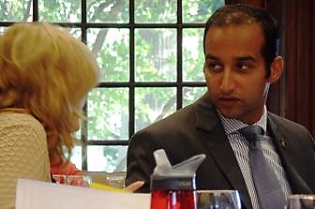

Important Partnerships
CROSS CABINET INITIATIVES
  Delaware State Housing Authority - SRAP
  Early Childhood Education
  I-ADAPT - Individual Assessment and Discharge Planning Teams
  Health Care Transformation
  Behavioral Health - Education and Prevention - Treatment and Recovery
COMMUNITY PARTNERS
Notes:
The Department could not begin to meet the needs of Delawareans or arrive at effective public policy initiatives without the support of our multitude of partners within the Cabinet and those from our community. We are fortunate to have experts in the industry that provide hours of support and expertise to our task forces, advisory councils and consortiums. We rely on the countless number of volunteers and hours dedicated to providing direct service to those in need, who are facilitating better outcomes and ensuring basic needs are being met.
In order for DHSS to serve our clientele and lead them to enhanced self-sufficiency and better health outcomes, we continue to partner with community service providers. In fact, DHSS has over 1,538 contracts worth hundreds of millions of dollars. The success of our mission is dependent upon the engagement of many community organizations dedicated to a common purpose.
As mentioned throughout the presentation, we will continue to align our limited resources to the strategic focus of the Department and leverage the resources as best as possible. We need to engage all our partners in the roll out and cascade our focus throughout the organization in order to effectively execute and advance during these times of transition. The state cannot achieve this goal without the support and collaboration of all, our customers; our providers; our community developers; our education system; our health care system; our funders; our legislators; our advocates; and our workforce.

Slide 47
“Do all the good you can. By all the means you can. In all the ways you can. In all the places you can. At all the times you can. To all the people you can. As long as ever you can.”
~ John Wesley
Notes:
As we approach the final year of the Markell Administration, I plan to push ahead hard, knowing that much can be accomplished in this final year. I, along with the people of DHSS share a strong commitment and determination to fulfill and advance our mission. With the Governor, I have set the Department’s priorities, and we will make every day count to improve the quality of life for Delaware’s residents by promoting health and well-being, fostering self-sufficiency, and protecting vulnerable populations.
Thank you for the opportunity to share with you the accomplishments, challenges and opportunities facing the Department of Health and Social Services. We look forward to the year ahead, and collectively working towards brighter tomorrows. We invite you to share your thoughts, recommendations and concerns with us as we move forward.
I and members of my team will be happy to answer any questions.

