Slide 1
Project Overview

Slide 2
Personal Commitment
Dave Blaeuer – FSO Executive Director
born and raised in Kent County, resides in Smyrna
history of family involvement in health care
catalyst for FSO into Kent County in 2010 and the continued expansion
responsible for oversight of the entire project
personally committed to advancing quality of health care and life in Kent County
Jeff Lord – FSO Director of Operations
born and raised in Kent County, resides in Dover
history of family involvement in health care
personal involvement in health care with Dr. Tooze and Dr. Manifold
responsible for the construction and operations of the new facility
personally committed to advancing quality of health care and life in Kent County
Ray Krett Jr – FSO Administrator/Director of Nursing, Surgical Services
born at Dover AFB and raised in Delaware, resides in Bear
history of family involvement in health care
entire professional career in health care delivery, operations and management
responsible for design, construction and operations of the new surgery center
personally committed to advancing the quality of health care in Kent County
Robert MacLeish Sr – President Lighthouse Construction, LLC, MacLeish Group, LLC
raised in Kent County, resides in Dover
history of family involvement in health care
entire professional career in design, construction and building management
preferred Construction Management Group of FSO
responsible for design, planning and construction of the new facility
personally committed to advancing the quality of health care and life in Kent County

Slide 3
Project Objectives
- expand outpatient surgery services in our service area
- provide cost effective outpatient surgery options in our service area
- provide patient care with high patient satisfaction and patient outcomes
- provide increased access to CHIP and Charity Care programs
- provide student training experiences in outpatient surgical services
- provide additional patient care offices/facilities for our expanding practice
- provide the ability to expand outpatient surgery to include 23 hour recovery

Slide 4
Education Benefits
One of the surgery center's priorities is to create a teaching environment in partnership with local higher educational institutions. Nursing, CRNA and PA students, Surgical Technicians, and other allied health personnel will be able to learn proper techniques and decision-making skills through an interactive environment.
FSO would expand our already successful Student Training and Volunteer Observation Programs into Kent and Sussex County.
Student Training Program - our Physicians are members of the faculty for Arcadia and the University of Delaware. FSO maintains training agreements with Arcadia (PA Program), ATI Physical Therapy (PT) and the University of Delaware (Nursing and PT Students).
Volunteer Observation Program – provide observation experiences for those that are interested in pursuing a career in nursing or medicine as well as those that require volunteer hours for Service Organizations or college applications.
With reported shortages of health care providers and lack of clinical sites, access to student training experiences in the outpatient surgical setting would assist in decreasing the waiting period to obtain clinical assignments for students and increase the number of providers.

Slide 5
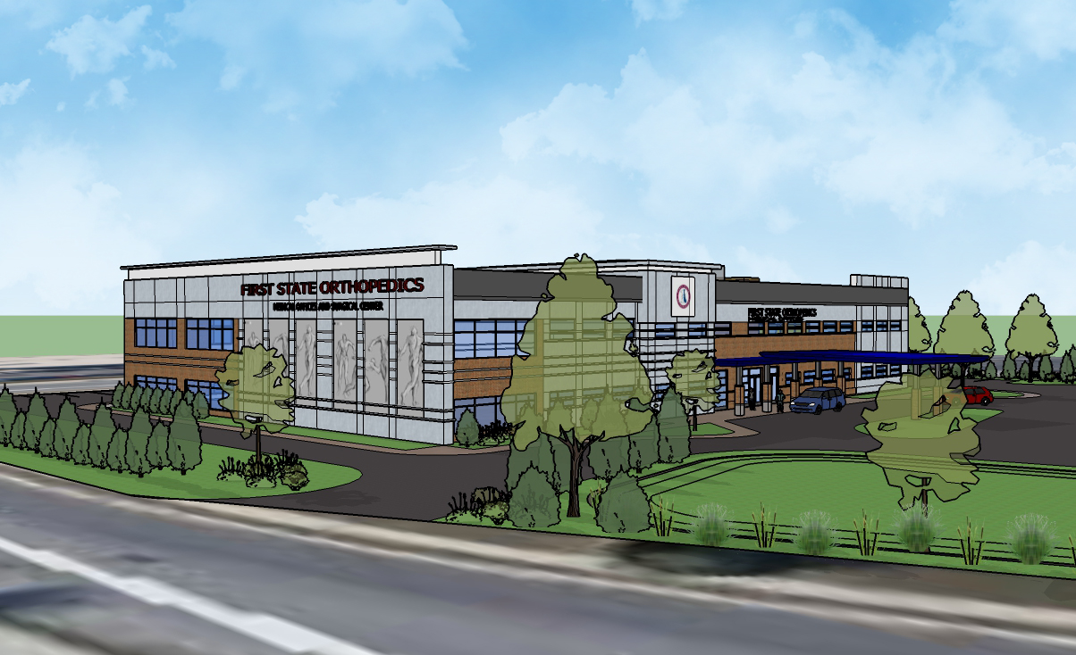
First State Orthopaedics

Slide 6
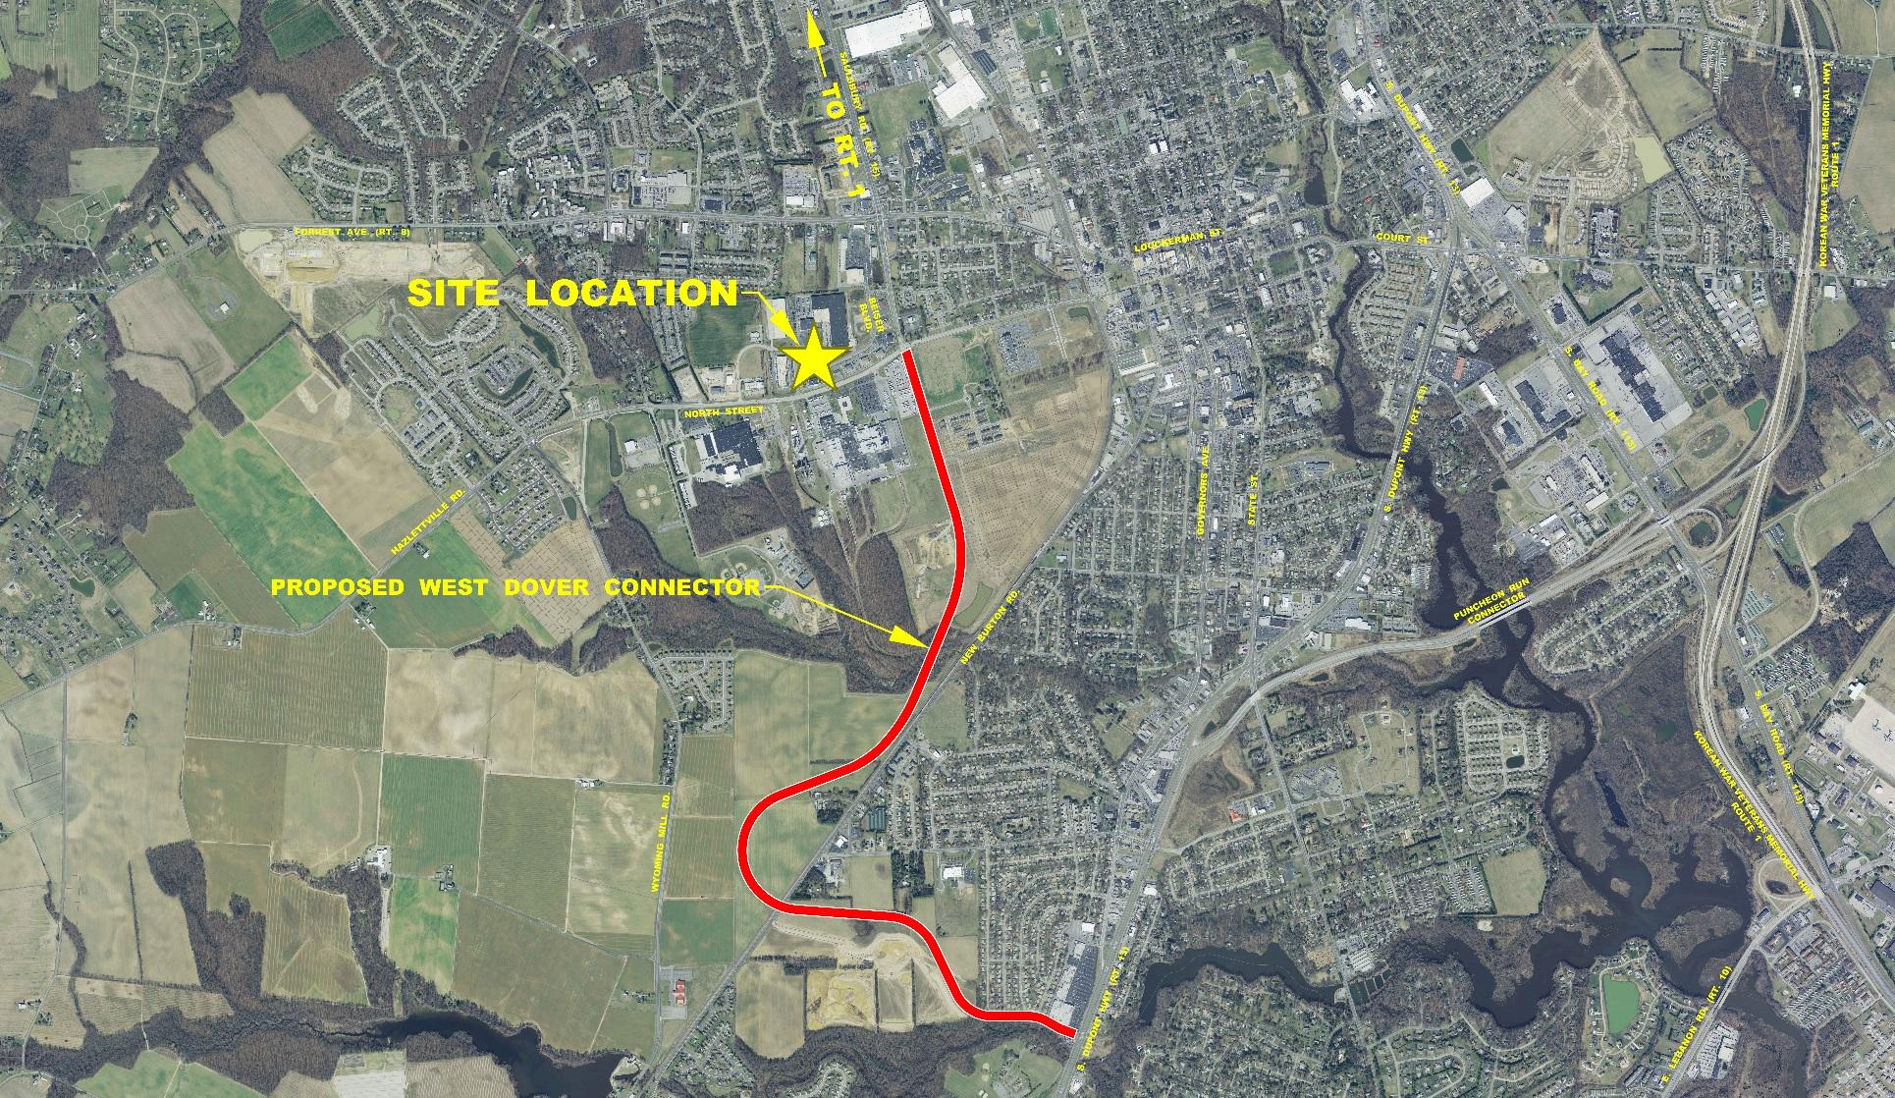
Location Plan

Slide 7
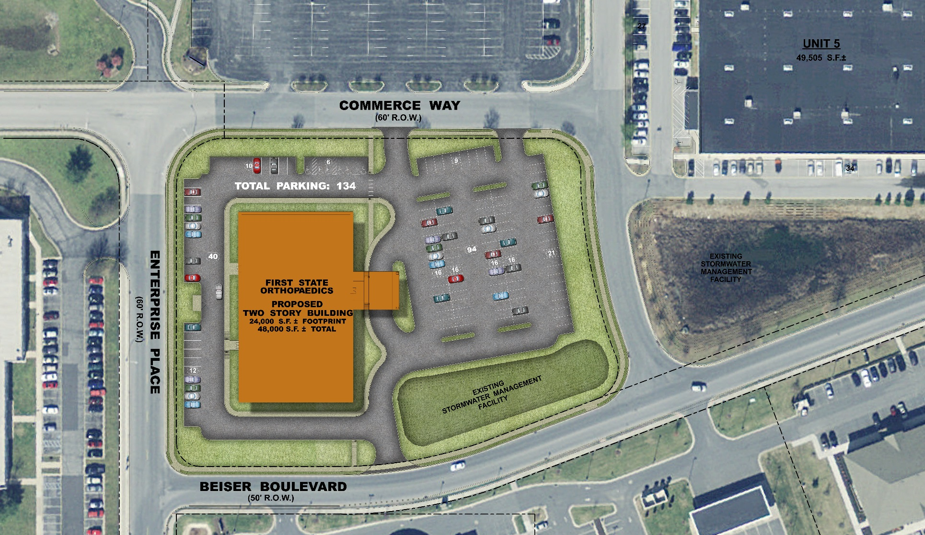
Site Plan

Slide 8
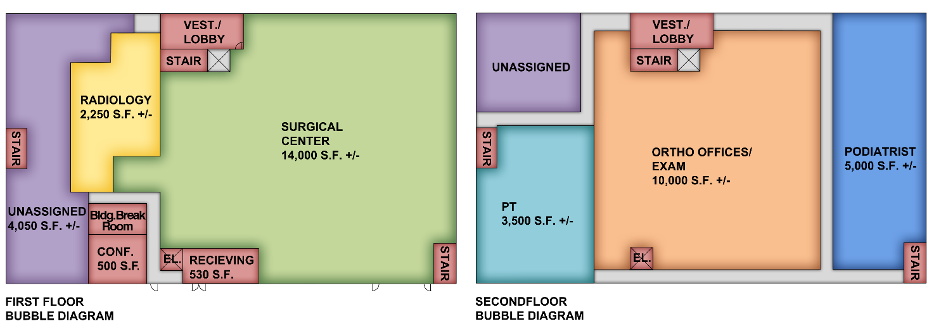
Concept Bubble Diagram

Slide 9
Project Overview
Medical Arts Building
- 48,000 Square Feet Two stories State of the Art Class A Medical Office Space
- Steel Construction with Masonry Brick and Metal Wall Panel Exterior
- Multidisciplinary Groups of Healthcare Providers within Building
- Fully ADA Accessible
- Covered Patient drop-off and pick up
- Easy access to major arteries Rt. 1, 13, 113 and downtown Dover
- Public Transportation at site, close proximity to restaurants, retail shops
- Located at Enterprise Business Park

Slide 10
Surgery Center Overview
The Surgery Center would be part of a multidisciplinary musculoskeletal medical office center to meet the needs of Dover and Greater Kent County community. The Surgery Center will be one of the occupants offering an exceptional range of surgical and medical services for its patients at one location making this a key benefit in health and well-being. Our staff will work with the other medical providers to fully understand and treat injuries and disorders, create a treatment program, with a range of options, for each individual patient.
Initially, the surgery center would employ a staff of 15, at a minimum, in various positions and expand our staff as our cases increased. These would be high paying positions with the ability for advancement and longevity. At full staffing, approximately 50 medical and support positions would provide care at the surgery center.
Over Three Million dollars would be invested into the design, construction and medical equipment required for the new Surgery Center, employing an additional 100 plus design professionals and local construction workers to complete the project.
At the present time there are no 23-Hour facilities in Kent County or the State of Delaware. The Surgery Center in Newark has applied to become one of the first in Delaware to operate as 23-Hour. The proposed Surgery Center will be designed as a 23-hour facility with two operating rooms and two procedure rooms to start. This will allow for expanded surgical procedures and overnight recovery options. As part of our future planning, there would be an additional two operating rooms opened as our demand increased.

Slide 11
Surgery Center Overview
Currently nine of our physicians are providing patient care in offices located in Smyrna, Dover and Milford. We are actively recruiting three additional physicians for the Kent County offices and expect them to be in place in 2015. These physicians would have office hours and perform their outpatient cases at the surgery center.
The Surgery Center would allow our patients minimal disruptions in their lives when and if a procedure may be required by having access to obtain surgery close to home. Issues such as travel distance, travel time, fuel costs, and access to public and private transportation become less of a factor when medical care is available within the community. Removing these issues allows the patient and their families to focus on their recovery.
Patients requiring surgery from our Kent County offices are currently scheduled at the Newark surgery center. Since January 2013, over 1000 patients from Kent County have traveled to New Castle County for their surgery. There was an almost 50% increase in patients from Kent County scheduled at the Newark Surgery Center this past year.
With the population of Kent County projected to continue to increase and the largest age group being 20-65, the number requiring surgery is anticipated to increase. These patients would be able to stay in Kent County.
The surgery center would provide the residents of Kent County and the surrounding communities with the ability to obtain cost effective, quality, outpatient surgery closer to their home, increasing their satisfaction and their surgical outcomes.

Slide 12
Surgery Center Benefits
We bring a history of high quality Orthopaedic surgery to Kent County and surrounding communities, a history of high patient satisfaction and outcomes, a history of providing Charity Care to those less fortunate.
The statistics show more patients are having outpatient surgery, outpatient surgery decreases cost to insurance companies in lower costs/lower charges, outpatient surgery decreases cost to patients in lower co-pays and deductibles and out of pocket expenses.
We are applying as a 23 hour facility, saving 25-35% of cost of hospital based surgery centers and increasing the type of surgeries performed in outpatient surgery centers to include total joint replacement and spine surgery.
The center is being designed as a Training Facility to provide hands-on training for PA, Allied Health and Nursing students.
Good for Kent County – approximately 50 positions with good wages, advancement and longevity; utilizing local vendors; increase in the local economy; keeping outpatient surgery in Kent County, now going to New Castle County.
Good For Patients – less expensive, less travel, closer to home, recruitment of physicians, high quality care.
Our surgery center model has a proven track record, 14 years, over 60,000 surgeries, it works because we focus on what we do best – Orthopaedics & Musculoskeletal.
By utilizing same equipment/trays, less inventory, bulk purchases, able to negotiate lower implant and supply costs, allows for increasing efficiency and productivity which allows for lower costs.
We keep number of physician owners manageable; better understanding and decision making; stay focused on goals, standards of care and patient outcomes.
We have highly motivated long term staff, consistent and supportive management structure, forward thinking administration.
Surgery Center Model = increased efficiency and productivity with high quality patient care, outcomes and satisfaction.

Slide 13
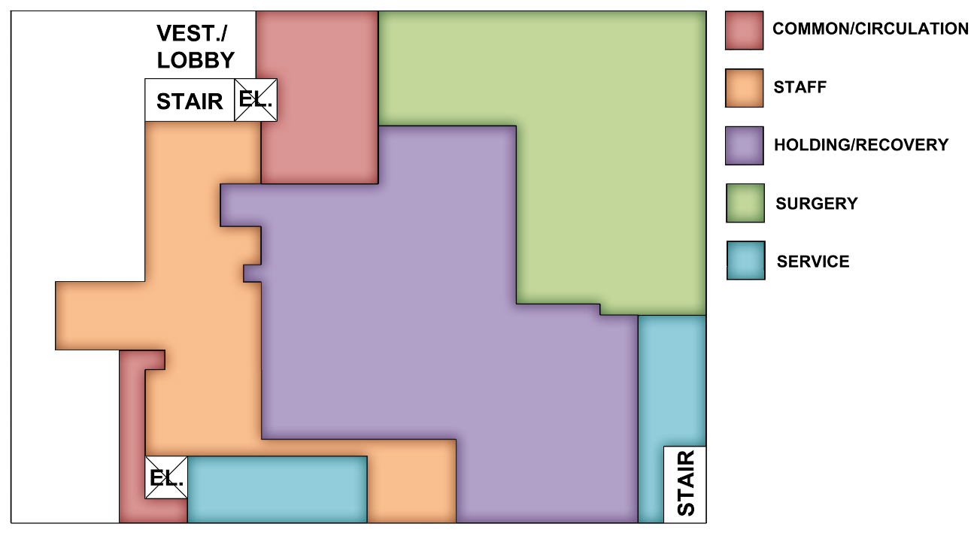
Surgery Center – Enlarged Plan

Slide 14
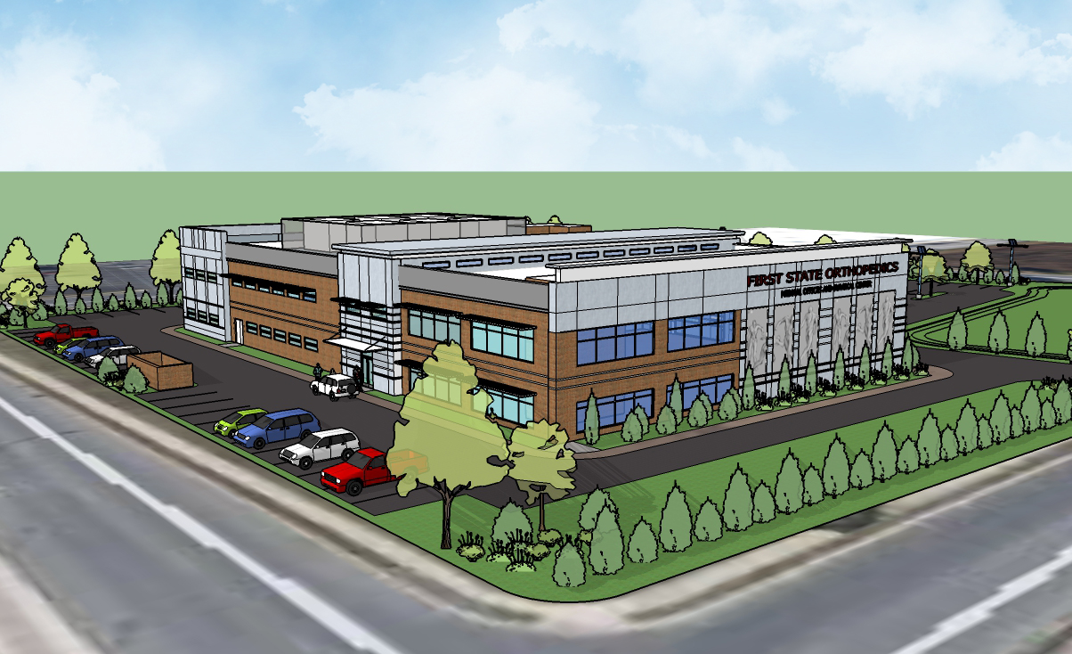
First State Orthopaedics

Slide 15
About First State Orthopaedics
First State Orthopaedics (FSO), the largest Orthopaedic Physician Practice in Delaware, has been providing care to the residents of Delaware and surrounding communities for over 20 years. FSO Physicians are well known in the community as well as in local and national organizations.
We are proud of the fact that many of us have been with First State Orthopaedics for more than 20 years. We are proud that we continue to attract highly trained and qualified physicians to our practice. We are proud that the physicians and staff at First State Orthopaedics have become an integral part of the community in which we live.
Seventeen of us are trained in orthopaedic surgery; three are trained in pain management and rehabilitation and one in non-operative sports medicine. With our thirteen Nurse Practitioners
and Physician Assistants, there are 36 medical professionals available to provide patient care.
In 2010 we established our first Orthopaedic Office in Dover, and in 2014, Steven Tooze M.D. and Stephen G. Manifold M.D. joined to expand our Dover office and coverage of Kent County. We have completed the expansion of an office in Smyrna DE that will open in April of 2015.
All together, there are 12 First State Orthopaedics locations providing patient care .

Slide 16
About First State Orthopaedics
At First State Orthopaedics , we are uniquely qualified to offer you the best in advanced orthopaedic care. Trained at the world's most renowned medical institutions, our physicians have completed advanced training to insure that the patients of First State Orthopaedics receive the best orthopaedic care available.
Our surgeons are well-published in medical literature and have gained national recognition for their work. In addition, they serve on the teaching staff of both Christiana Care and the University of Delaware. As physician-professors, they train the students of today to become the healers of tomorrow.
Our physicians have established themselves in both their orthopaedic and local communities. They are active leaders in hospital, state, and national medical societies and serve on the boards of local organizations. We realize the importance of being a part of and giving back to our community and have made a commitment to many local, national, and international charitable causes.
At First State Orthopaedics, we take great pride in providing a full range of operative and non-operative treatment for arthritis, fractures, and overuse injuries. Our areas of expertise include Sports Medicine, Trauma, Shoulder, Hand & Elbow, Hip & Knee, Foot & Ankle, Spine, Pain Management & Rehabilitative Medicine, and General Orthopaedics & Fracture Care.

Slide 17
Mission Statement
Our size and experience set us apart, but it is our devotion to treating each patient as a unique individual, providing personal, life-enhancing care that makes First State Orthopaedics the premier orthopaedic practice in the region.
Our surgeons and professional staff at First State Orthopaedics have earned the trust of countless patients, and we are ready to help you, too. Our goal is to diagnose and treat orthopaedic conditions so that our patients can return to the activities they love.
FSO has highly trained physicians, that have a desire to heal by providing state of the art care.
Our commitment to excellence makes you our first priority.

Slide 18
Guiding Principles of CPR Board
- Financial viability
- Increase in availability and access
- Quality of care, efficiency, appropriateness & adequacy of service intended to be provided in the service area

Slide 19
We at First State Orthopaedics have made a commitment to Kent County.
Highly Trained Physicians
State of the Art Care
A Desire to Heal
Thank you for your time!

