Slide 1
UPDATES: Marketplace Commissioner Trinidad Navarro, Department of Insurance

Slide 2
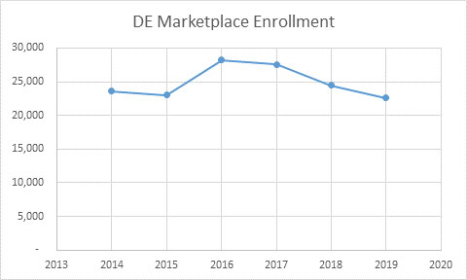
Marketplace Update

Slide 3
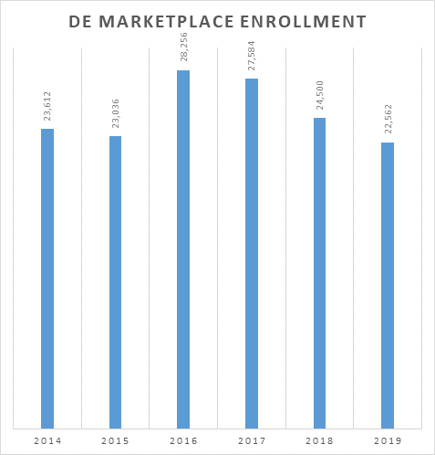
Marketplace Update

