Slide 1

Delaware’s Health Insurance Marketplace: Update on Activity
Delaware Health Care Commission
June 2, 2016
Secretary Rita Landgraf
Department of Health and Social Services

Slide 2
Agenda
National Updates
Plan Management
Proposed Rates for Plan Year 2017
Key Dates and Reminders
Questions/Comments

Slide 3
National Updates
3

Slide 4
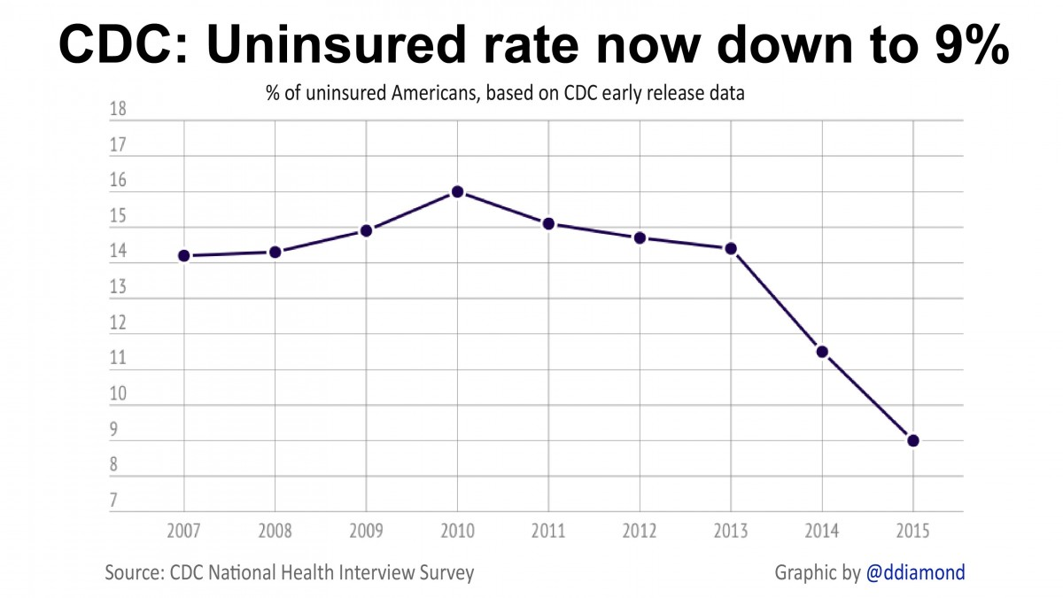
U.S. Uninsured Rate Continues to Fall
2015 rate of 9.1% was a 2.4-percentage-point drop from 2014.
Number of uninsured people in 2015 fell to 28.6 million nationwide, or 7.4 million fewer than in 2014. Total reduction since 2014: 16.2 million.

Slide 5

Delaware’s Uninsured Rate
Delaware Behavioral Risk Factor Surveillance System (adults age 18-64): 9.7% in 2015. In 2014, the rate was 10.8% and in 2013, 14.3%.
Gallup-Healthways Well Being Index (adults 18 and older): 7.4% in 2015. In 2014, the rate was 9.6% and in 2013, it was 10.5%.
CDC – National Health Interview Survey (ages 0-64): up to 7.7% in 2015 (CDC says not statistically significant); 5.4% in 2014, down from 10.7% in 2013.

Slide 6
Cost of Health Care
The 2016 Milliman Medical Index found that providing health care to the typical U.S. family of four will cost $25,826.
That was a 4.7% increase over the 2015 index and the smallest increase since the index began in 2001.
Prescription drugs represent nearly 17% of total health care spending in the U.S., with a typical family’s prescription drug costs increasing four-fold since 2001.
The Milliman Medical Index, which tracks only people who get health insurance through an employer, has more than tripled since its first year in 2001.
For the typical family of four, the cost breakdown for 2016: employer ($14,793); employee premium ($6,717); and employee out-of-pocket ($4,316).
6 3

Slide 7
ACA Lawsuit on Cost-Sharing
On May 12, a U.S. District Judge ruled that the Obama administration spent money on cost-sharing provisions of the Affordable Care Act that Congress never appropriated.
House Republicans challenged the administration’s spending through the Marketplaces to reduce deductibles, co-pays and coinsurance as unconstitutional.
Judge Rosemary Collyer stayed her decision pending an appeal.
It could take as long as 2 years for case to reach the Supreme Court.
43% of Delaware’s 28,256 enrollees receive cost-sharing reduction.

Slide 8
Changes at HealthCare.gov
CMS announced several changes on the federally facilitated marketplaces (FFMs) through HealthCare.gov:
  On auto-renewals, FFM will try to ensure that consumers who received cost-sharing reductions remain in silver level plans.
  If an insurer discontinues a silver plan, a consumer will be renewed into another silver plan in the most similar product line.
  Renewal and discontinuation notices will be shorter and will more clearly provide enrollees with direction on next steps.
  Quality ratings of health plans will not be available nationwide as originally envisioned. Ratings will be piloted in 5 states: Michigan, Ohio, Pennsylvania, Virginia and Wisconsin.
  FFM is encouraging new types of plans called “Simple Choice” plans with the same fixed deductible, out-of-pocket limits and co-pays for specified services within bronze, silver, gold and platinum levels.

Slide 9
Plan Management Updates
9

Slide 10
Update on Issuer Applications for Plan Year 2017 QHP Certification
The following issuers have submitted QHP Applications for participation in Plan Year 2017.
Similar to last year, several Issuers have submitted stand-alone dental plans for certification off-exchange in the small group market.
  Issuers include: Ameritas, Reliance, Companion, Standard and Met Life
The DOI continues to work with additional issuers to promote the Delaware market for the 2018 plan year.
Medical Issuers Aetna Health Aetna Life Highmark BCBSDE | SADP Issuers Delta Dental Dominion
10

Slide 11
Medical QHP Submissions for PY2017
Three medical plan issuers have submitted plans for certification and offer on the Delaware Marketplace:
  Highmark BlueCross BlueShield Delaware, Inc.
  Aetna Health, Inc.
  Aetna Life Insurance Company
Metal Level | Individual* 2017 | Individual** 2016 | SHOP 2017 | SHOP 2016
Bronze | 6 | 7 | 3 | 5
Silver | 9 | 8 | 4 | 5
Gold | 4 | 12 | 4 | 5
Platinum | 0 | 1 | 0 | 0
Catastrophic | 1 | 1 | 0 | 0
Total | 20 | 29 | 11 | 15
*Does not include Multi-State Plans that may have applied to the federal Office of Personnel Management (OPM) for certification in PY2017 ** Includes one Silver and one Gold Multi-State Plan

Slide 12
Stand-Alone Dental (SADP) QHP Submissions
Two SADP Issuers have applied for certified plans for Plan Year 2017:
    Delta Dental of Delaware, Inc.
    Dominion Dental Services, Inc.
SADP applications indicate that Plan Year 2017 will see a fairly equal number of dental plans with a ‘high’ (85%) and ‘low’ (70%) actuarial value.
Actuarial Level | Individual 2017 | Individual 2016 | SHOP 2017 | SHOP 2016
Low (70%) | 5 | 6 | 2 | 3
High (85%) | 5 | 6 | 3 | 6
Total | 10 | 12 | 5 | 9
122

Slide 13
QHP Review for Plan Year 2017 Is Under Way
CMS is working with Issuers on 2017 “Plan Preview” activities to ensure that data and information that will be available on HealthCare.gov is accurate and complete.
The DOI and CMS Plan Management teams have begun reviewing Issuer QHP applications for compliance with federal and state regulations and standards.
Proposed Timeline | QHP Review Activities
May - September 2016 | DOI reviews plans for compliance with federal and state laws and standards Areas for review include rates, actuarial value, benefit design, cost-sharing, network adequacy, among others
September 2016 | Federal government conducts final QHP reviews and certifies state-recommended plans DOI releases Premium Rate information
October 2016 | Federal government releases list of certified QHPs for Plan Year 2017 Open Enrollment begins November 1 for Plan Year 2017
139

Slide 14
Proposed Rates for Plan Year 2017
14

Slide 15
Requested Rates Increases for 2017 QHP Issuers Announced
June 2: Department of Insurance announces 2017 rate requests from Marketplace Issuers – Aetna Health, Inc., Aetna Life and Highmark Blue Cross Blue Shield of Delaware.
Overall Average Increase Requested
Issuer rate requests are subject to review and approval by the Insurance Commissioner and are not the final rates.
 | Aetna Health, Inc. | Aetna Life | Highmark BCBSD
Individual | 25.0% | 23.9% | 32.5%
Small Group | 23.2% | 18.6% | 2.7%
15 15

Slide 16
PY2017 Rate Increase Requests for QHP Issuers: Aetna Health, Inc.
Individual Market
Overall Average Increase | 25.0%
Range of Increase | 19.5% to 30.7%
Number of Plans Impacted on and off Marketplace | 12
Number of Covered Lives Impacted: | 1,531
Small Group Market
Overall Average Increase | 23.2%
Range of Increase | 13.5% to 27.9%
Number of Plans Impacted on and off Marketplace | 4
Number of Covered Lives Impacted: | 6,252
169

Slide 17
PY2017 Rate Increase Requests for QHP Issuers:
Aetna Life Insurance Company
Individual Market
Overall Average Increase | 23.9%
Range of Increase | 18.8% to 24.8%
Number of Plans Impacted on and off Marketplace | 12
Number of Covered Lives Impacted: | 2,084
Small Group Market
Overall Average Increase | 18.6%
Range of Increase | 12.0% to 27.7%
Number of Plans Impacted on and off Marketplace | 17
Number of Covered Lives Impacted: | 501
17 9

Slide 18
PY2017 Rate Increase Requests for QHP Issuers: Highmark BCBSD
Individual Market
Overall Average Increase | 32.5%
Range of Increase | 24.2% to 35.8%
Number of Plans Impacted on and off Marketplace: | 9
Number of Covered Lives Impacted: | 22,586
Small Group Market
Overall Average Increase | 2.7%
Range of Increase | 0.4% to 6.4%
Number of Plans Impacted on and off Marketplace | 5
Number of Covered Lives Impacted: | 23,108
18 9

Slide 19
Health Insurance Premium Rate Review for Plan Year 2017
The DOI approves/disapproves all health insurance rates following a comprehensive review of all Issuer filings, including requests for rate increase.
Reminder:
  The rate is the base amount filed by the carrier. Premiums paid by an individual include the base rate plus whatever adjustments are permitted under the law -- Age, Family Size and Tobacco Use
Information on proposed health insurance rates for Plan Year 2017 is located on the DOI’s website: delawareinsurance.gov
  These are the initial requests from Issuers and not the approved rates.
919

Slide 20
Comment Period for Requested Rates
The Department of Insurance will conduct public information sessions on the proposed rates:
  Monday, June 20, 6:00 p.m.
  Carvel State Office Bldg., 820 N. French St., Wilmington
  Tuesday, June 21, 11:00 a.m.
  Delaware Tech Owens Campus, 21179 College Drive, Georgetown
  Tuesday, June 21st, 6:30 p.m.
  Insurance Dept., 841 Silver Lake Blvd., Dover
Written comments will also be accepted beginning today, June 2, at ratedivision@state.de.us or by regular mail to the following address:
  Insurance Commissioner
  841 Silver Lake Blvd.
  Dover, DE 19904
20

Slide 21
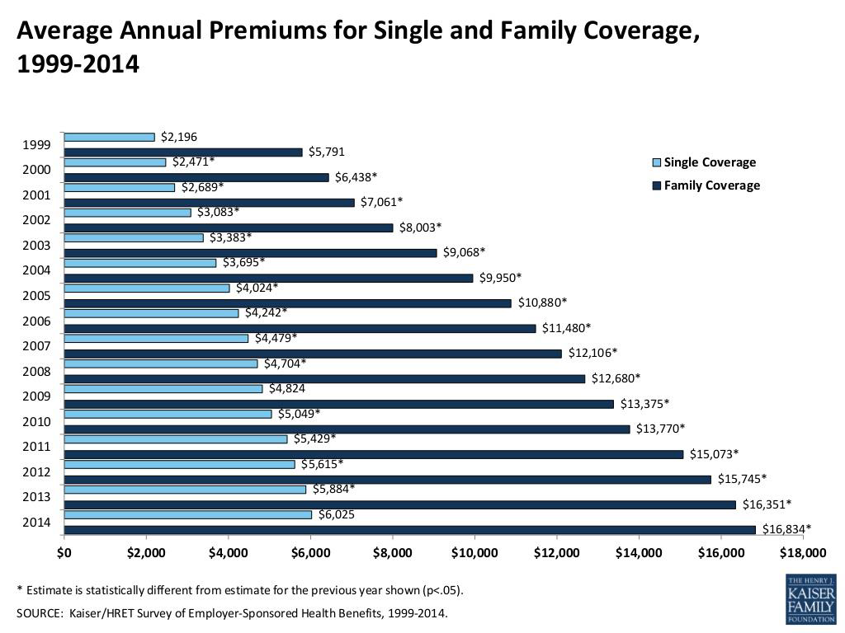
Cost Trends in Employer-based Coverage

Slide 22
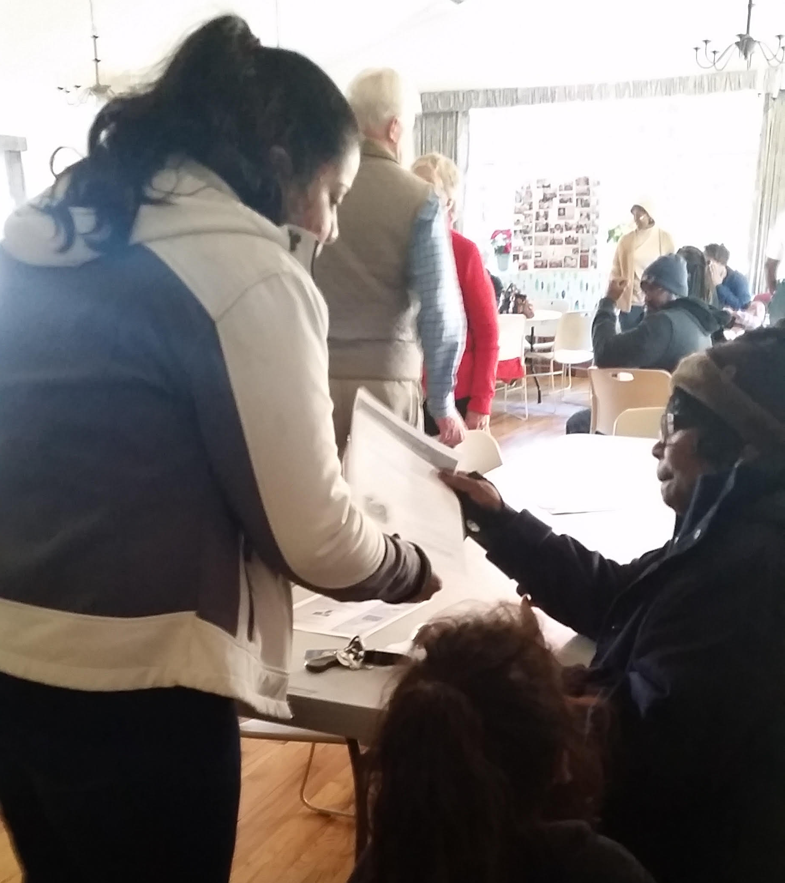
Mitigating the Impact of Rate Increases on Delawareans
Health insurance rate increases will affect the cost of coverage, both for those in the Individual and Small Group markets.
However, the impact of these increases will be mitigated for the approximately 82% of Delawareans who were eligible for premium tax credits and purchased plans through the Marketplace.
  Premium tax credits offset the price that eligible consumers pay each month to maintain coverage.

Slide 23
DOI Health Insurance Premium Rate Review Timeline-PY2017
Activity | Proposed Date
Deadline for Issuers to submit complete Form and Rate Filings for single risk pool coverage (QHPs and non-QHPs) for Individual and Small Group health insurance products | 5/11/2016
DOI begins detailed review of Issuer Form and Rate Filings and QHP Application submissions | 5/12/2016
DOI issues Press Release on proposed health insurance rate changes for all Issuers in Individual and Small Group markets, and posts information about proposed changes to DOI website | 6/2/2016
DOI begins Formal Public Comment Period to gather consumer and stakeholder feedback on proposed health insurance premium rate changes | 6/2/2016
DOI conducts county-based Public Information Sessions on proposed health insurance premium rate changes | 6/20/–6/21/2016
DOI submits final recommendations for QHP certification to CMS | 9/8/2016
CMS sends final list of certified QHPs for Plan Year 2017 to Delaware | 10/7/2016
DOI issues Press Release on approved health insurance rate changes for all Issuers in Individual and Small Group markets, and posts information about approved rates to DOI website | 10/15/2016
Marketplace Open Enrollment begins | 11/1/2016

Slide 24
Key Dates
Date | Milestone
June 20-21, 2016 | Public meetings on proposed rates increases in all 3 counties
July 15, 2016 | Public comment period ends on proposed rate increases
Nov. 1, 2016 | Open enrollment begins for Plan Year 2017
Jan. 31, 2017 | End of open enrollment for Plan Year 2017
Consumers who experience qualifying life events such as birth/adoption of a child; marriage or divorce; loss of minimum essential coverage; denial of Medicaid; aging out of parents’ insurance at age 26; or domestic violence eligibility may enroll outside of open enrollment.
Navigators, assisters and agents and brokers are available to help with enrollments outside open enrollment.
Visit www.ChooseHealthDE.com to find free assistance.
Enrollment in Medicaid and in the SHOP marketplace for small businesses is open year-round.

Slide 25
Questions/Comments
Health Care Commission
Public
24

