Slide 1
Improving De’s health: Behavioral health consortium s DE health care commission
Lt. Governor Bethany Hall-Long, PhD, RNC, FAAN
Professor, University of DE Nursing & Urban Affairs
October 4, 2018

Slide 2
introduction

Slide 3
Behavioral Health in Delaware Outlining the Problem - Role of Health care Commission
Delaware has about 30,000 adults and 9,000 children suffering from a substance use disorder or a mental illness.
Total population of Delaware is about 945,000
1 in 5 Delawareans will suffer from some form of a mental illness in any given year.
82% of Delaware inmates have a mental illness or substance use disorder.
This makes the prison system or largest treatment provider.
Delaware had over 300 overdose fatalities in 2016, up 35% from 2015.

Slide 5
Behavioral Health in Delaware Outlining the Problem Part II
Mental Health Taskforce of 2015 --Causes for Higher Rates of Addiction and Mental Illness? (To Build Upon with the Consortium)
Stigma
Cost
Workforce
Lack of Access to Treatment/Transportation
Service Delivery/Handoff Gaps
Lack of Early Intervention

Slide 6
What We have done to save lives: Example Policy & Program Actions – More to Come!
Naloxone- Community/Law Enforcement
Prescription Drug Monitoring Program (PDMP) – expanded 9/18
Overdose Fatality Review Commission
911 Good Samaritan Act
Brock’s Law – Fentanyl Charge
Hospital’s and treatment clinics in underserved areas
Addiction Action Committee
Behavioral Health Consortium
Mental Health Parity
First In the Nation – OD System of Care
Alternative Therapies
START Open Bed –(DSAM)
More to come

Slide 7
The Creation of the Behavioral Health Consortium
Senate Bill 111 w/ Senate Amendment 1- establishes the Behavioral Health Consortium. Companion Bill “Addiction Action “ Committee (focus on Prescriptions) reports to the BHC
The bill establishes an oversight body that will coordinate the State’s private and public bodies to reduce current silos, establish greater access to care, and combat addiction and improve mental health services.
The Consortium calls from grassroots advocacy groups, non-for-profits, providers, health systems, first responders and community members to collaborate to tackle the pressing issues in the First State.
The Consortium is modeled after the Delaware Cancer Consortium.

Slide 8
Delaware Cancer Consortium: The essential framework
Engaging & Advocating
Identifying, both quantitate and qualitative, the pressing issues:
Opioid epidemic
Workforce shortage
Barriers to access to care
Gathering stakeholder feedback to create tangible action plan.
Implementing action plan & assessing result

Slide 9
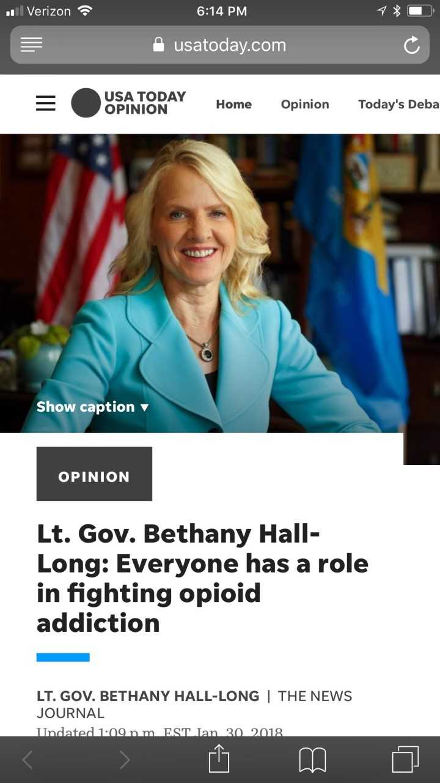

Slide 10
The path forward for Delaware
Behavioral Health Consortium
PEW Charitable Trust – selected for 2018-2019
Johns Hopkins Study of the System for DHSS
Lt Governor’s Challenge – 10/25
Community Health Workers – Peers - Navigators
Special Populations – Pregnant Women, Veterans, Homeless
DSAM/DPH - START, Open Beds,
AG Efforts
Eliminate the Silos and Fractured System

Slide 11
Additional Resources & Programs
K-5 Wellness Center Expansion
Targeting Title I funded elementary schools within identified “hotspot” using CDC data
Creating greater access to care for vastly underserved population
Partnering with health systems and Primary Care Providers
Funding generated via Medicaid expansion and local school district dollars
Community Health Workers
Developing a comprehensive Community Health Worker Program
Providing culturally competent individuals to perform basic health assessment and care
Creating a critical touch point for individuals suffering from addiction
Funding generated by CMS waiver and hospital “community benefit” dollars.

Slide 12
Action Steps
Delaware has created a forum that brings diverse stakeholders together to formulate a strong path forward
Real conversations, with people who have directly been impacted helps formulate a road map to combating the critical issues
The work of the Overdose Fatality Review Commission has spotlight critical areas of need
Targeting high impact areas and properly dispatching resources to these areas, all while working with providers and first responders, will save lives
Providing greater access to care transforms those impacted
Early intervention, coordinated treatment from health providers, and increased programs will directly impact population health outcomes

Slide 13
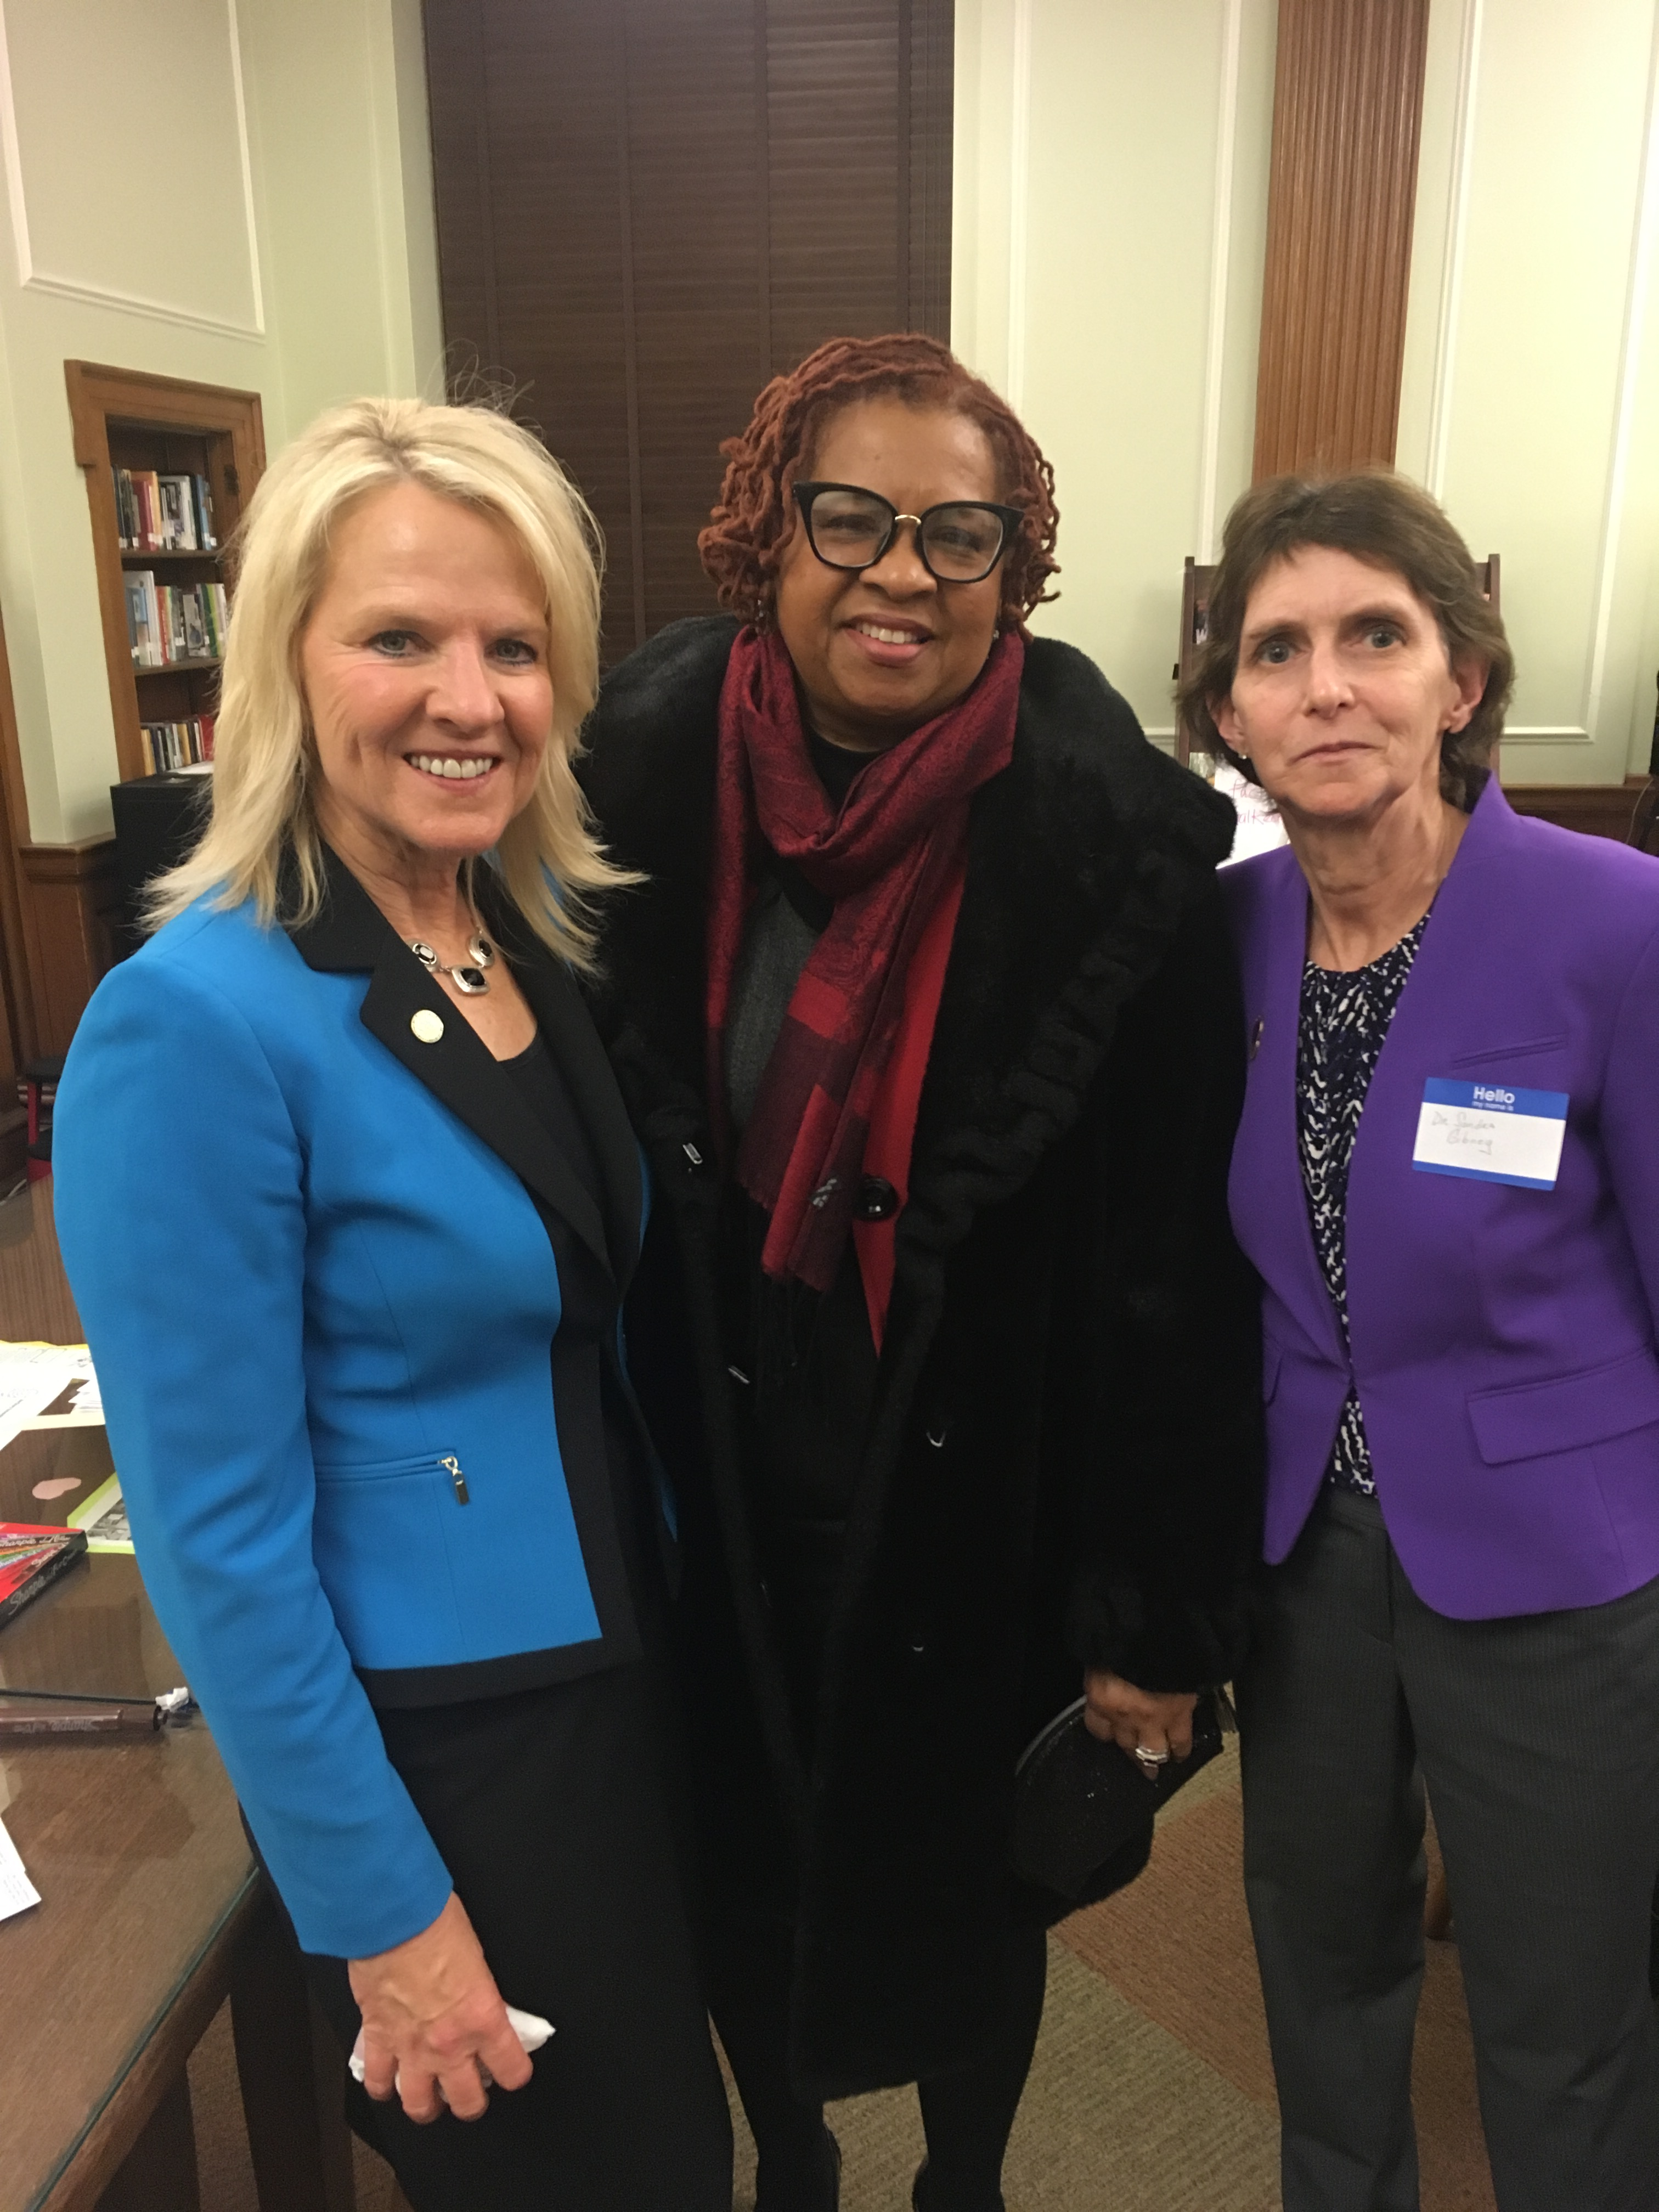
FORUM Guiding Questions Question 1: When you think about mental health and addiction (behavioral health), how behaviors affect health, and how people feel about their health where you live, what is happening in your community?
Question 2: What is the number 1 thing we in Delaware can do to deal with mental health related issues and the issues we are facing in behavioral health?

Slide 14
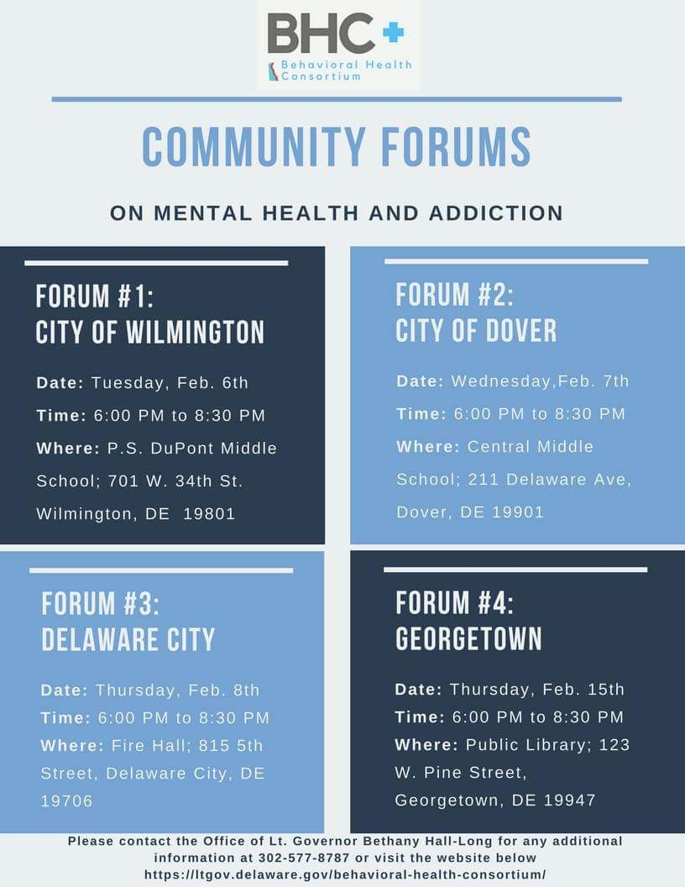

Slide 15
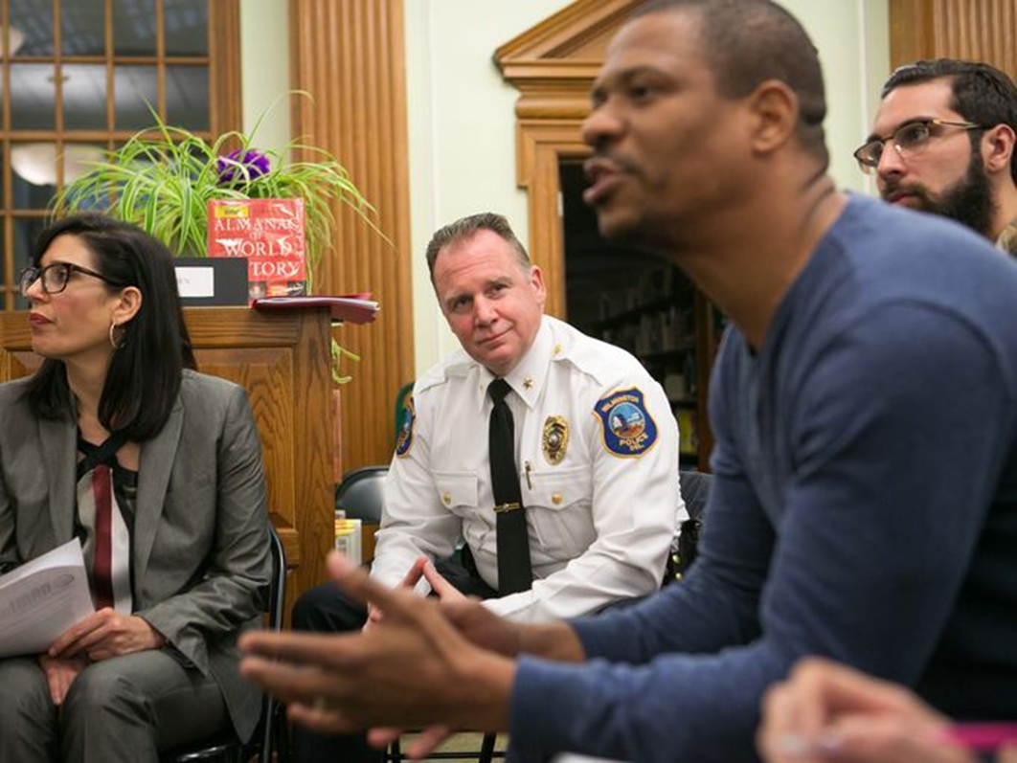
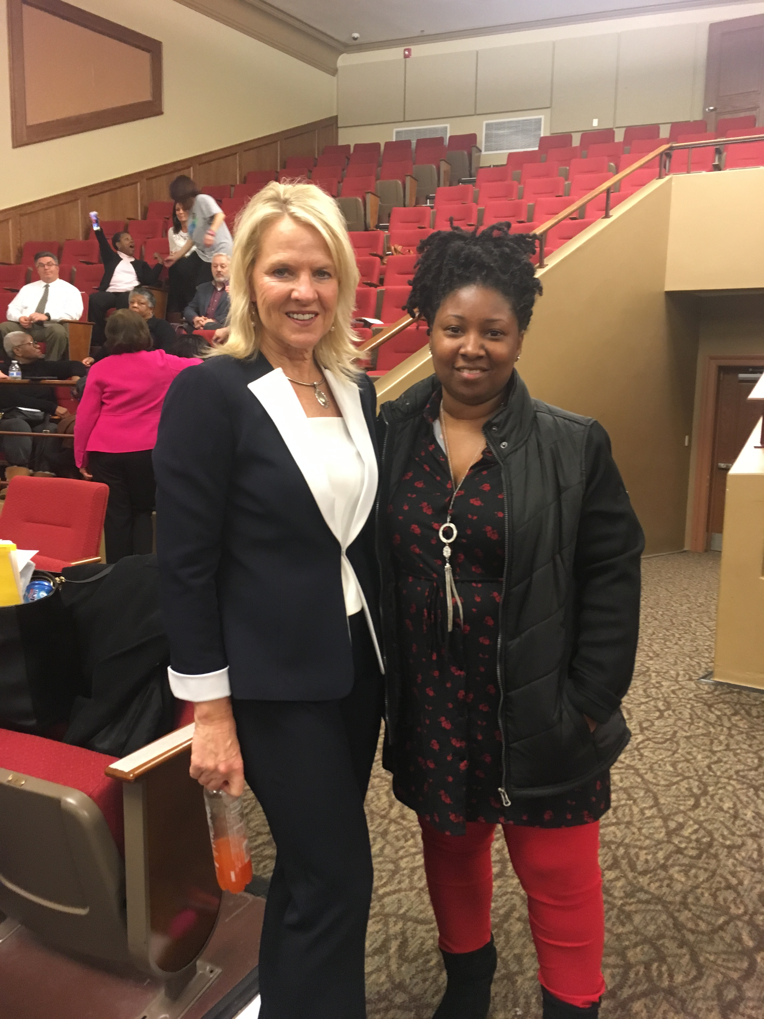

Slide 16
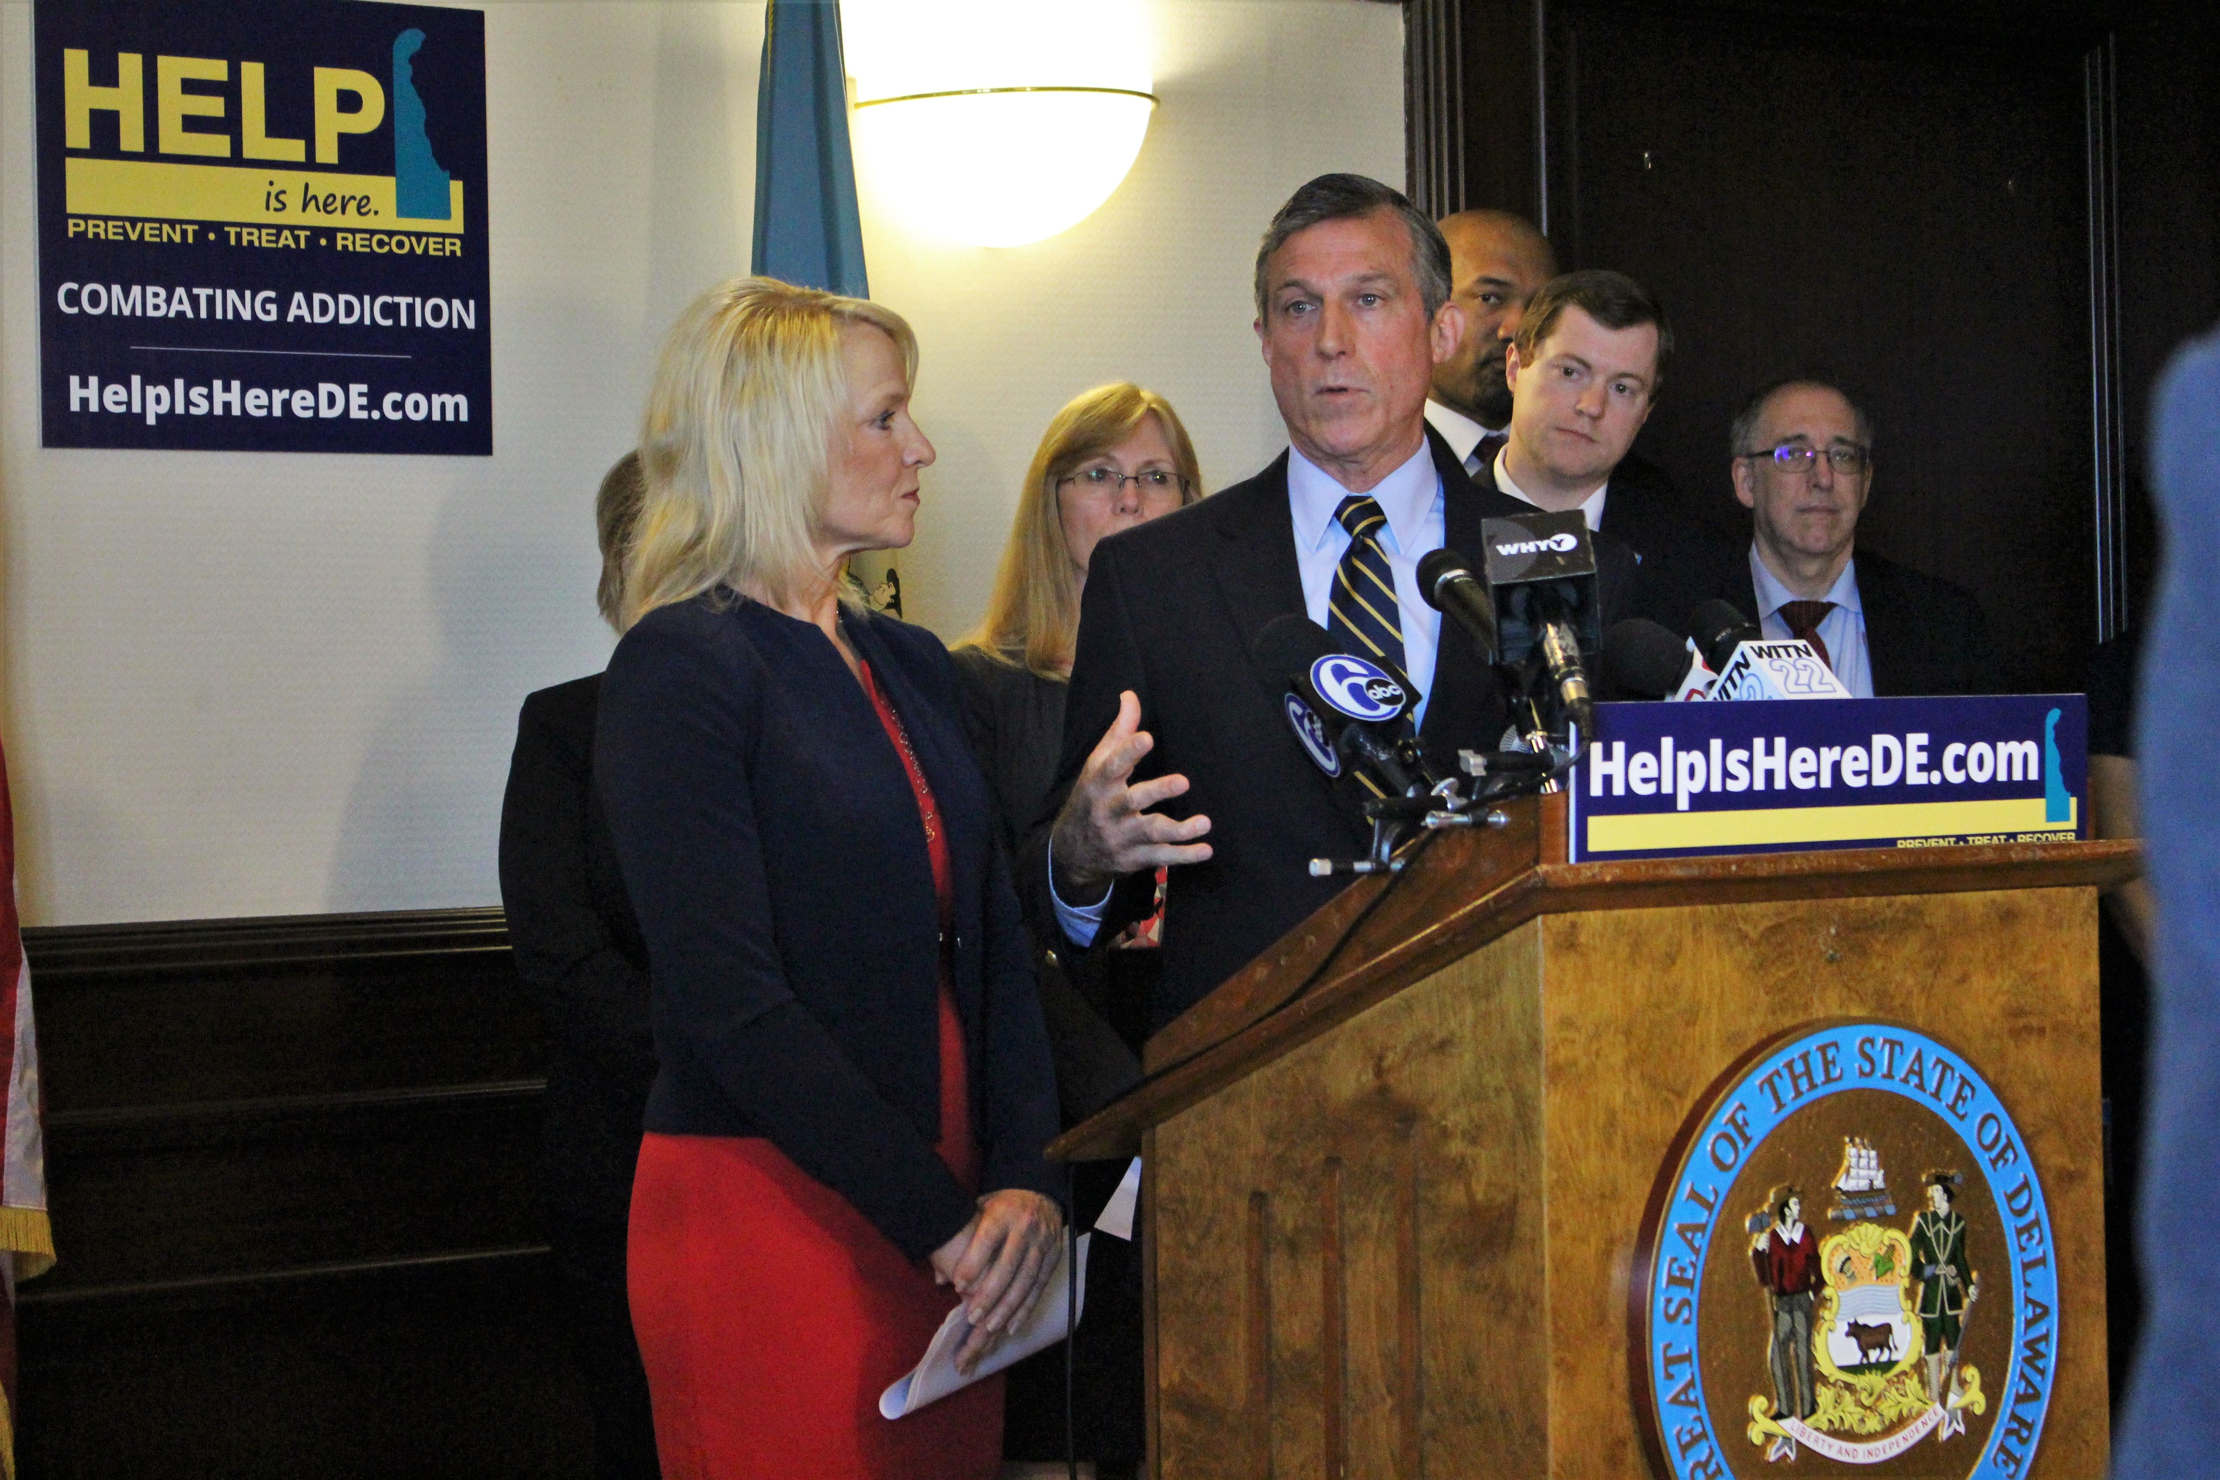
Initial - 3 Year action plan
Creation of Six Committees:
Access & Treatment
Changing Perceptions & Stigma
Corrections & Law Enforcement
Data & Policy
Education & Prevention
Family & Community Readiness

Slide 17
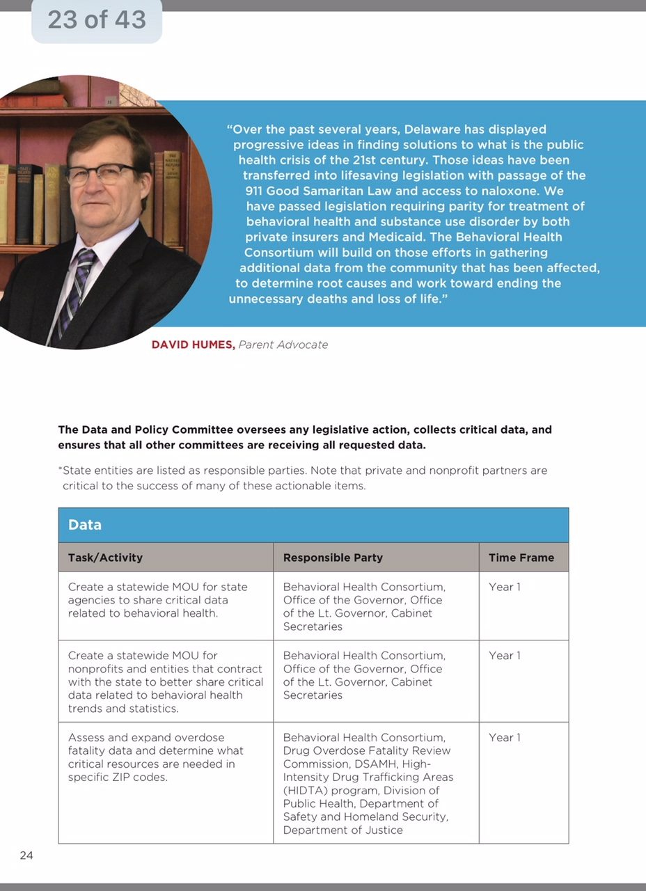
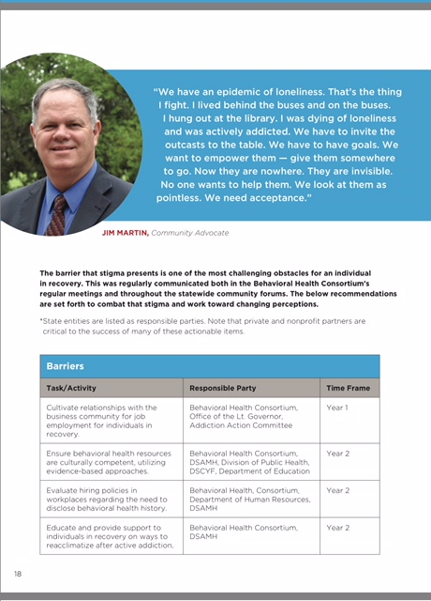

Slide 18
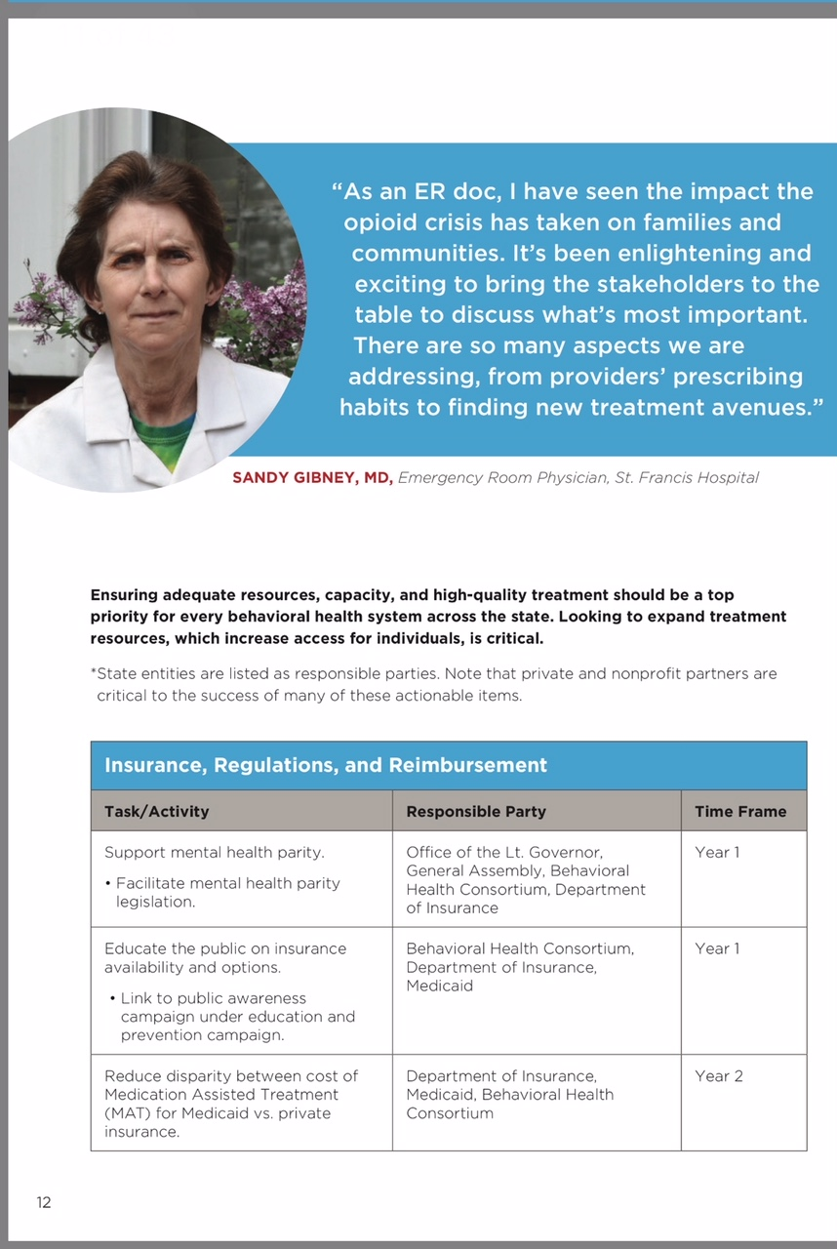
Legislative Action THIS Year
Overdose System of Care
1st in the Nation
Mental Health Parity
Ensuring Equity
Alternative Pain Management
DMMA/HighMark- low back pain
PDMP Improvement
Perception monitoring enhancement

Slide 19
Policy into action
https://youtu.be/6aWdMpvQdbg

Slide 20
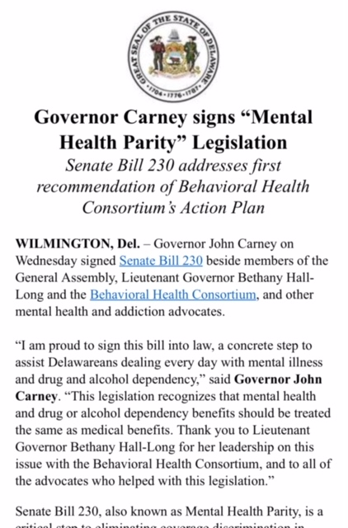
Emerging Priorities
Harm Reduction Measures
Narcan/Fentanyl Strips
Expansion of Medication Assisted Recovery
Correctional Setting
Statewide Community Health Worker Network
Youth Treatment & Education Assessment
Expansion of Law Enforcement Diversion Program
Deploy a statewide public awareness, education campaign
Increase SUD treatment system

Slide 21
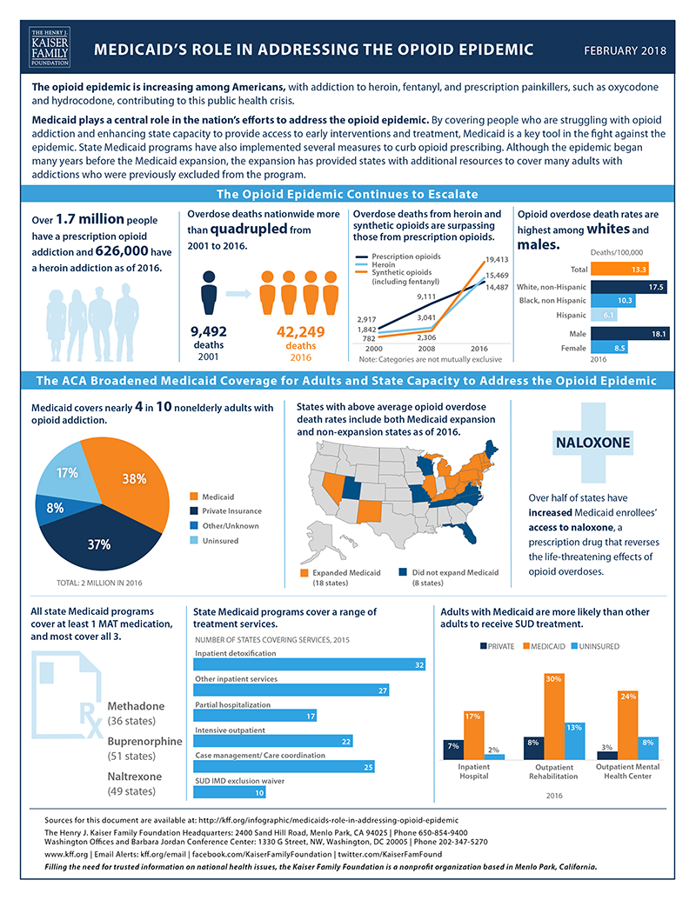
Current funding Picture
DSAMH:
Current funding: 23 Million USD
Behavioral Health Consortium:
5 Million USD additional
2 Million: Delaware Health Information Network
3 Million: System Transformation

Slide 22
Implications for DE Health Care Commission
Q & A
ACTION STEPS
SUMMARY

Slide 23
Bethany Hall-Long, PH.D, FAAN, RNC Lt. Governor- State of Delaware
SUMMARY : Q & A
Contact Info -
Main Office Contact: 302- 577-8787 or
744-4333
Bryan Gordon, Deputy Chief of Staff
Bryan.Gordon@state.de.us
302-744-4311
Tanner Wm. Polce, MBA, Policy Director
Tanner.Polce@state.de.us
302-744-4312

